Slide 1
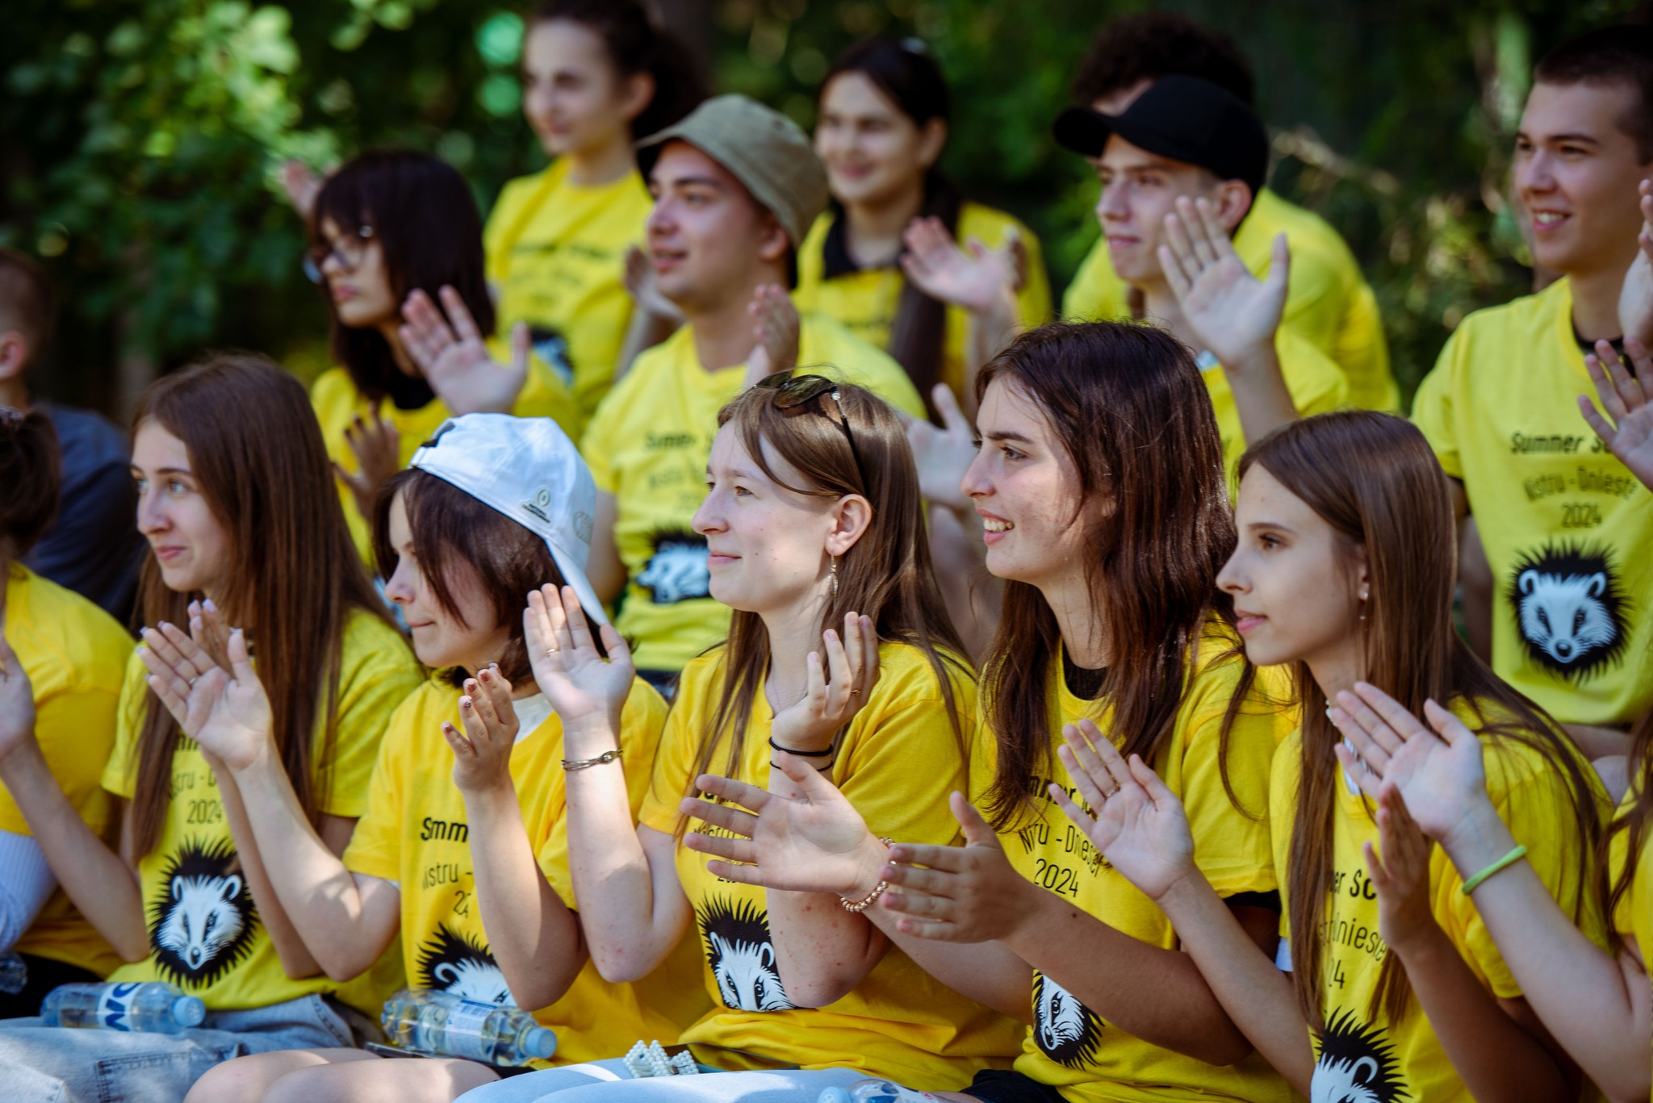
.
THE DNIESTER YOUTH SUMMER SCHOOL, THE DNIESTER EXPEDITION, & THE DNIESTER CONFERENCE - 2024
Chișinău, 2024

Slide 2
Dniester Youth Summer School 2024
Was organised by Eco-TIRAS in July 2024 in Molovata Nouă
Duration - 10 days
Participated 70 youngsters: 33 - right bank, 33 - left bank + 4 Ukrainians. Age 16-20.
Support of Sweden via UNDP-Moldova
Agenda included:
- European environmental legislatuion and integration;
- Dniester transboundary cooperation;
- Climate change and water resources;
- Biodiversity challenges and conservation;
- Water and health;
- Public participation in environmental decision making.

Slide 3
Dniester 2024 expedition
Was organised from 8 to 15 July, 2024.
Support of UNDP and EU Confidence Building Programme
Participated 30 persons (students and lecturers of universities, academics, ecoNGOs, journalists, TV media)
Main activities:
- observations and study of river hydromorphology, including sedimwents, water and wetland biodiversity, natural and historical sites, protected areas, meetings with local population, lectures.
- expedition has been reflected at the Dniester River Basin Conference proceedings in November 2024.

Slide 4
13th Dniester River basin conference 2024
Was organised in Nov.ember 15th, 2024, in frames of the “Confidence Building Measures” Program of UNDP with financial support of the EU - Environmental Platform Eco-Tiras project.
59 reports, authors from 8 countries (Belarus, Czech Rep., Greece, Lithuania, Moldova, Romania, Russia, and Ukraine). Format - physical and online.
Proceedings have been published and placed to the website with DOI access to each article.

Slide 5
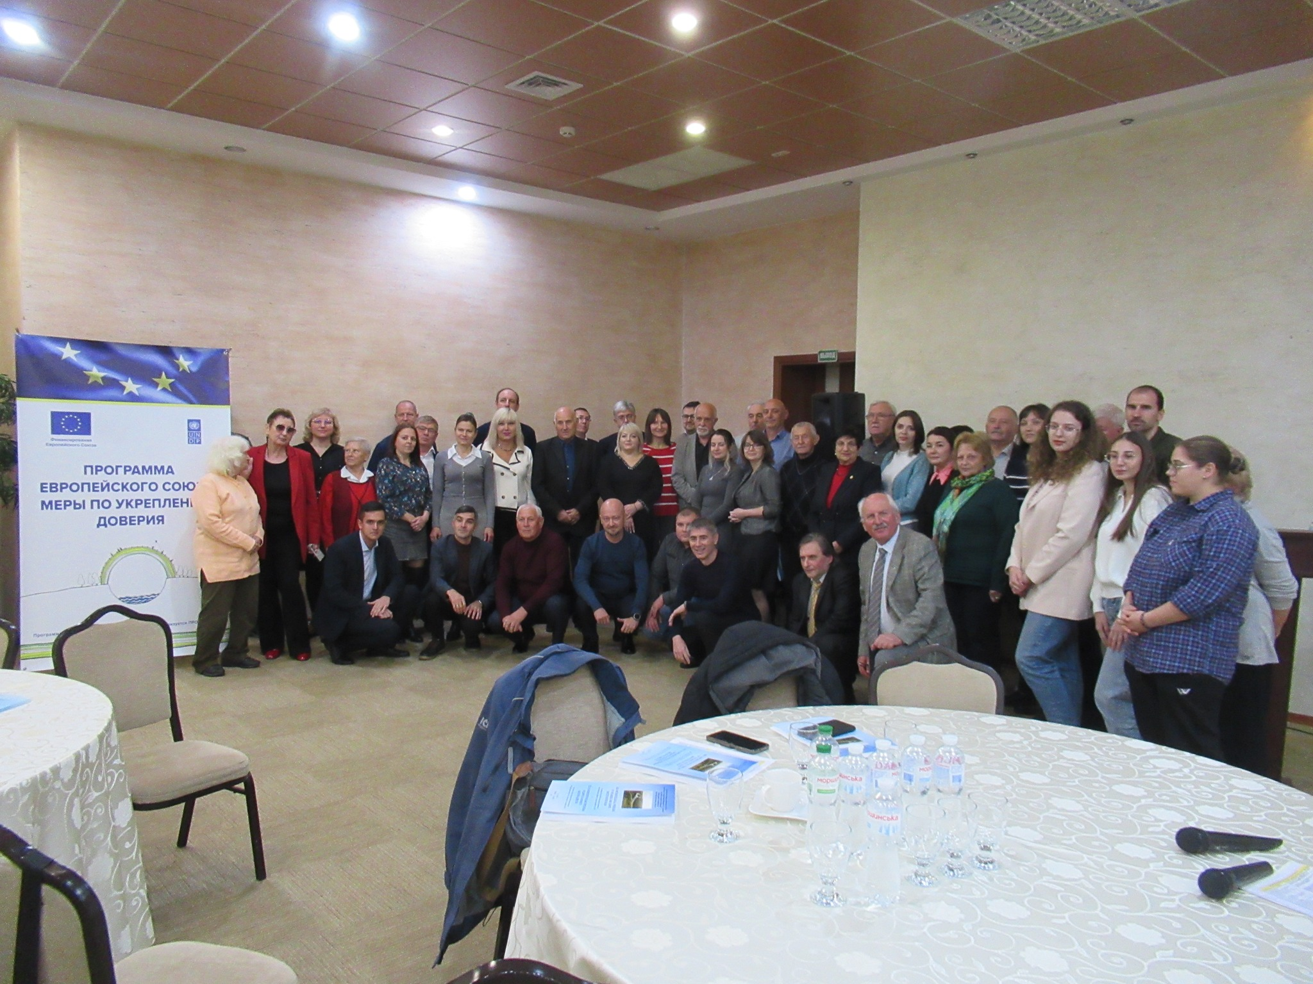
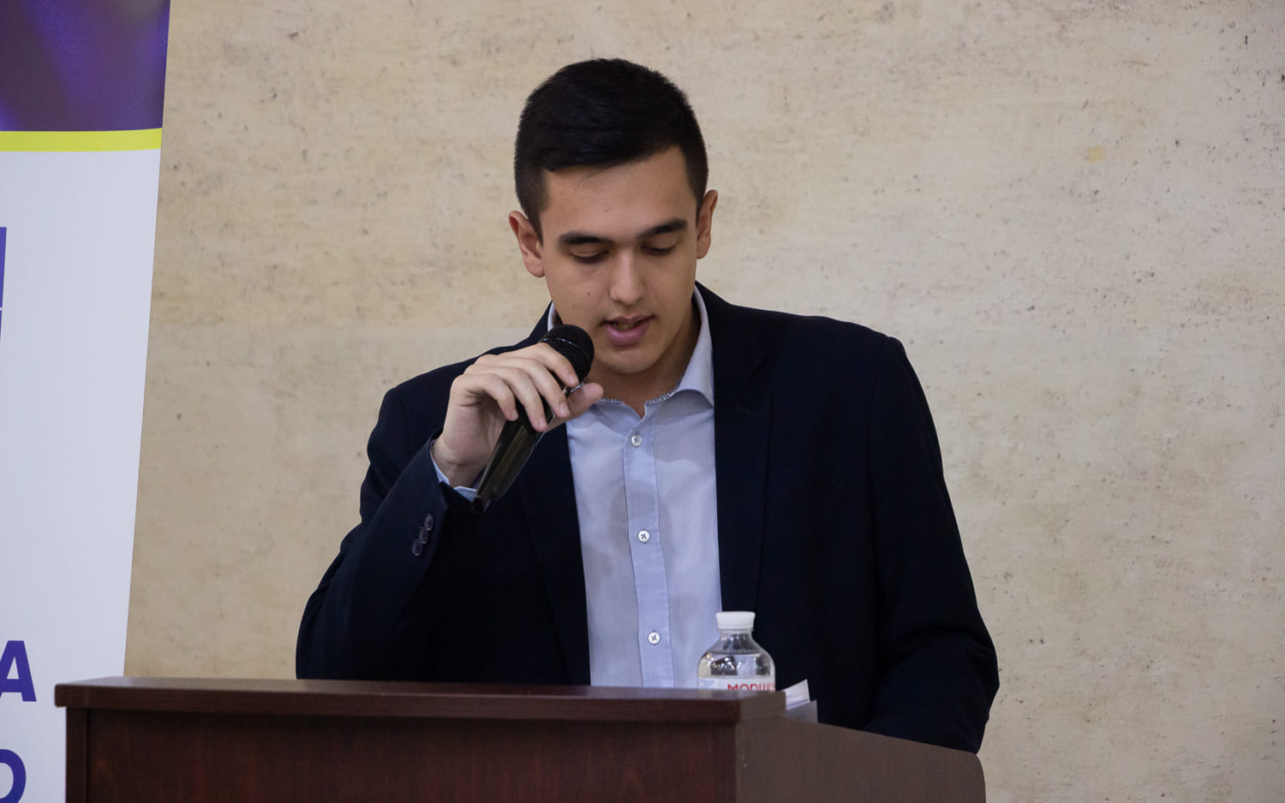
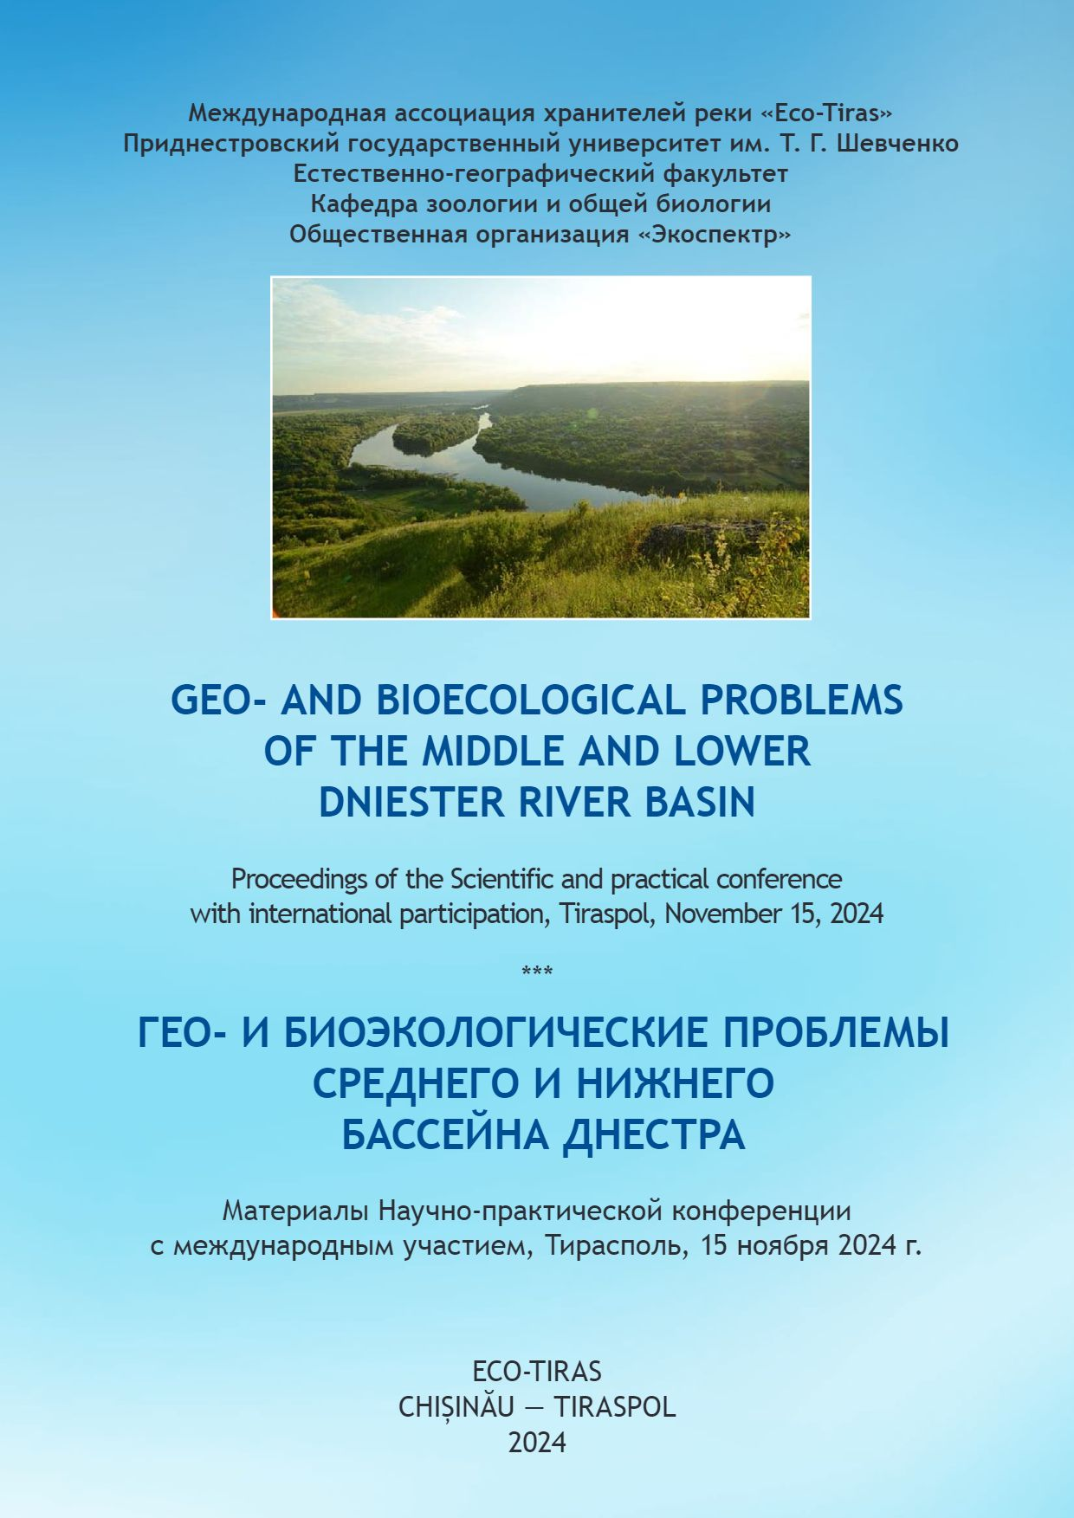
Dniester Conf. 2024

Slide 6
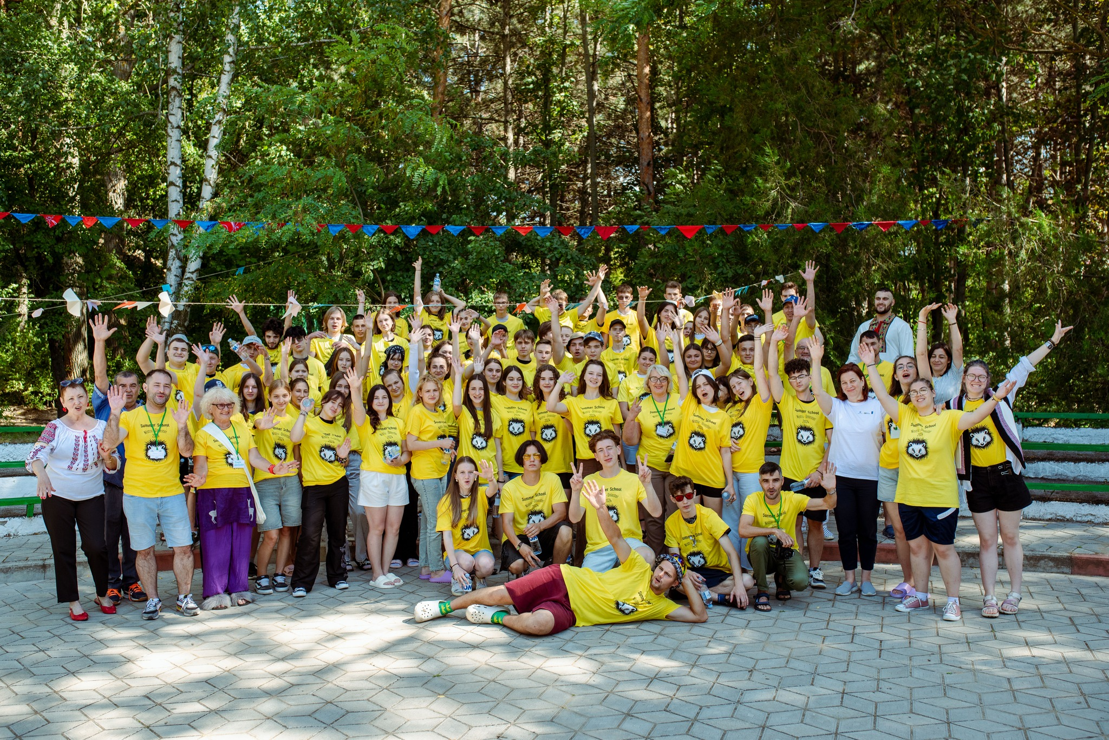
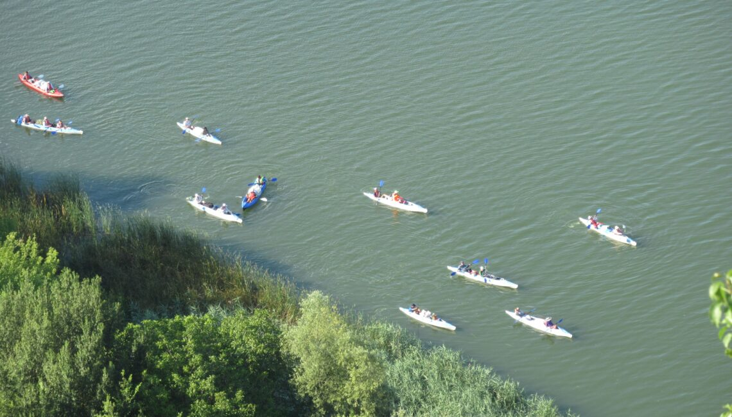
Thank you for attention!
http://eco-tiras.org

