Slide 1

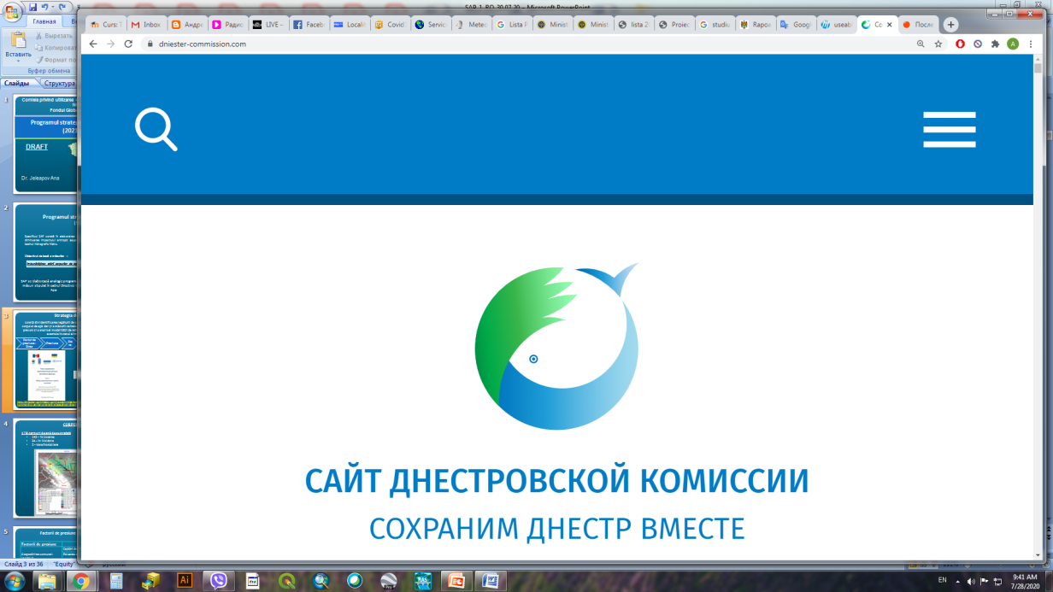
Proposals regarding the revision of the Rules of Operation reservoir of the Dniester Hydropower Complex
The 5th meeting of
The Commission on Sustainable Use and Protection of the Dniester River Basin
Oleksii Iaroshevych
Ana Jeleapov
Costesti, 28-29 November 2024

Slide 2
MINUTES OF THE 4th MEETING OF THE COMMISSION ON SUSTAINABLE USE AND PROTECTION OF THE DNIESTER RIVER BASIN
«6.3. The Commission entrusted the WG for River Basin planning and management, together with other WGs, to draw up a document containing proposals of the Moldovan Party to be integrated into the Rules.
WG for River Basin planning and management shall present the draft list of proposals to the Commission for examination.»
At a joint meeting of the WG (September 25), all proposals were discussed and a corresponding table was prepared, which indicated the arguments and positions of both sides.

Slide 3
Consideration of proposals submitted by the Moldovan side
Both parties agreed that these Rules need to be revised in the future.
There is consensus on some proposals, some do not fall within the competence of the WG, and on some there are currently different positions.
It was proposed to ask for consultancy from other WG of the Dniester Commission and/or relevant institutions of Ukraine.
Work on the submitted proposals should be continued by the WGs within their competences.

Slide 4
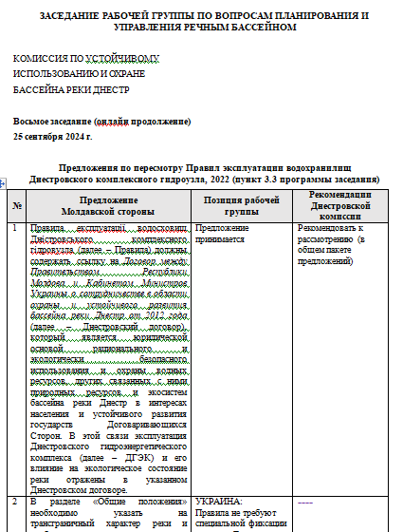
Main themes discussed:
- Transboundary state of the Dniester river basin
- Management aspects
Hydropeaking effect thresholds
Ecological flood parameters
Standard operational procedure for managing hydrological risks that create a threat of emergency situations
Flood management and releases through DHC
priorities of the DHC regulation
improvement of some annexes

Slide 5
Issues (I)
In order to improve DHC protection level, it is considered important to develop and include in the Regulation of Standard operational procedure for managing hydrological risks that create a threat of emergency situations.
The Regulation, including the above mentioned standard, is periodically updated as necessary, based on the accumulated experience in the exploitation of the DHC reservoirs and the management of the impact of reservoir exploitation on the environment and water users upstream and downstream of the reservoirs, in collaboration with the competent authorities of the Republic of Moldova
Control over compliance with the DHC Regulation must be carried out jointly by the competent authorities of Ukraine and the Republic of Moldova.

Slide 6
Issues (1I)
spring environmental flows – all parameters as well as period of release should be revised!.
In Ukraine, it is planned to develop a regulatory document on ecological flow based on the Guidance No. 31 for EU WFD Implementation and the best practices of EU countries. Amendments to the Water Code of Ukraine will be performed based on this document It is expected that this document will be adopted no earlier than the first half of 2026 (N.B. Ukraine performs monitoring of the ecological and chemical state of the Dniester below the HPP 2 dam and has planned to do so in 2025).
In the Republic of Moldova in the RBMP for 2024-2029, it was included Development and approval of the Methodology for estimating minimum flows and spring ecological floods. The deadline for this measure is IIIrd part of 2025.

Slide 7
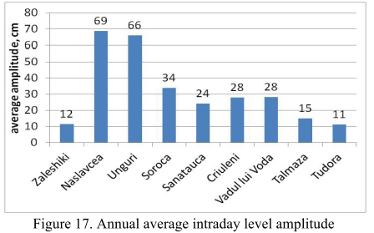
Issues (III)
Another important problem is lack of thresholds for hydropeaking effect that negatively influences biodiversity lower DHC
2023
The Moldovan side was asked to prepare a separate report (issue paper) on the analysis of hydropeaking downstream of the Dniester Hydropower Complex.
The report will serve as a basis for hydropeaking parameters thresholds in order to develop recommendation for the Rules revision (from the minutes of the WG meeting of 5.09.2024)

Slide 8
Issues (IV)
To reduce the hydromorphological alteration of the downstream sector of HPP-2, it is considered appropriate to reference in the Regulation and comply with the European Normative Document SR EN 15843:2010 "Water quality. Guidance standard on determining the degree of modification of river hydromorphology".
The presence of flood passage indicators without using forecasts significantly increases the risk of flooding the territory of the Republic of Moldova, especially in the case of floods with less than 0,5% exceedance probability. Point 5.1 regarding the operation of the Dnestrovsk reservoir without considering the hydrological forecast, and annex 7 concerning the Indicators for passing floods of different exceedance probabilities through the Dniester HPP (without using forecasts), should be excluded from the current Regulation, and the table in annex 10 must be corrected according to the flood passage scenario using forecasts.

Slide 9
Issues (V)
Priorities in regulating the Dniester Hydropower Complex reservoirs
To correct the tables in annex 2 to make the information about the volume and surface rating curves complete.
It was proposes to include in the annexes: the scheme of the DHC reservoirs, a table with the volume and surface rating curves of the PSHP reservoir, annexes 6-18 from the draft Regulation presented for analysis to the Moldovan side in 2021
Additional requests – to be answered by competent authorities during next year

Slide 10
Continue working
1. To take note by the Commission, other WGs and competent authorities of the actual document on Proposals for the Completion of the Regulation on the Exploitation of Reservoirs within the Dniester Hydropower Complex
2. To continue working on Proposals for the Completion of the Regulation on the Exploitation of Reservoirs within the Dniester Hydropower Complex
3. To ask the new GEF project "Development of transboundary cooperation and integrated water resources management in the Dniester River Basin through the implementation of the Strategic Action Plan" and UNDP / Sweden project “Supporting the Moldovan authorities in the sustainable management of the Dniester River” for help in realization of some issues (such as spring ecological flood parameters and efficiency estimation etc.)

Slide 11
Thank you for attention

