Slide 1

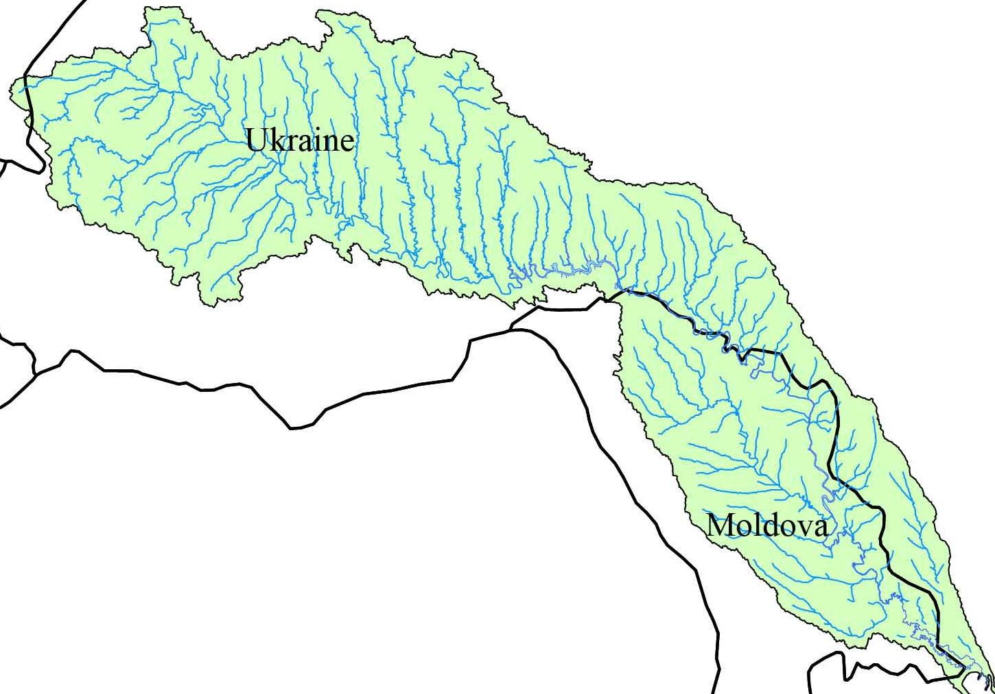
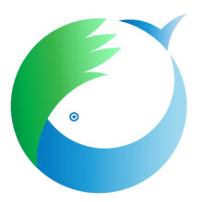


The Commission on Sustainable Use and Protection of the Dniester River Basin
The 5th meeting
Report of Working Group on River Basin Planning and Management
2024
Ana Jeleapov
Oleksii Iaroshevych
Costesti, 28-29 November 2024

Slide 2
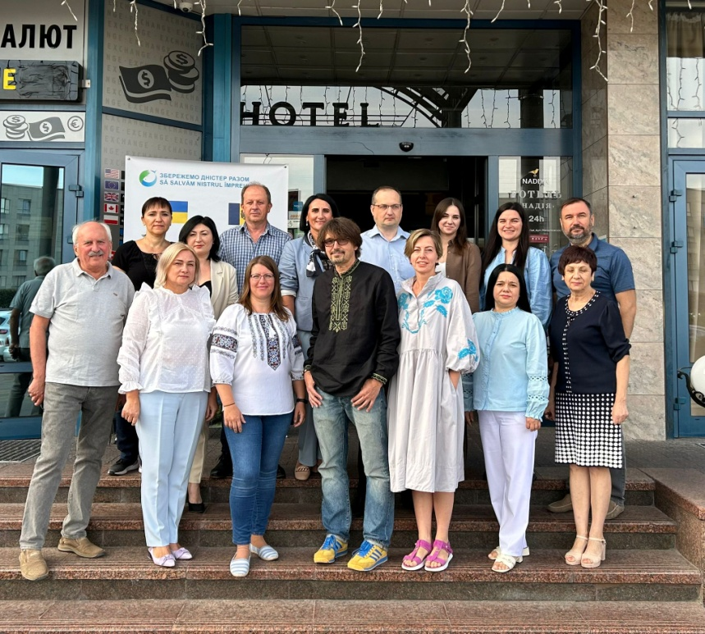
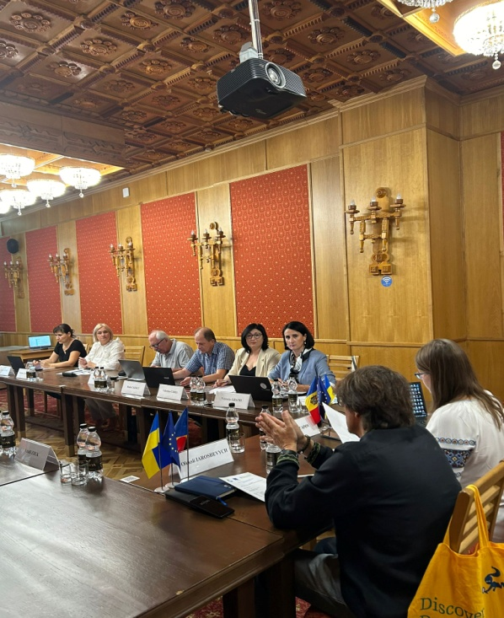
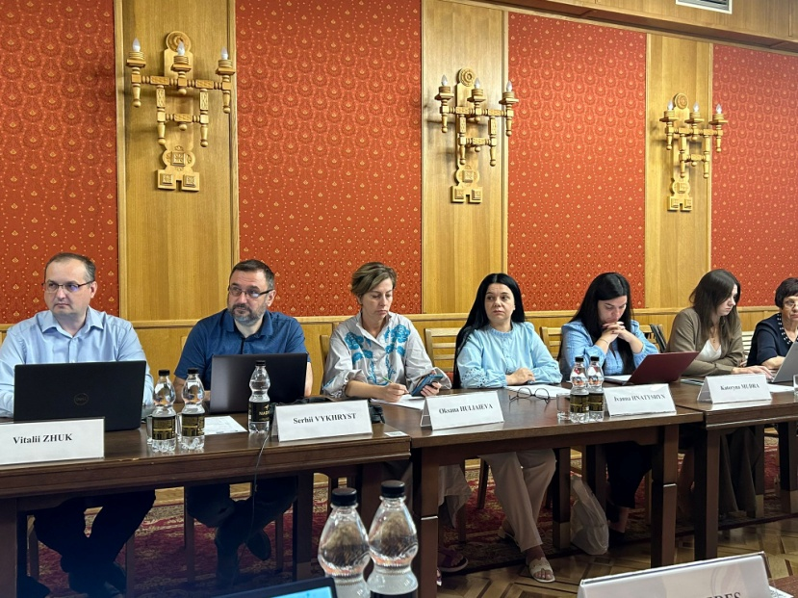
Common meeting of WG on RBPM
5 September 2024 in Ivano-Frankovsk
Participants: Moldova (7) and Ukraine (8)
All agenda items were presented and discussed

Slide 3
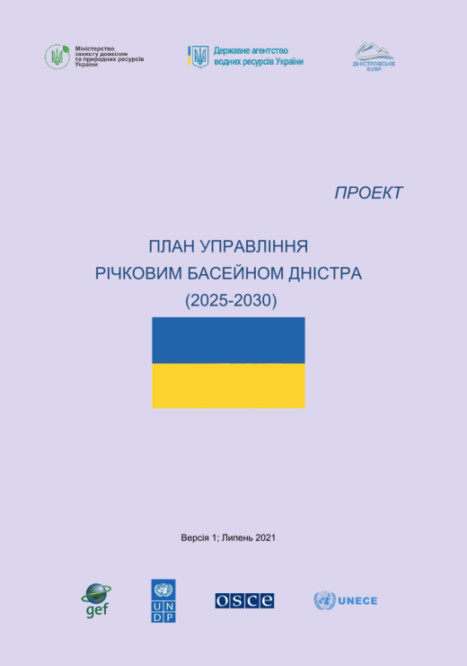
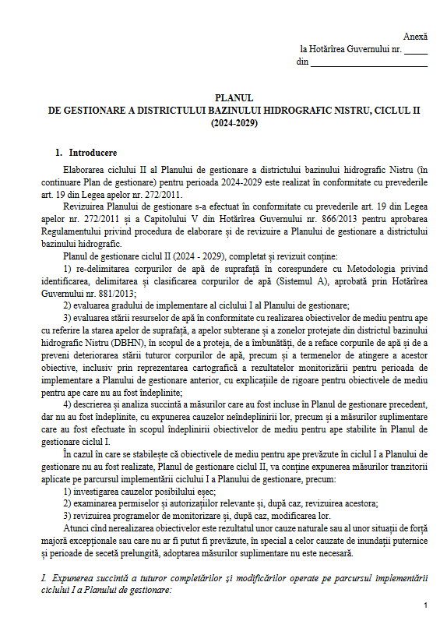
Dniester river basin management plan
Dniester river basin management plans 2024-2029, Moldova - IInd cycle
Dniester river basin management plan 2025-2030, Ukraine – Ist cycle
Themes discussed:
Legal bases
Contents
Water bodies
Chapters (impact assessment, monitoring, ecological /chemical status, water use, protected areas, etc.)
plan of measures
Main stakeholders
public consultations
SEA procedure
RBMP were prepared in full compliance with the structure of the EU WFD

Slide 4
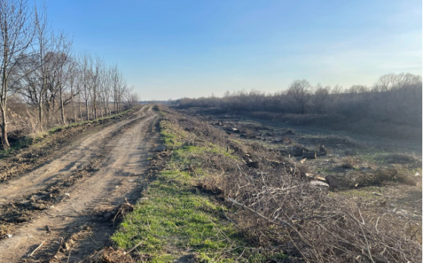
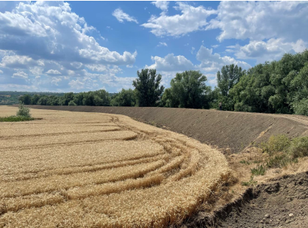
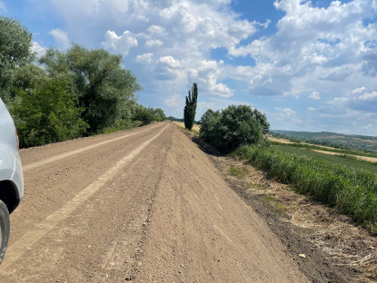
Flood risk management plan
Moldova: Flood risk management plan for the Dniester River Basin District (GD 562 of 31.07.2020)
General analysis of the plan
Implemented measures
Planned measures for next year
Ukraine: Flood risk management plan for the Dniester River Basin (adopted on 8.10.2022 # 895)
-Implemented measures
-Measures for next year

Slide 5
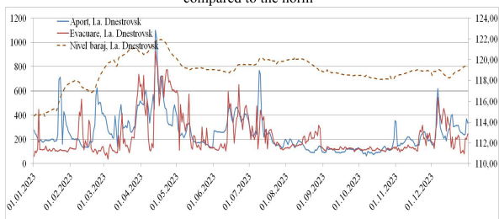
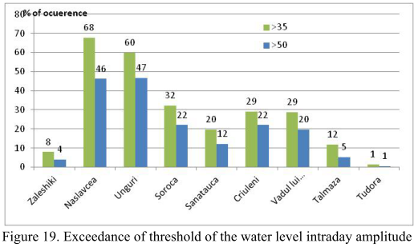
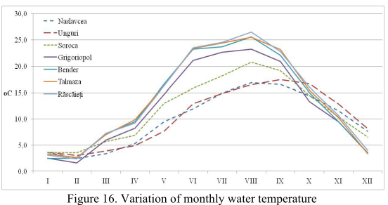
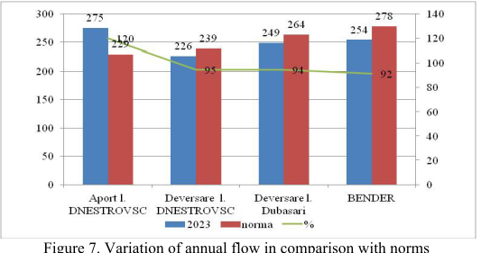
Analysis of hydrological regime of 2023
Themes discussed
Meteorological situation
Temperature
Precipitation
Hydrologic situation
Seasonal flow
Spring flood
Minimal flows
Water temperature
Hydropeaking effect

Slide 6
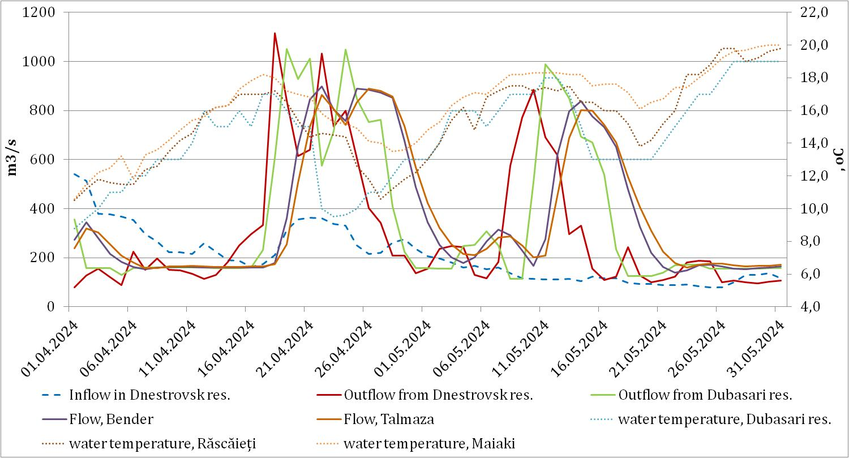
Ecological flood of 2024
- Natural spring flood was generated in February 2024.
- In April-May two floods were released from DHC:
*The flood in April 2024 – 17.04.24 – 27.04.24. Total volume – 0.8 km3
*The flood in May 2024 – 07.05.24 – 15.05.24. Total volume – 0.5 km3
The temperature during April flood varied widely. Serious drop of temperature took place from April 19 (-5 grades), so the most of spawned eggs died. The next temperature –favourable period occurred in the first part of May. However, the river level quickly dropped due to short-term release form DHC.
An intergovernmental working group should be established to manage the hydrological regime during the ecological flow period;

Slide 7
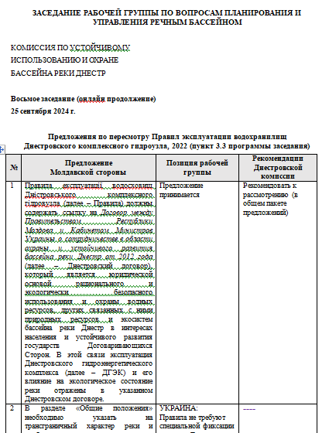
Proposals regarding the revision of the Rules of Operation reservoir of the Dniester Hydropower Complex
Main themes discussed:
- Transboundary state of the Dniester river basin
- Management aspects
Hydropeaking effect thresholds
Ecological flood parameters
Standard operational procedure for managing hydrological risks that create a threat of emergency situations
Flood management and releases through DHC
priorities of the DHC
improvement of some annexes

Slide 8
Proposals regarding improvement of bilateral montiroting
Common hydrological post on level, flow, water temperature station downstream of DHC, Naslavcea region
automatic level station within reservoir with HPP 2 for volume dynamics assessment
transfer of planned outflow and of real outflow from HPP1 and HPP 2 in time to the Moldovan side
adoption of indicators for evaluating the functioning of DHC(indicator of hydrological alterations, environmental flow components)
installation of new hydrological station on the Dniester as part of the implementation of the bilateral infrastructure project of the Iampil-Cosauti bridge crossingconstruction
to address the WG on Monitoring and Information Exchange and the WG on Emergency Situations with an initiative to supplement the Regulation on Cooperation on Monitoring and Information Exchange in the Dniester River Basin for further approval by the Commission with a clause on prompt notification of the competent authorities of Moldova and Ukraine on water discharges from hydropower plants to avoid emergencies and to define the list of such competent authorities in the Annex to this Regulation

Slide 9
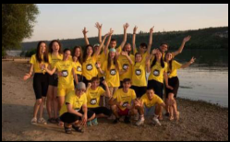
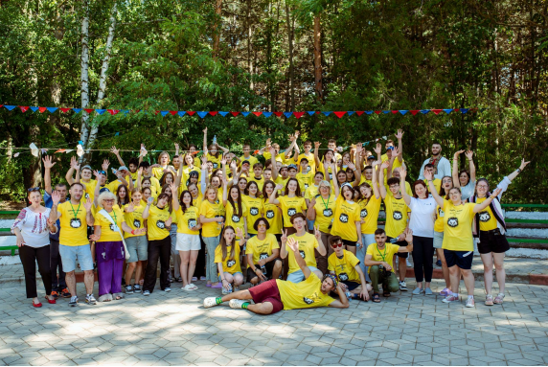

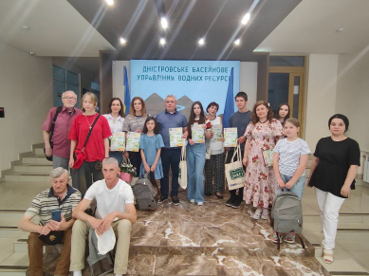
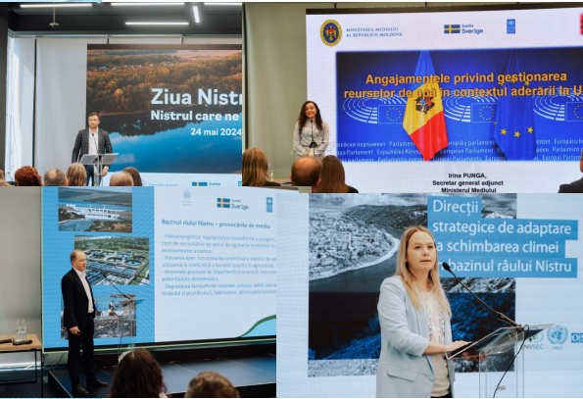
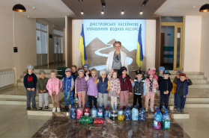
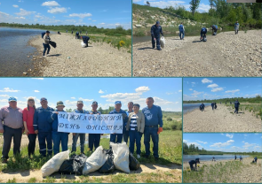

Important themes
Summer school 2023 and 2024
Dniester Day 2024
Basin Council/ Committee Dniester Basin District

Slide 10
Plan for 2025
National Dniester river basin management plans: implementation, screening for compliance with the EU WFD and comparability methodological approaches and received results
Hydrological analysis for 2024
Hydrological analysis for the first half-year 2025 and ecological flow
Development of proposals regarding the revision of the Rules of Operation reservoir of the Dniester HPP integrated complex
Hydropeaking analysis of the Dniester downstream the HPP
Supplement to the Regulation on Cooperation on Monitoring and Information Exchange in the Dniester River Basin for further approval by the Commission with a clause on prompt notification of the competent authorities of Moldova and Ukraine on water discharges from hydropower plants to avoid emergencies and to define the list of such competent authorities in the Annex to this Regulation
The impact of military operations on the status of water in the Dniester basin
Summer​ school 2025
Dniester Day 2025
Information about activities Basin Council and Committee of the Dniester Basin District

Slide 11
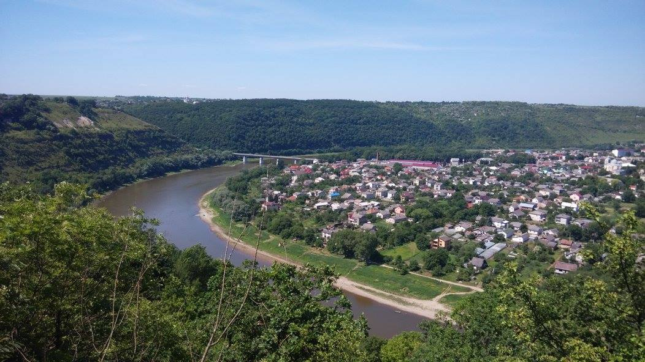
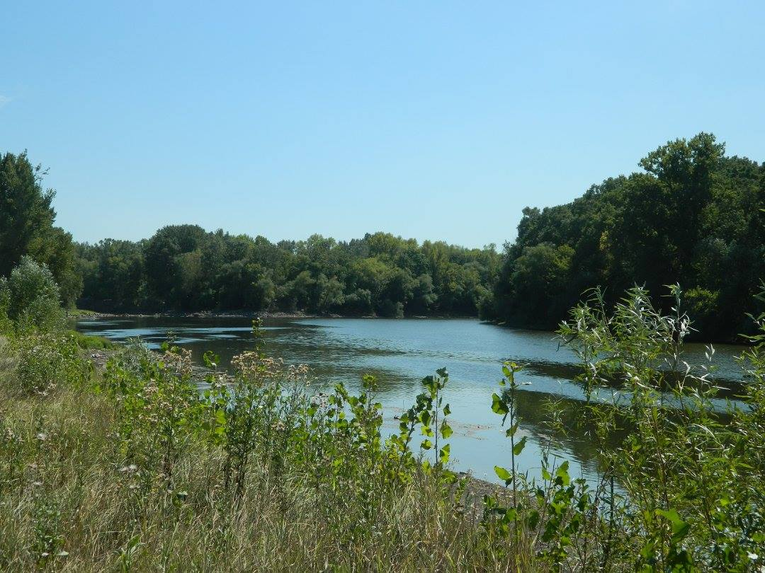
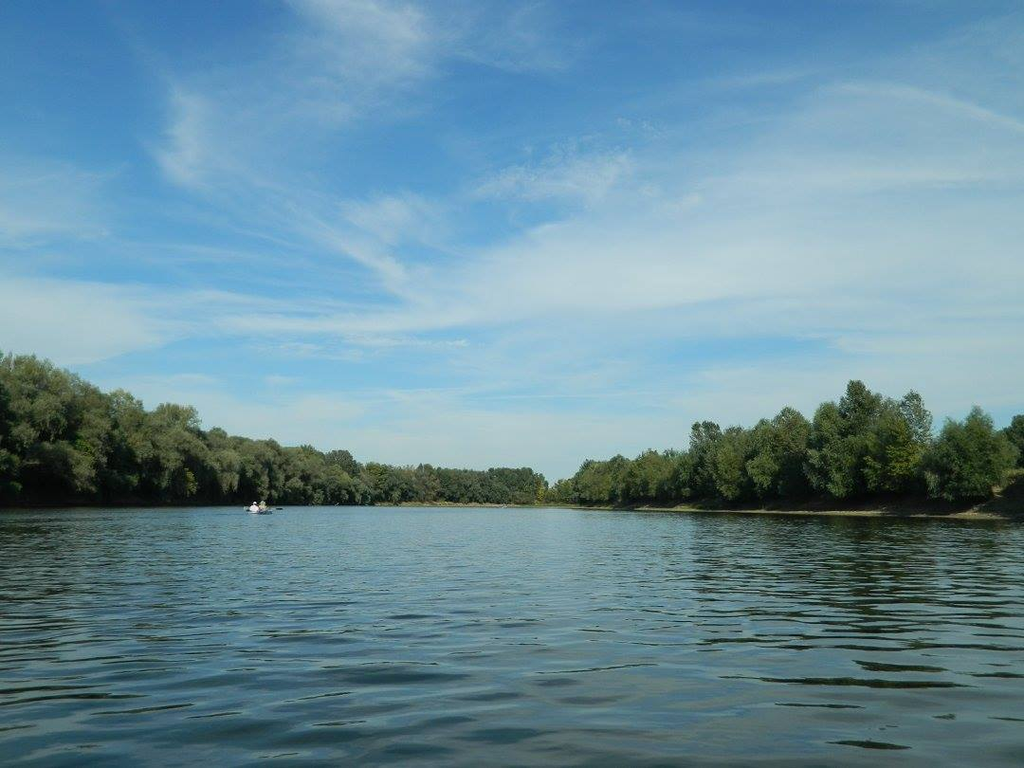
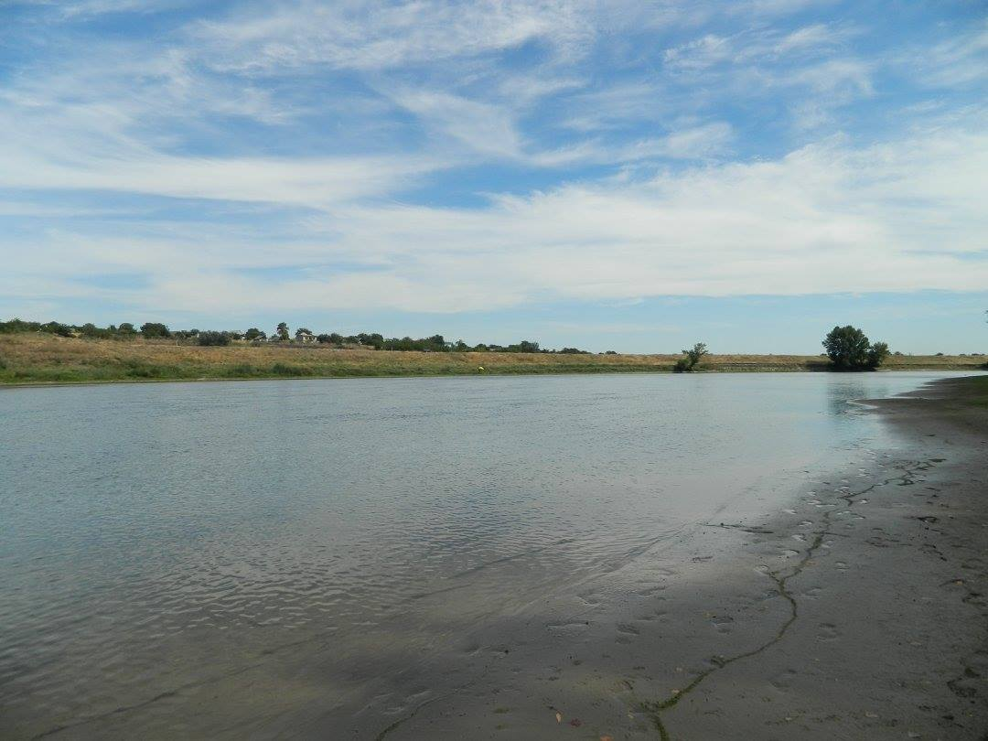
Thank you for attention!

