Slide 1

Evaluation of the DHPC operation mode
DHPC evaluation – identified deficiencies and proposals
Eng. Ionel Zlate-Podani, PhD

Slide 2
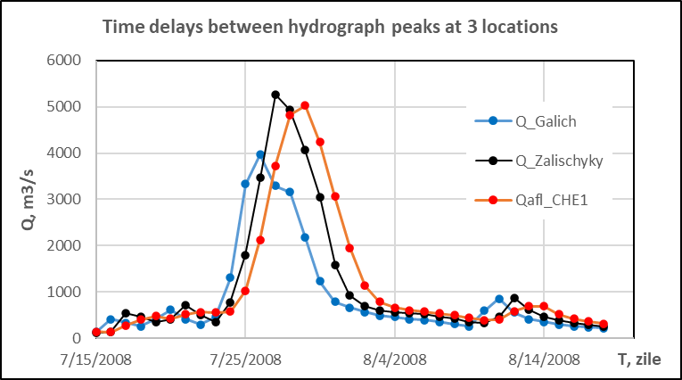
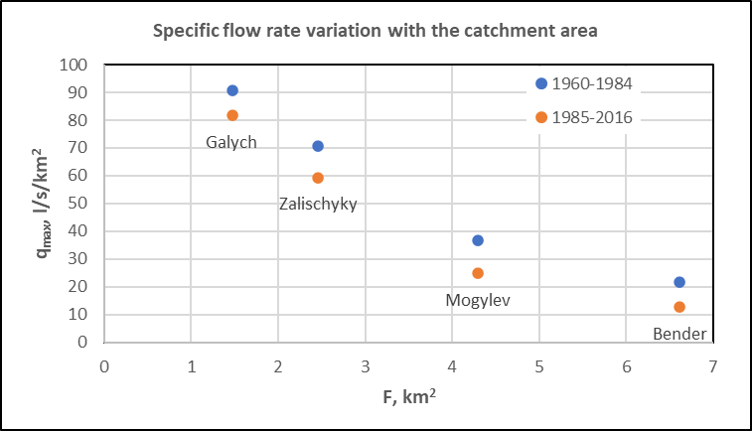
High waters’ management in the Dniester reservoir
General data:
Main period of water accumulation: during March-April months
High water scheme: at flow rates of 1000-4200m³/s, the discharges downstream are limited to 2600m³/s until the reservoir water level will reach the max level of125mMB, with free flood attenuation outside this range
Pre-emptying function of the reservoir of max 50cm; insufficiently used, as being required the Commission approval
The reservoir water level management during the flood events – function of the hydrological data, mainly from the Zalischyky gauge and secondary from the Galych one
The reservoir operation is mainly based on the statistical scenarios from the design phase
Identified deficiencies:
Lower attention for the flood events that occur in the other months
Insufficient valorisation of the hydrological system potential within the operational mode and mostly for its accessible time ahead which will allow a better use of the reservoir pre-emptying function
The attenuation degree of extreme flood events is generally low (~6%)

Slide 3
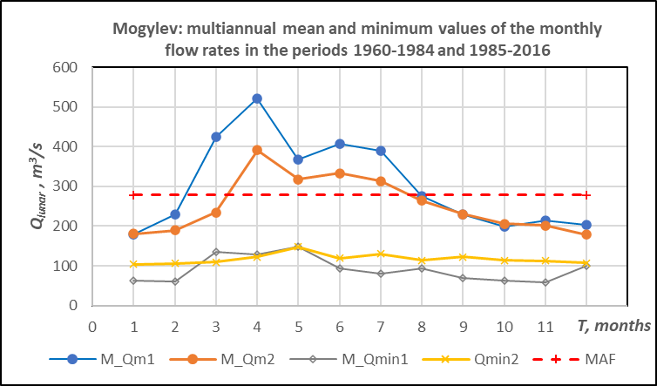
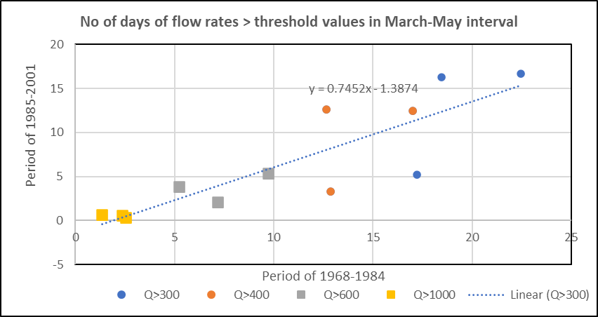
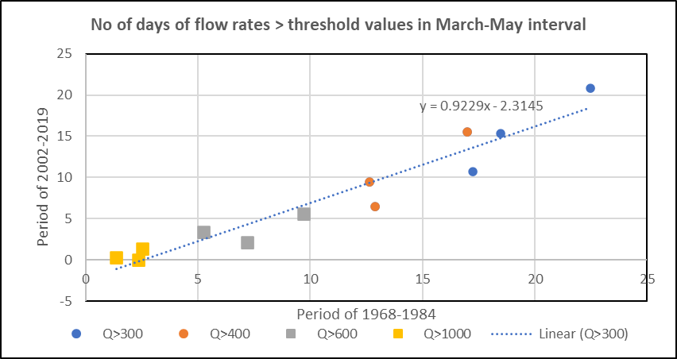
High waters’ management in the Dniester reservoir
Water accumulation in the Dniester reservoir mainly occur in the spring months, as usually being of higher flows with or without significant flood events; this further with monthly change of flow rate decrease is of about:
35% in March
20% in April
Obvious positive effect: flow rates’ increase in the summer-autumn seasons
Related adverse environmental effect:
Decrease of the springtime intervals of lateral connectivity with neighboring wetlands

Slide 4
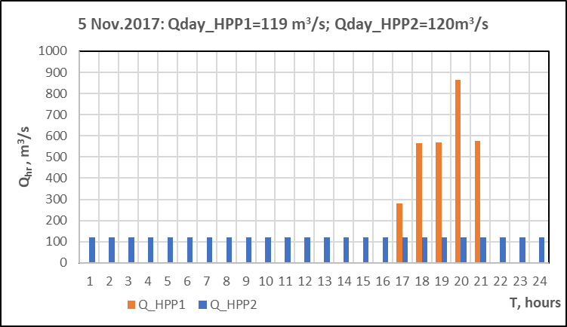
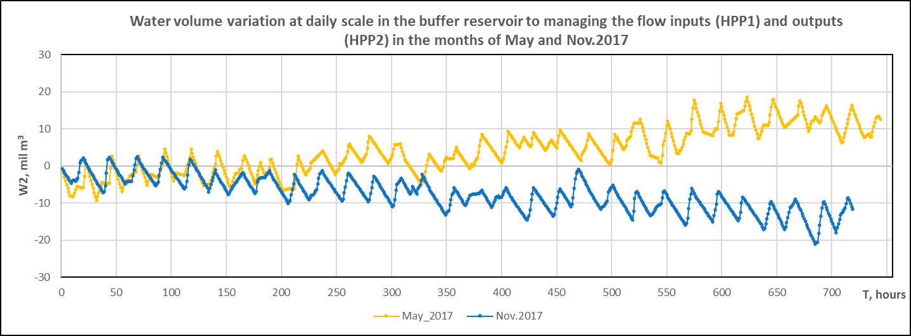
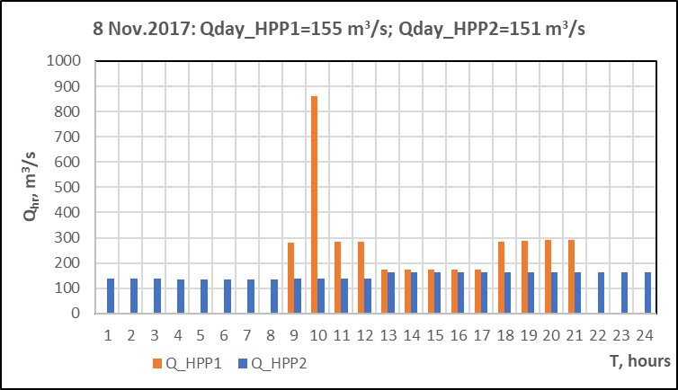
Managing the buffer reservoir: adaptation of the HPP2 discharges to the HPP1-PSPP flow inputs to keeping water levels in buffer reservoir in the due range
Flow rate inputs-outputs in buffer reservoir
The buffer reservoir has the attenuation function of the HPP1 and PSPP discharge impulses during load peak time intervals in connection with HPP2 operation for continuous discharges during the day, that are adjusted to the current volume twice a day.
The water volume variation in the buffer reservoir has been in May and Nov of ±5-15mil.m³/day; at a monthly scale, such volume variations will cover to the maneuver range Vutil = 20.4 mil.m³.
After PSPP finalizing, there is planned to daily operate with pumped and turbined volumes of 31.3 mil.m³; downstream hydropeaking effects might be of double size than the actual ones.
Adverse effects for the downstream sector: significant hydropeaking effects that attenuate with the distance downstream; for their mitigation, there will be required at least a double number of adjusting interventions for the HPP2 current discharges downstream.

Slide 5
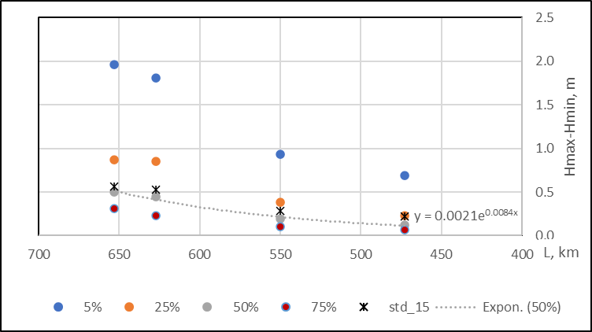
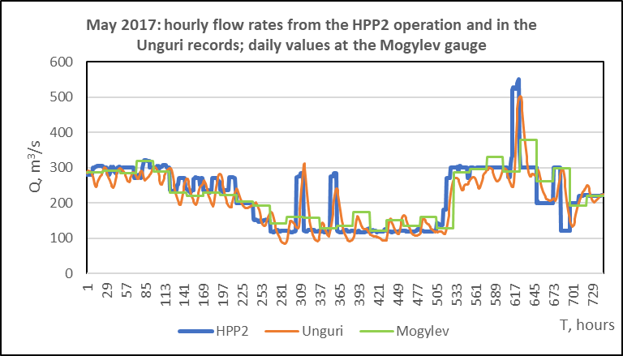
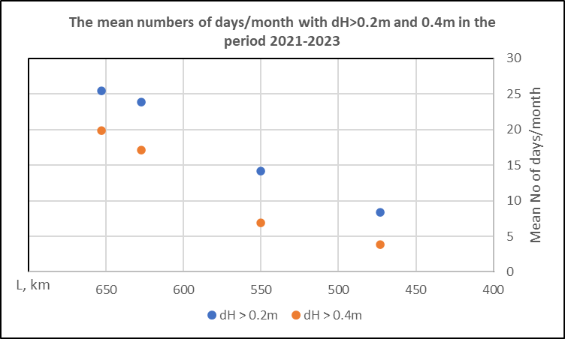
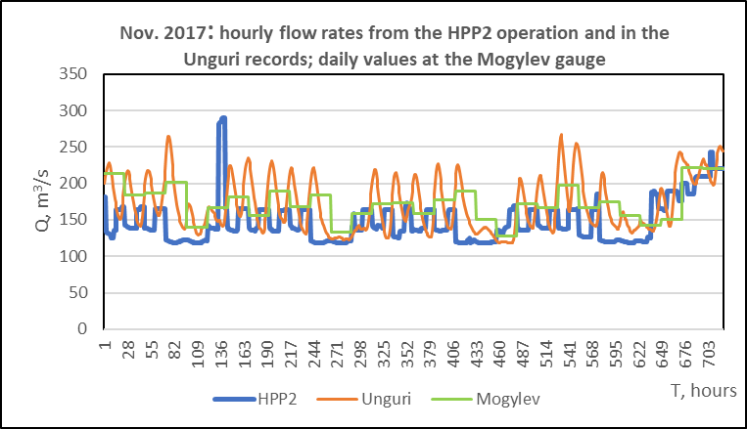
Inference for hydropeaking effects along the downstream sector
Exemplification of hydropeaking effects
The size of hydropeaking effects at various distances from HPP2 according to the duration curves of the daily range for the 15min records at the 4 automatic gauges.
Daily flow rate fluctuations in a range of 50-80m³/s at the Unguri gauge, for a double range than of the turbined discharges in case of HPP2 operating with 1 group.
Average No of days/month when hydropeaking effects are greater than 20cm and 40cm.

Slide 6
Potential improvements of the DHPC operation mode
1. High flow periods:
To increase the hydrometric data quality (i.e., flow rate measurements with a monthly frequency), additional readings for the water levels during flood events
To operationalize the pre-emptying function for the Dniester reservoir to further improve the managing potential during high flood events
To improve the system of flood forecast that will maximize the anticipation time intervals – on which depend the efficiency of the decisions of reservoir pre-emptying, and possibly less restrictive operations of water accumulation during the spring months
To apply the high-flows scheme for the flood hydrograph in the HPP1 location, that will allow a longer anticipation time interval (i.e., > 3 days ahead as in June 2008) and thus a better use of the pre-emptying function
2. Low flows periods:
Accessible interventions for hydropeaking decrease along the downstream sector will be by increasing the daily frequency of HPP2 discharge adjusting to also control the water volume in the buffer reservoir
For their success, to periodically take account of recent records at the automatic gauges and decide what further improvements for HPP2 operation might still be

Slide 7
Evaluation of the DHPC operation mode
Thank you for your attention!

