Slide 1
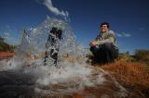
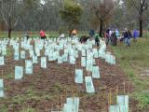

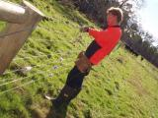
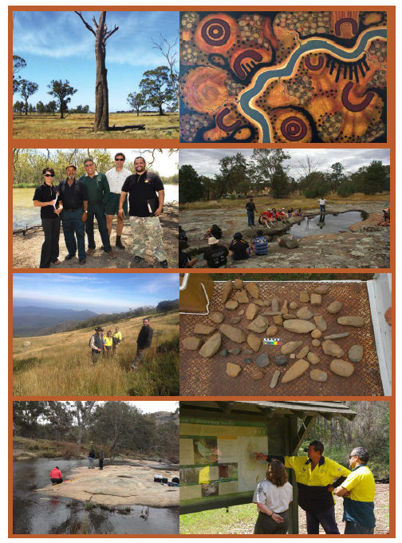
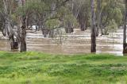
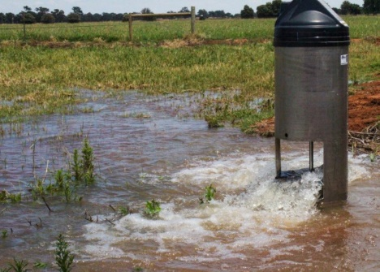
Goulburn Broken
Catchment Management Authority
Chris Norman, head of the GB basin management
Mark Turner, manager of river and wetland health programme
Study Tour of Dniester River Basin
30 Sept. - 7 Oct. 2019

Slide 2
Location
Notes:
The Farm Water program is delivered across Northern Victoria, Australia, in an irrigation region known as the Goulburn Murray Irrigation District which is approximately 1 million hectares.

Slide 3
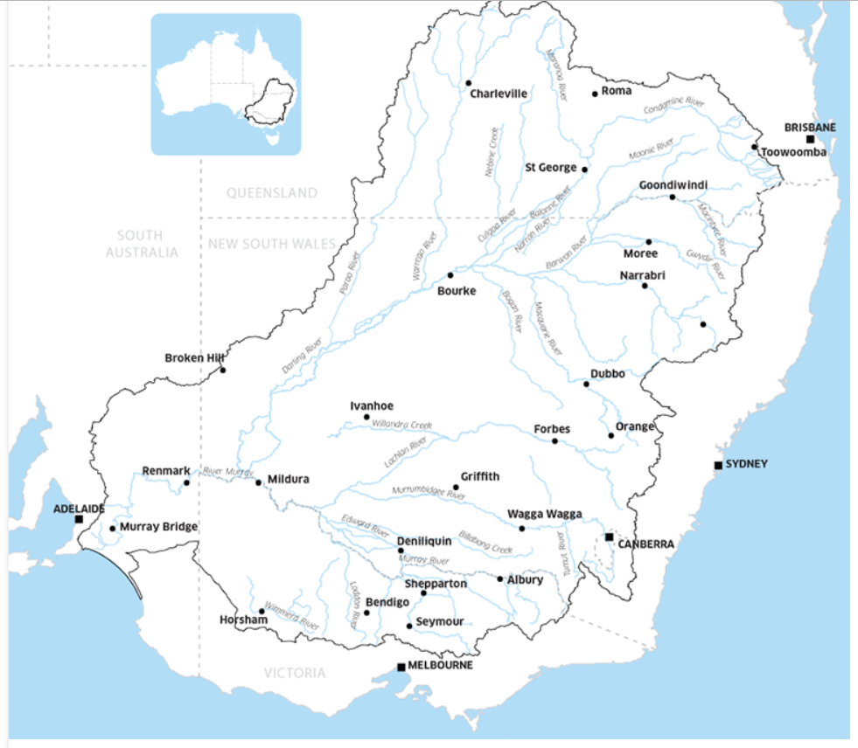
Part of the Murray Darling Basin
Area 1,042,730 km² (14% of mainland Australia)
Average annual rainfall 469 mm
Population 2,100,000 (10% of the Australian population)
Gross value of agricultural production $14,991 million (39% of the national value)
Average annual inflows (includes inter-Basin transfers)e 32,800 GL
Major water storage capacity 22,663 GL
Average annual outflows (modelled)e 5,105 GL
Notes:
Murray Darling basin – covers components of 4 states.
We are in Victoria and mange one of 10 catchment areas in Victoria

Slide 4
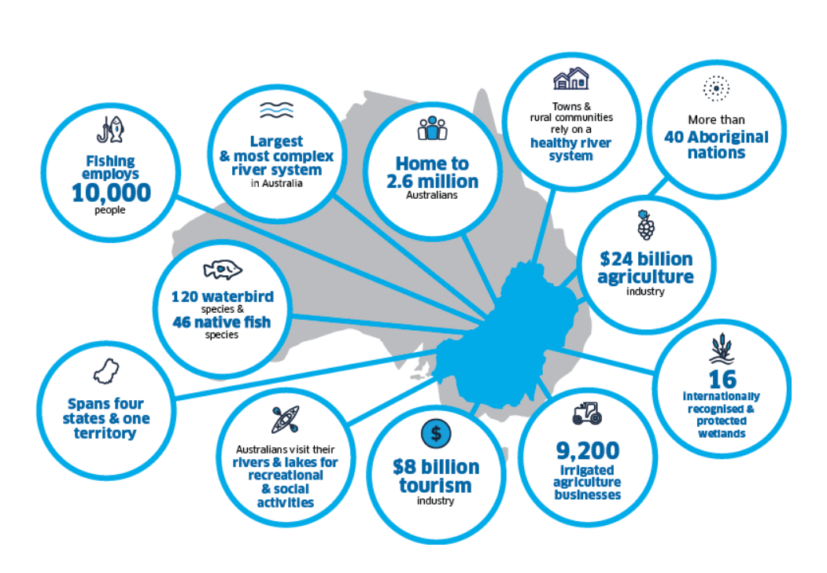
Notes:
Attribute Murray–Darling Basin
Area 1,042,730 km² (14% of mainland Australia)
Average annual rainfall (1997–2006)b 469 mm
Long-term average annual rainfall (1895–2006)c 457 mm
Population 2,100,000 (10% of the Australian population)
Gross value of agricultural production $14,991 million (39% of the national value) Average annual inflows (includes inter-Basin transfers)e 32,800 GL
Major water storage capacity 22,663 GL
Average annual outflows (modelled)e 5,105 GL

Slide 5
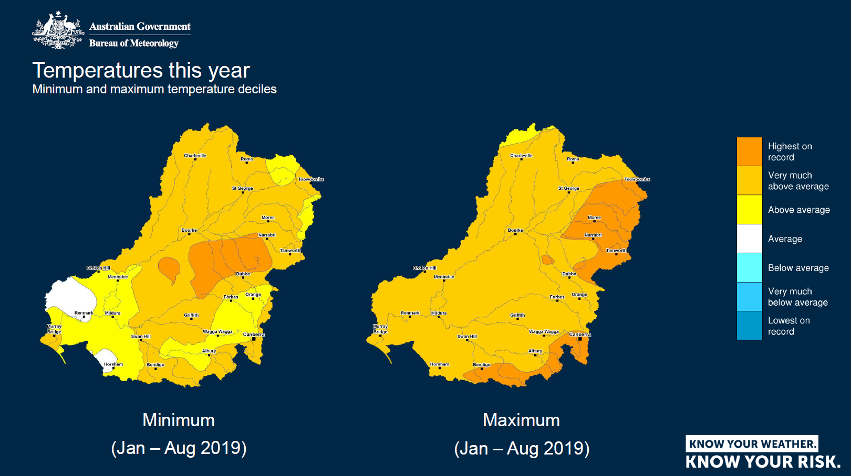

Slide 6
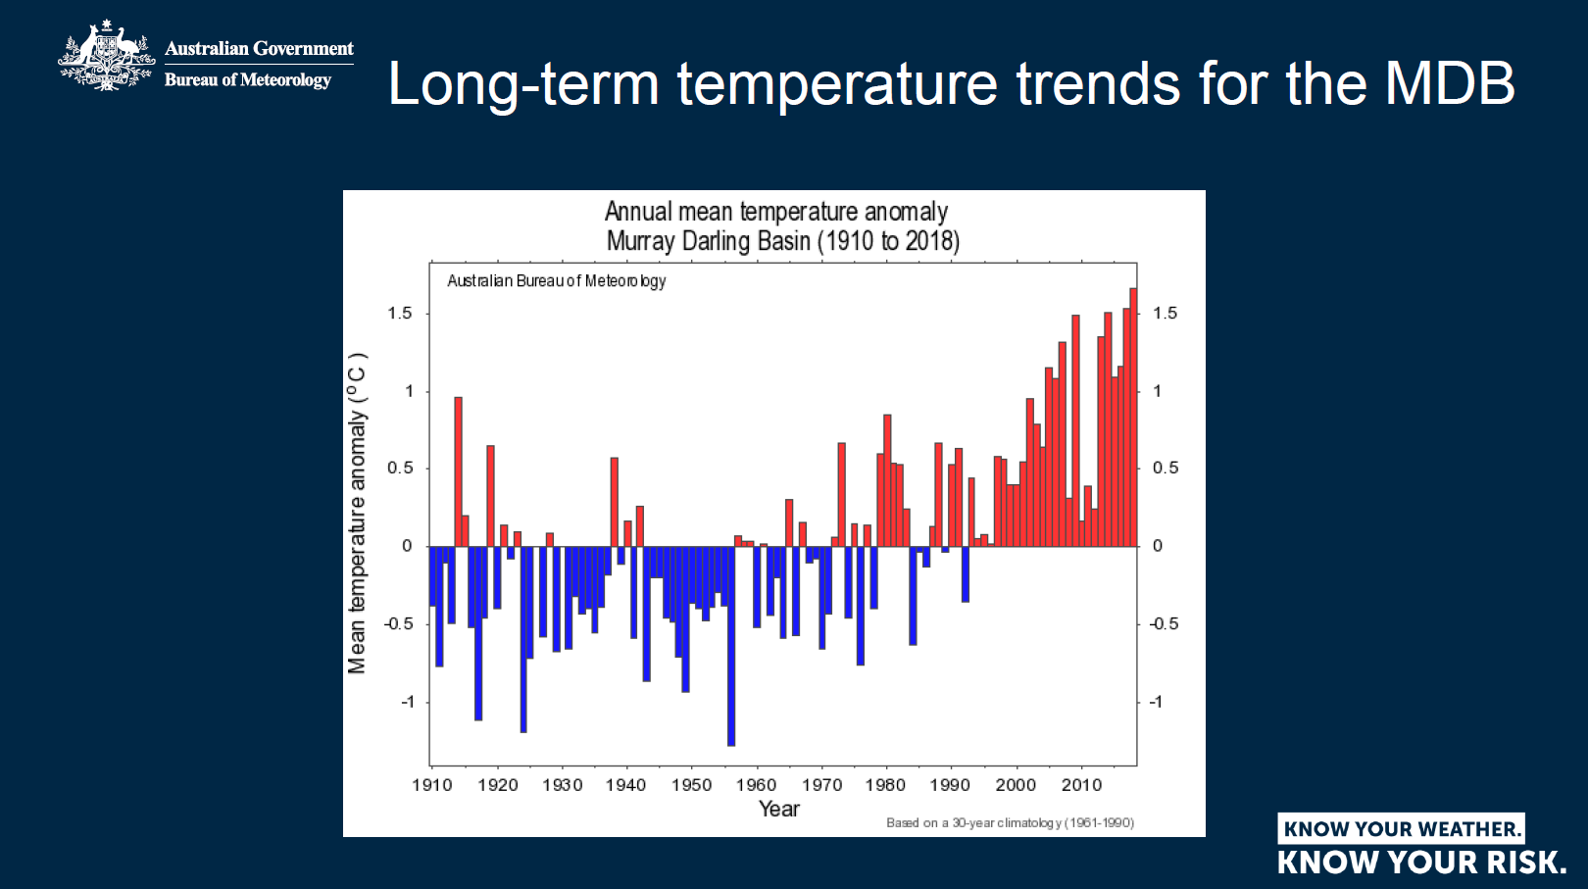

Slide 7
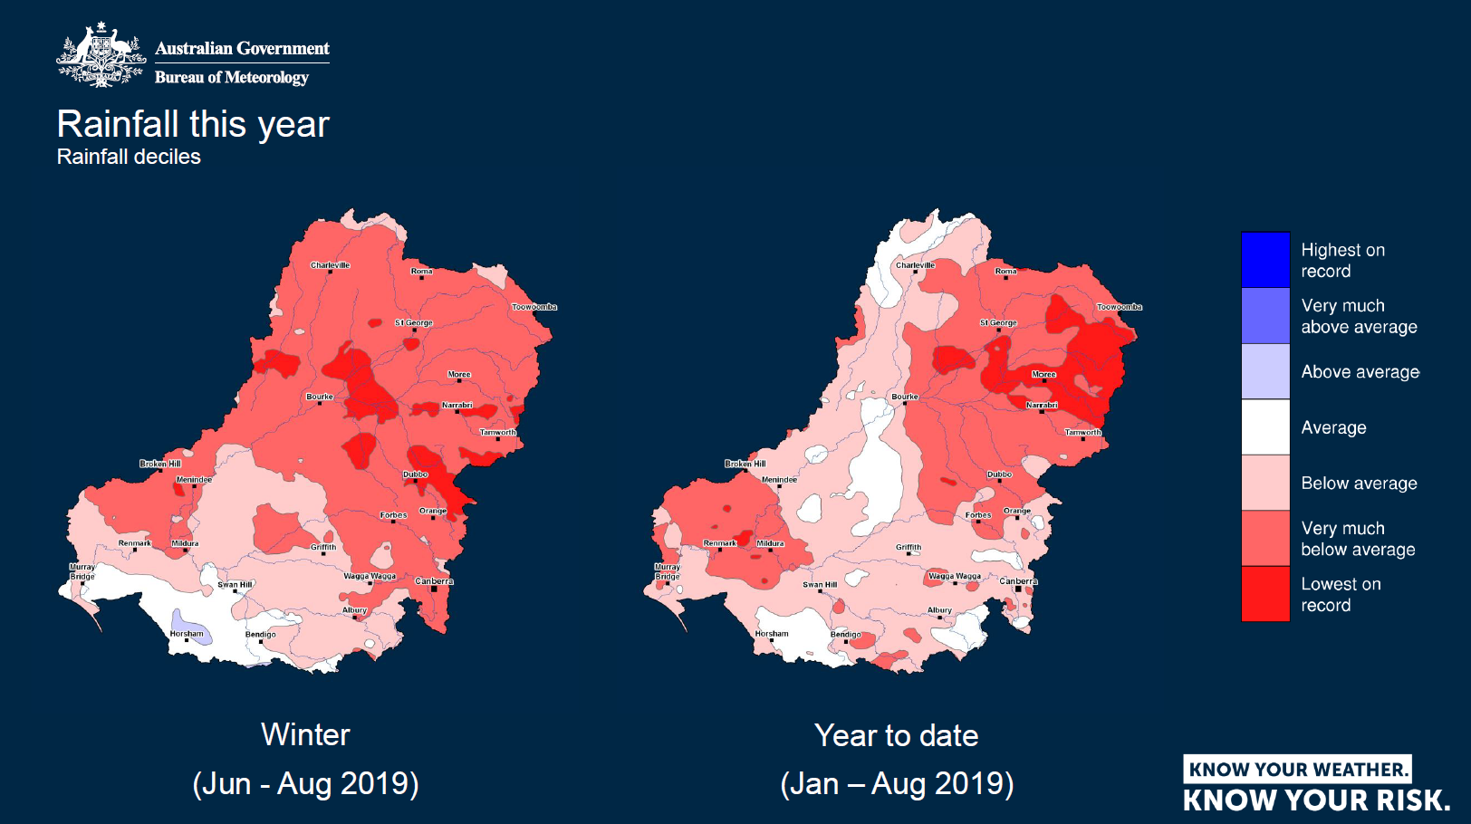

Slide 8
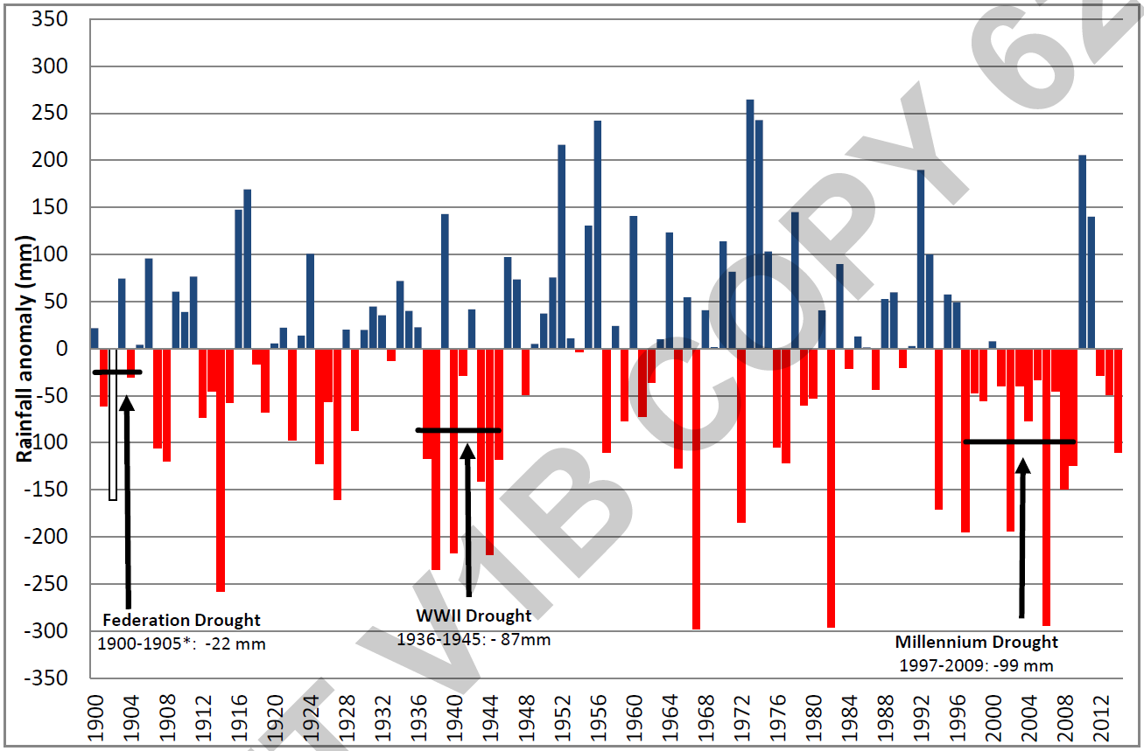
Historical rainfall extremes
Notes:
My comment about long warm spells is reinforced by the drought periods highlighted here in red that seem to be lasting longer each time they occur!!

Slide 9
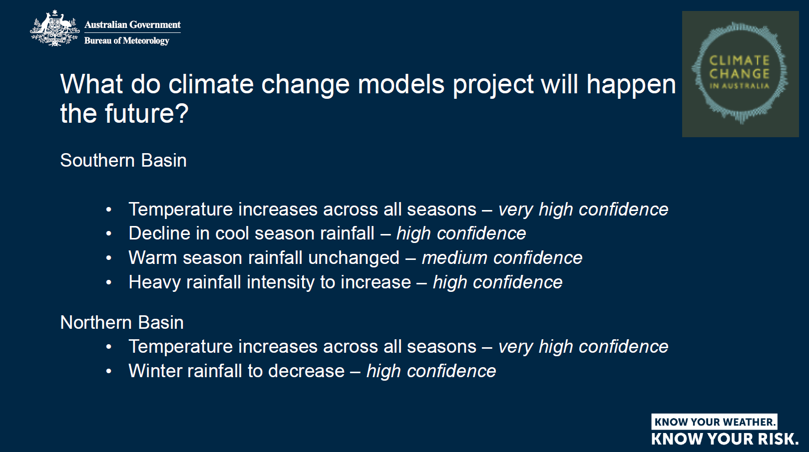
Notes:
Climate predictions and level of confidence

Slide 10
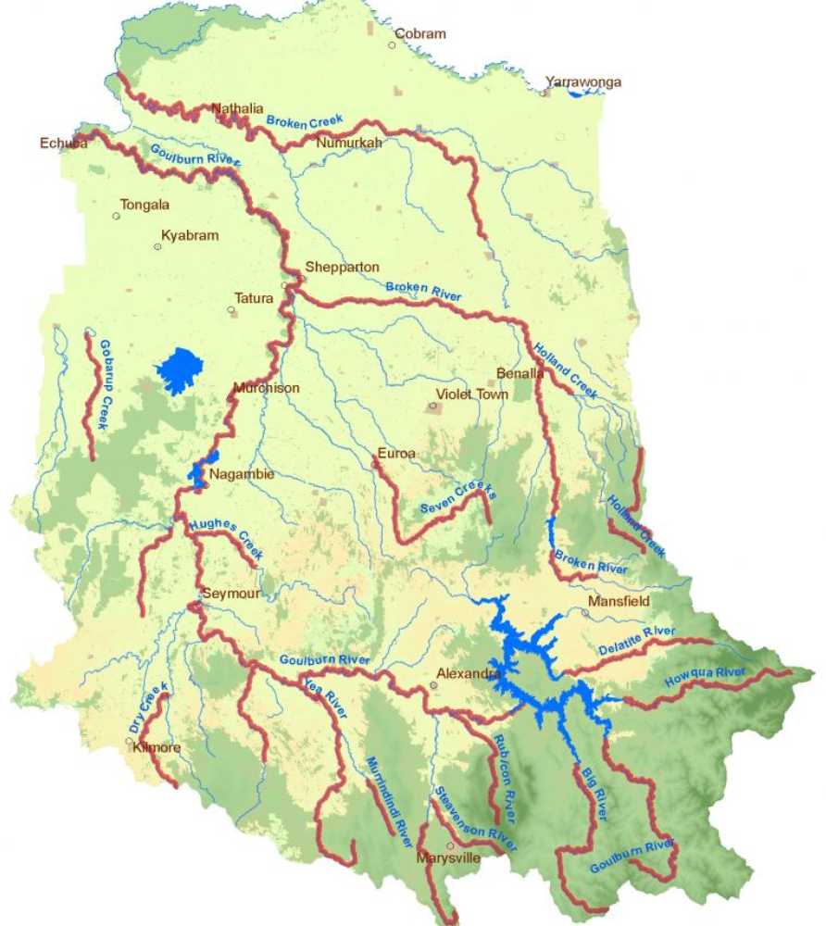
Goulburn Broken Catchment
Population of 204,000+
2.4 million hectares
1.4 million hectares is dryland agriculture
270,000 hectares is intensive irrigated agriculture
800,000 hectares is public land with extensive areas for conservation.
mixed farms, irrigated pastures and orchards
natural landscapes
range of social, economic and environmental pressures and drivers
Catchment yields 11% of the Murray Darling Basin’s water despite covering only 2% of its area.
Annual economic activity for the Catchment $15.9b in 2009
Agricultural production contributing $2.37b in 2017/18 (15.8% of Vic.).
Notes:
Area
Catchment covers from Echuca (north-west) to Kilmore (south-west corner)
across to Woods Point (south-east) and north to Yarrawonga.
Industry
Dairying is the largest agricultural industry, controlling about 70 per cent of water entitlements. Other major industries are irrigated horticulture and viticulture, dryland grazing and cropping, timber production, thoroughbred and standardbred horses, food processing, tourism and recreation.
Varied landscapes
From 1,800 metre (6,000 ft) snow covered alps to moist montane and dry
sclerophyll forests
From granitic outcrops to gentle sloping plains
From box woodlands to red gum floodplains (world’s largest at Barmah)
People (ethnic/indigenous) – 6,000 aborigines (largest urban population outside of Melb.)
Environmental problems
Major environmental problems include degraded river health, reduced extent and quality of native vegetation, reduced water quality and quantity, dryland and irrigated salinity, loss of biodiversity, and pest plant and pest animal invasion.
Some of the figures from our catchment are:
Over 60% of the catchment has been cleared, principally in the intensive ag. areas
13% of our 2,750 native vegetation species are threatened
The area of natural wetlands in the catchment have been reduced by approx. 30%.
29% of the 2,492 km of the catchments streams and waterways are rated as poor to
very poor.
22% of the 493 vertebrate fauna species in the catchment are threatened.
Very little knowledge of the health of our below ground flora and fauna.
Economy
Annual economic activity estimated to be $15.9b in 2009 with Gross Value of Agriculture Production estimated to be $2.37b in 2017/18 (15.8% of State’s total ag. production of $15b in 17/18) – most of this from SIR. GB Catchment is 3rd most productive NRM Region in Aust. (behind NSW Riverina & WA Wheatbelt).

Slide 11
Notes:
RCS – Cover resilience and main drivers we are facing noting we will mainly focus on water and climate change in this presentation

Slide 12
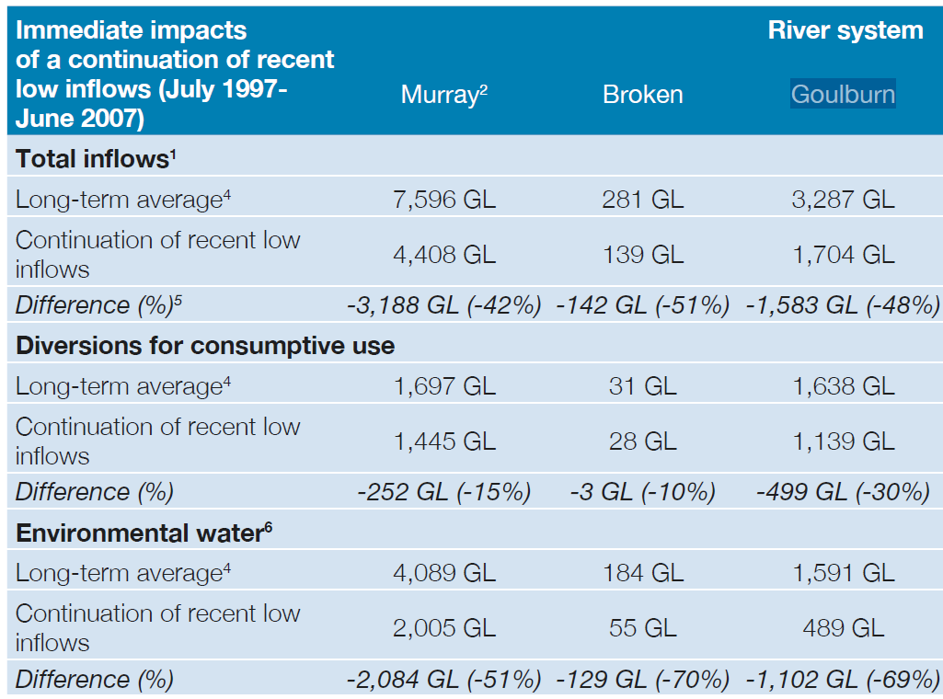
Notes:
Millennium drought lead many changes to water management.
This highlights impact on consumptive and environmental use at that time, before major changes in water for the environ.ment

Slide 13
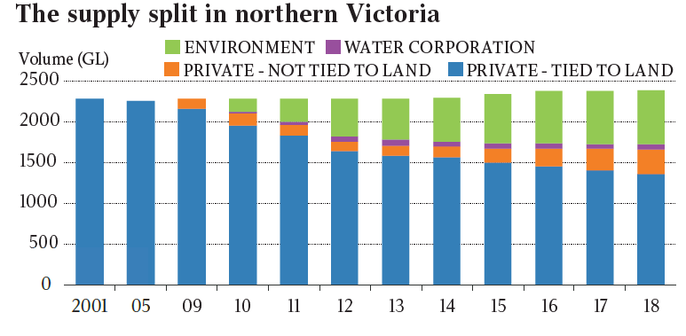
Recent changes on water volumes and ownership across norther Victoria
Notes:
Recent changes on water volumes and ownership across norther Victoria

Slide 14
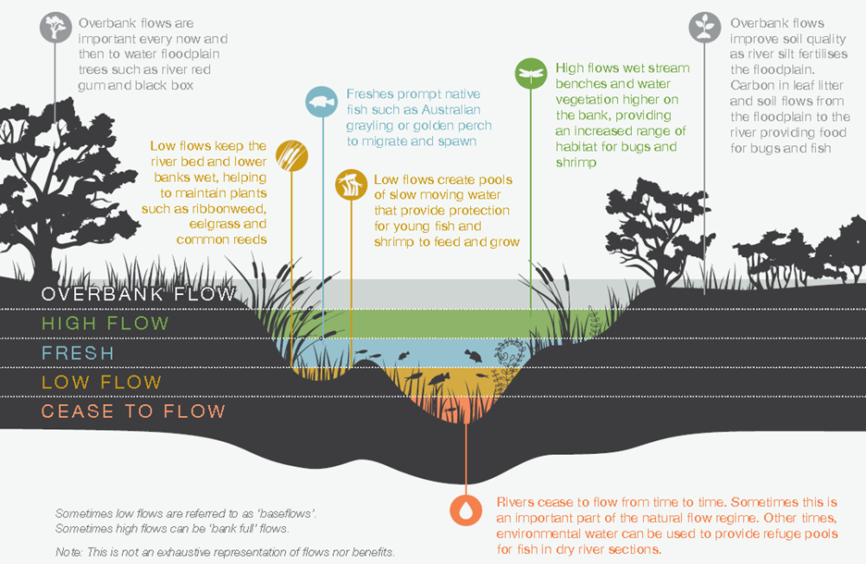
Environmental flows
Notes:
Environmental flows targeted

Slide 15
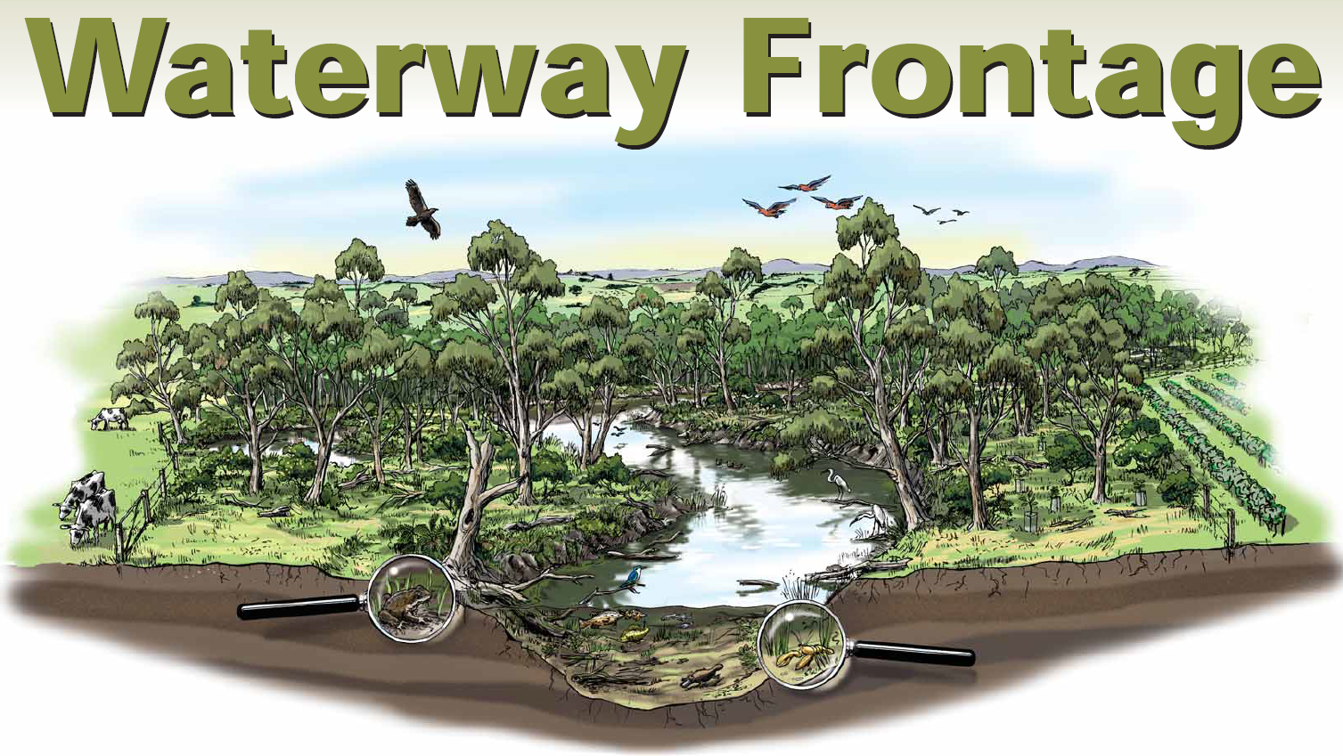
Notes:
Typically in rural Victoria what we are trying to achieve here is.
sustainable and productive agricultural,
heathy and diverse riparian vegetation
well buffered waterways
good water quality and health waterways for a range of benefits.
Government typically co-invests with frontage managers to undertake activities to address these issues. These include;
Erosion control
Stock exclusion fencing
Weed control
Revegetation
Off stream watering
An important point to make here is that riparian management can only be undertaken with the voluntary support of the land manager.

Slide 16
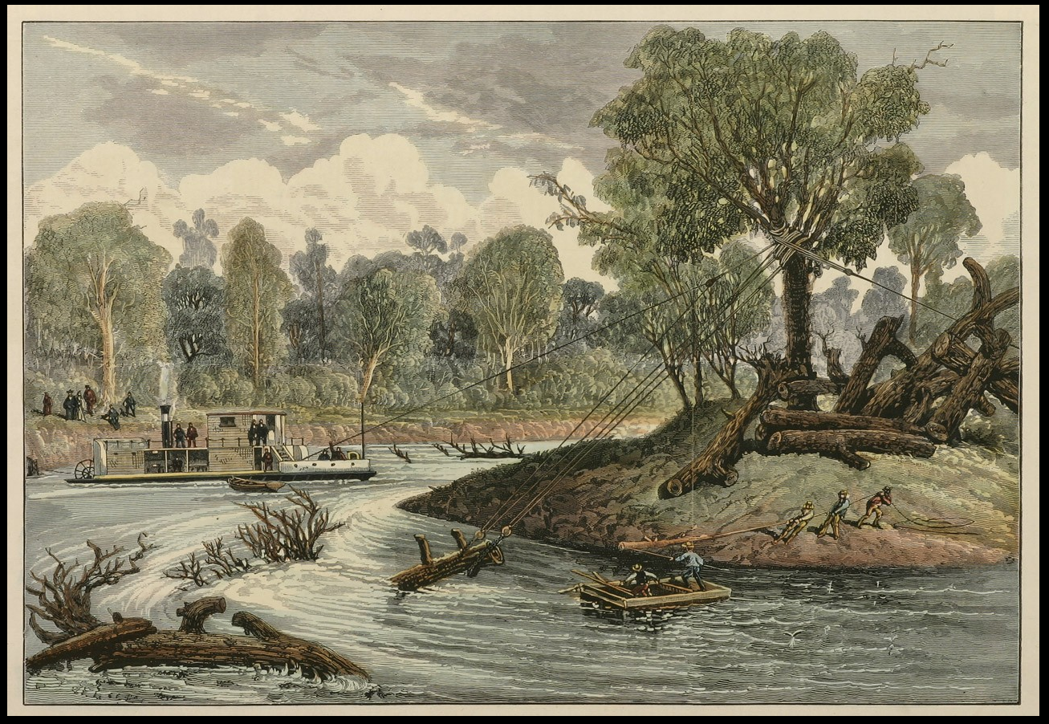
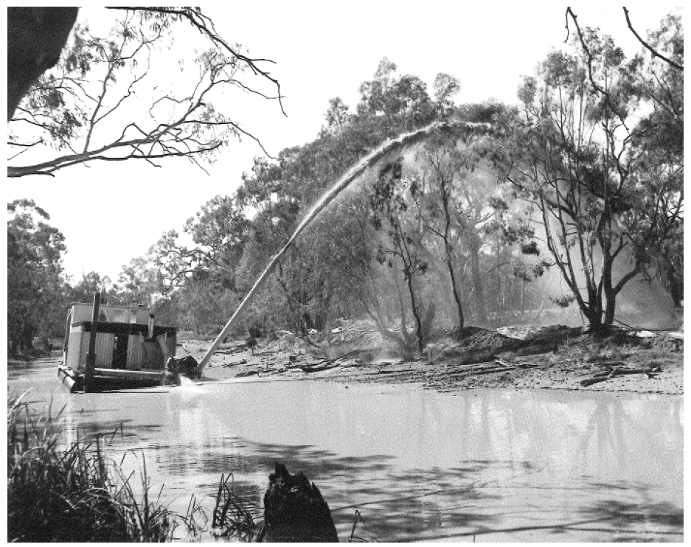
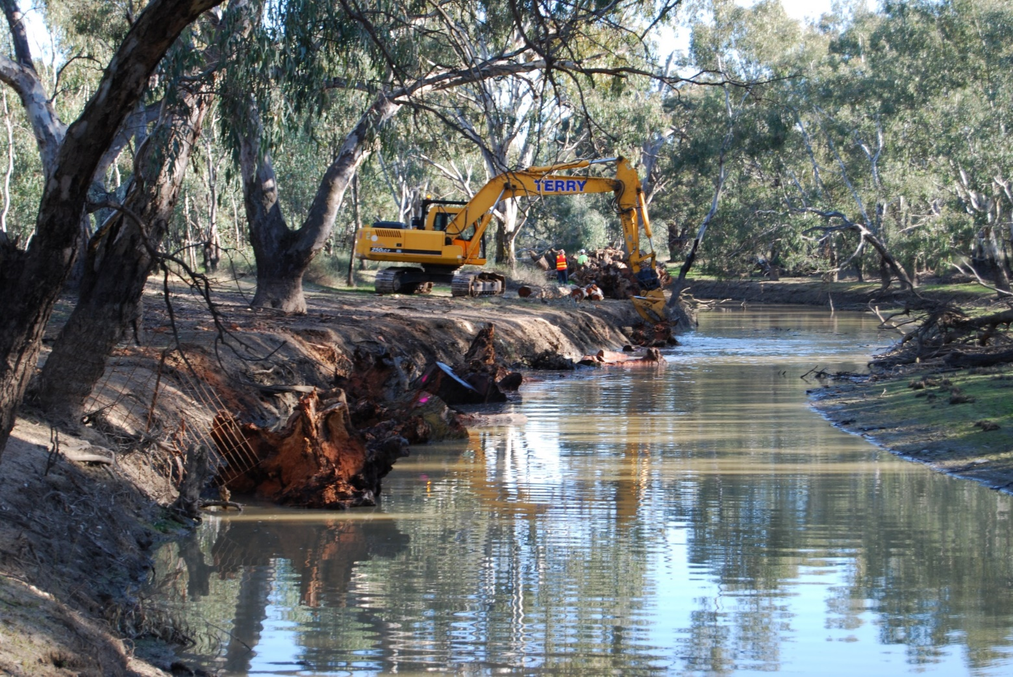
Notes:
Our rivers have been desnagged (woody habitat removed) and in some cases dredged. Reduced complexity of river channel.
We are now replacing it. Studies have shown that if we can increase wood loads we can increase fish population by up to 3 times.

Slide 17
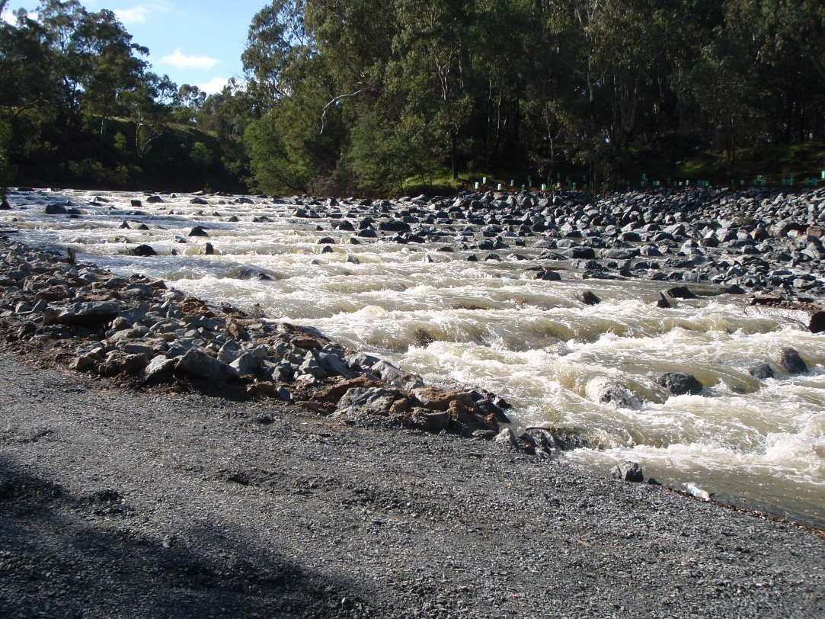
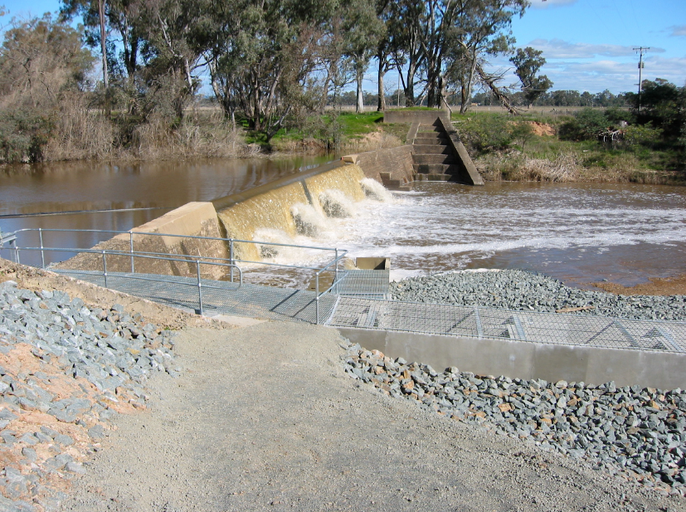
Caseys, Rices, Euroa
Notes:
In our 100 years od of river management we have built many dams and weirs.
Over that past 20 years we have started to retrofit fishways as many of our native fish move significant distance (up to 100’s of kms) as part of lifecycles.

Slide 18

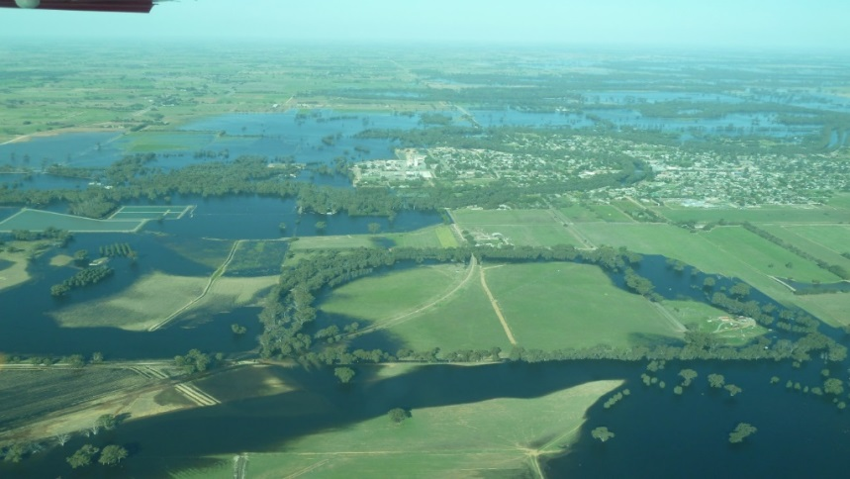
Floodplain Management
Management of the existing (legacy) flood problems - can involve a range of structural mitigation measures such as floodway, levees, diversion channels, retardation basins, and total flood warning systems.
Management of the future flood problems - land-use planning policy and guidelines in municipal planning schemes
Management of the residual flood problem - if not above 2 then the residual flood problem must shift to emergency management arrangements, in particular through the Municipal Flood Emergency Plans (MFEPs)
Notes:
Read through

Slide 19
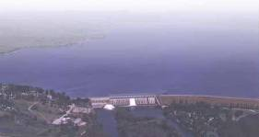
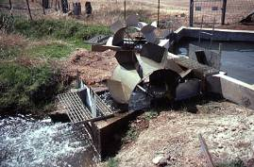
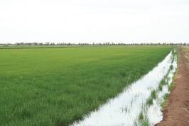
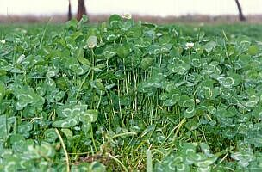
Irrigation - A Managed Water Cycle
Dam
Efficiencies
from Storage
Channel
Aim to improve all steps e.g. from 70% to 85 to 90%
70%
Dam to Farm
Operating Spills
Poor Measurement
Leaks
Seepage
Evaporation
Farm
50%
Supply to Crop
Poor Service
Slow Delivery
Varying Flows
Poor Control
Plant
35%
Use by Plant
Imprecise Timing
No Measurement of Crop Needs
Notes:
The next stage of managing irrigation water efficiently has been the modernization of the whole irrigation cycle across northern Victoria, which we started on in this region in late 2008.
This approach recognizes the need to drive efficiencies at every stage of the delivery chain;
From modernisation of the delivery system
To improvements in on-farm irrigation efficiency
To R&D to improve plant breeding, agronomy and pasture management
We are seeking to improve the efficiency of the whole system from the Dam to the Plant from 70% to around 85-90%.
Interestingly in the late 1990’s the GB CMA Board through its SIR Community & Agency Implementation Committee investigated issues around the channel leakage and seepage part of this cycle, and concluded that this only contributed about 10-15% to efficiency losses (which is actually reflected in this diagram) and wasn’t worth the effort, especially with the amount of irrigation water available and the fact that it was such a small input cost for irrigators – how things have changed in the last decade and a half!

Slide 20
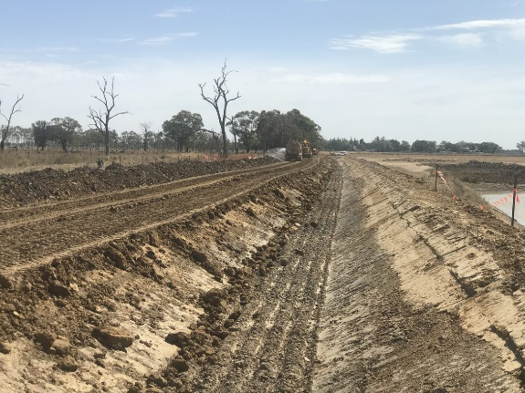
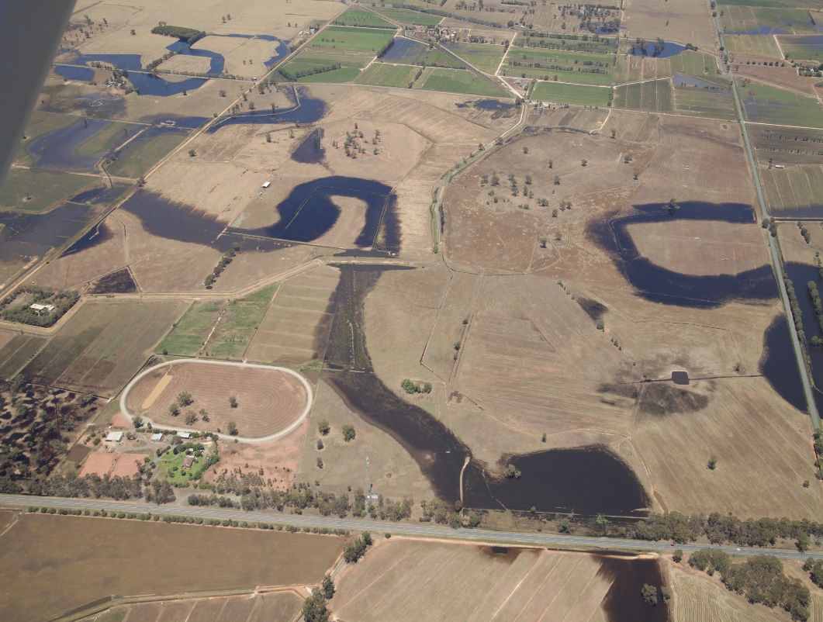
Drainage
Drainage
New Hybrid Drainage approach
Notes:
Surface and Sub-surface program
Following a review in 2015, the program was significantly changed. The original plan of having drainage cover to most of the SIR (which had been halted) was reconsidered in terms of outcomes and cost. The result was the emergence of the new hybrid drainage approach and phasing out of the extensive primary drain approach.
Photos show the difference. Primary drains were major earthworks constructed as part of a 300,000 hectare program until this year. The hybrid drainage system will have a smaller target of about 100,000 hectares and use existing drainage lines in the landscape. Main work is get the drainage course declared (gazetted) and then remove obstructions. The first DCD went through at the start of this year. The Hybrid drainage approach is a much cheaper option.

Slide 21
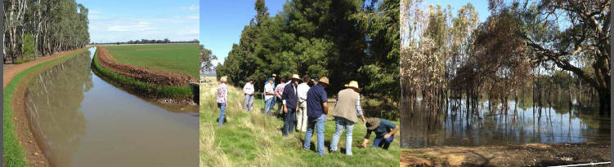
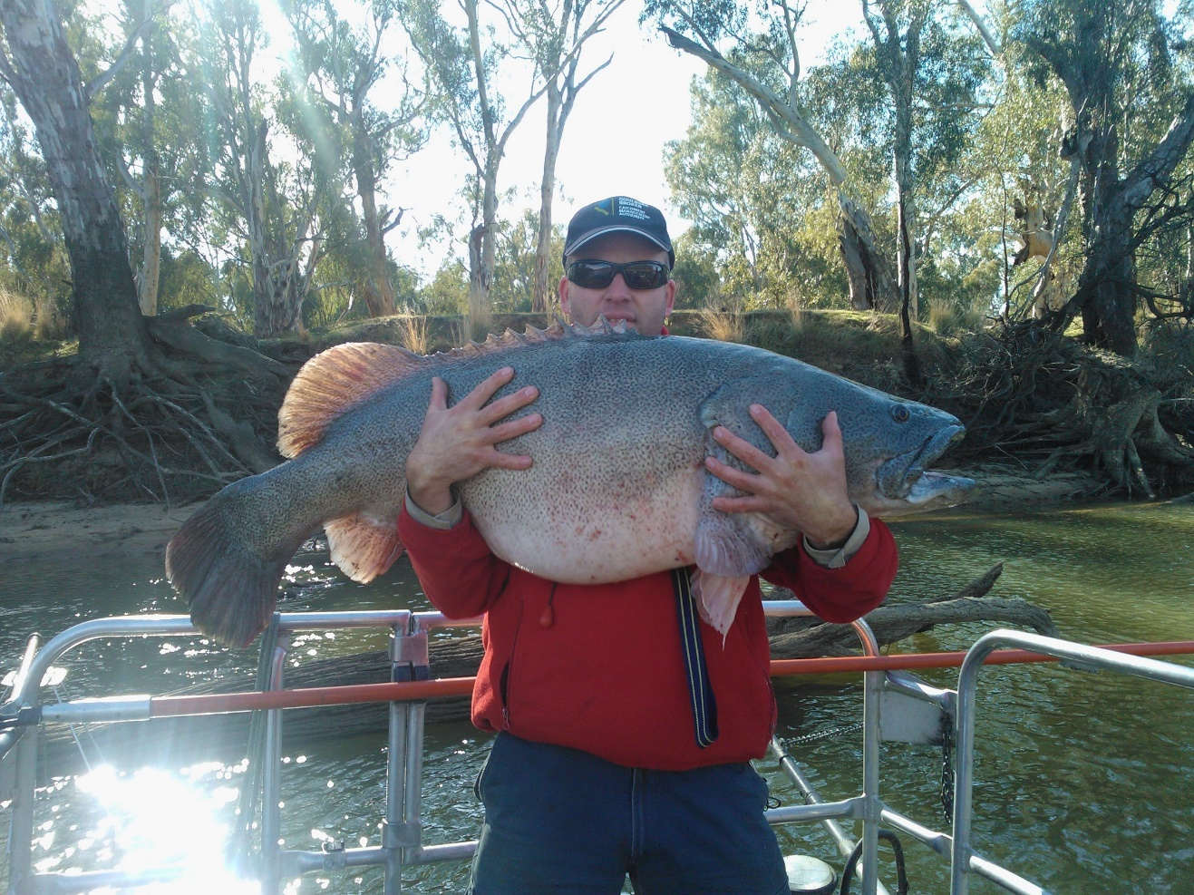
Questions?
Notes:
ANY QUESTIONS?

Slide 22
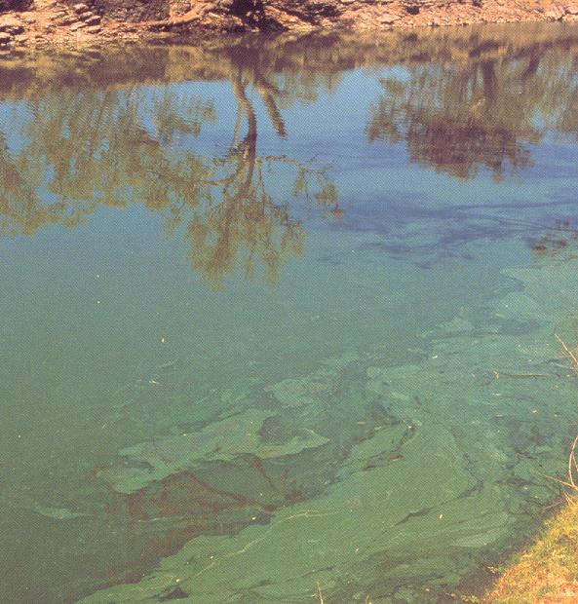
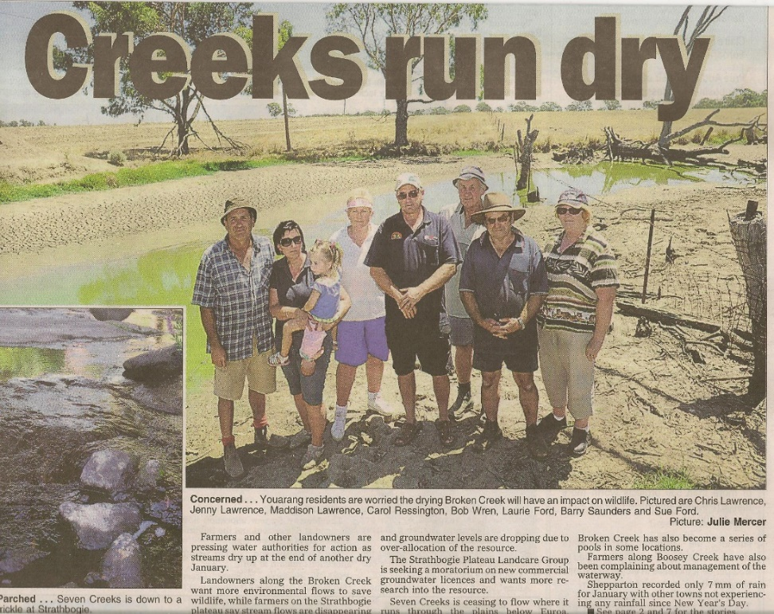
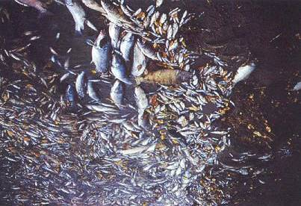
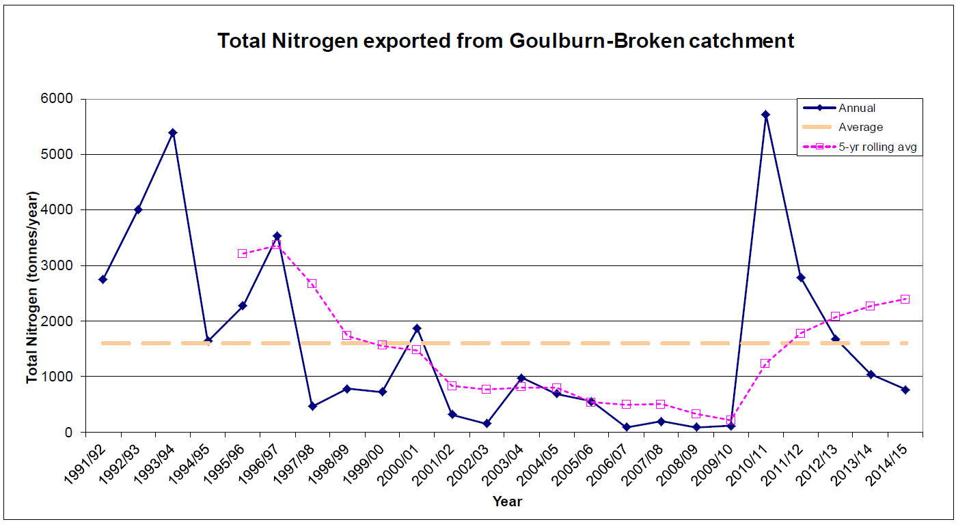
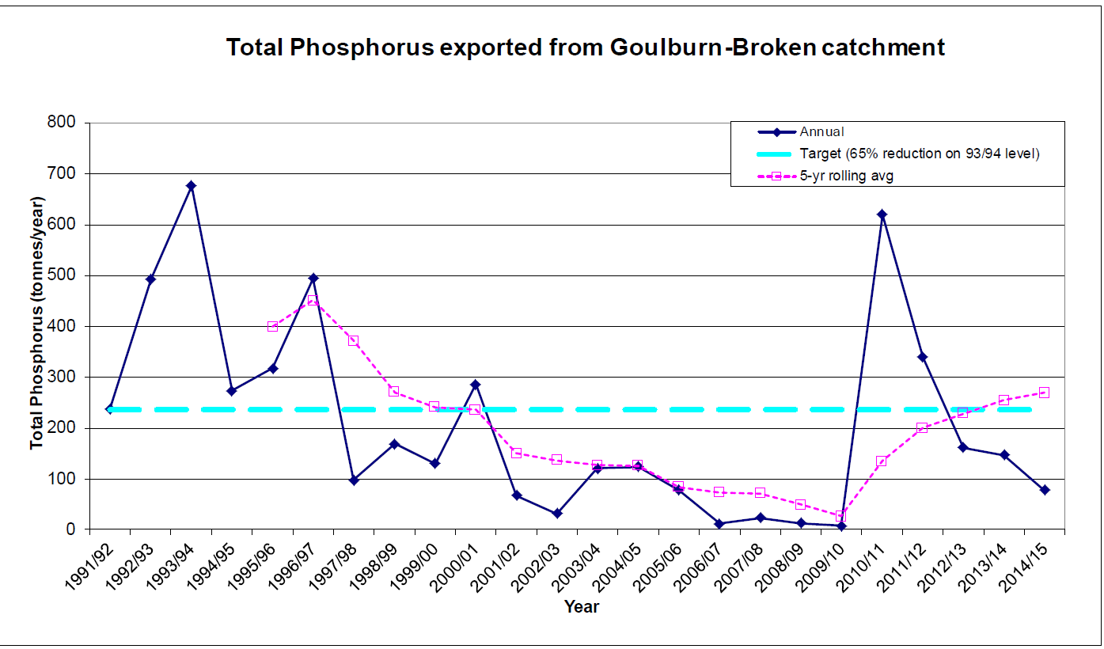
Water Quality
Notes:
Managing water quality became critical following Blue-Green Algae outbreaks in the Murrumbidgee, Darling, Murray and the Goulburn during the mid-1990’s.
Actions were implemented to look at contributions and actions related to;
Point sources from industry and sewage treatment plants
Fish farms
Diffuse sources measured through channel and drainage outfall
Effluent reuse systems (as part of whole farm plans)
Broken Ck. where we used env. flows for the first time to manage dissolved oxygen and Azolla growth.
BUT not surprisingly and fortunately many of the works to drive salinity management through controlling water more efficiently also resulted in benefits to managing water quality.
Graphs at the bottom of the slide show the ongoing monitoring of the amount of N and P coming out of each of the irrigation regions – graphs here are for the SIR which show a close correlation with water availability and drainage flows.
You can see the spike in nutrient loads when drains were flowing strongly after the 2010/11 floods.

Slide 23
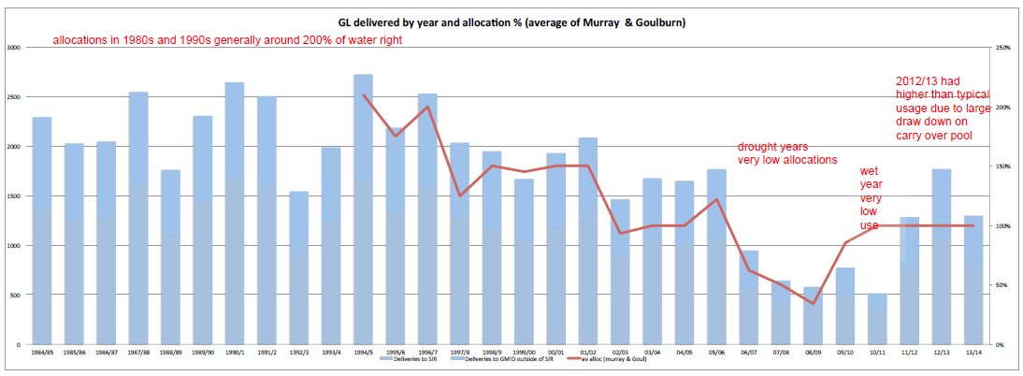
Water allocations 1984/85 – 2013/14
Notes:
This graph is showing water delivery and allocations across the Goulburn Murray Irrigation District from 1984/85 thru to 2013/14 – highlighting climate and water market impacts.
Left-hand column is total delivery in GL as the blue bars and the right-hand column is final annual allocation (as a % shown as the red line).
Water use has declined basically from 2000 GL/y to 1200 GL/yr due to;
80/20 sales entitlement reform to create low reliability water shares
water buyback
carry over
water reserve policy
net trade out of the GMID
Future demands will continue to be driven by:
• Net trade (including demand from SA and NSW)
• Victorian water being sought after for horticulture because of its
higher reliability. For example, the last 25 years has seen 200 GL/y
expansion in horticulture in the Victorian Mallee.
Now have almond devt. expanding in this area.
• Industry confidence

Slide 24
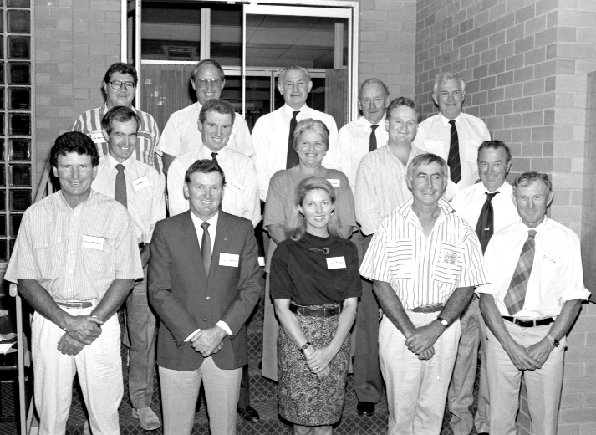
Our community partnership model
GB CMA Management
↓
GMW
&
DEDJTR
Support
GB CMA Board
Farm Water Program Advisory C’ttee
SIR People & Planning Impl. C’ttee
Murray Dairy NRM C’ttee
SIR Farm & Env. Working Group
SIR Drainage Working Group
Notes:
Community technical committees (like these shown here advising our Board) are critical for reviewing and adapting to change, and prompting solutions (good irrigator advice is critical to our decision making and the design of our programs).
Advice captured through these stakeholder Committees continue to reinforce to us the need to manage with greater sensitivity to the implications of change.
We recognize that modernisation is occurring in uncertain and dynamic times – we need to somehow provide time for good decisions, but we can’t afford to procrastinate and play each other off.
We must get the modernization completed to drive sustainable water use while the money is still there.
AND we can’t afford to finish with haves & have nots (that is, we must ensure we get the job fully finished).
We also need to recognise and promote the fact that the irrigation sector as a whole is innovative and readily adopts new practices, in this case that drive irrigation efficiency and sustainable water use, faster than most other sectors.

Slide 25
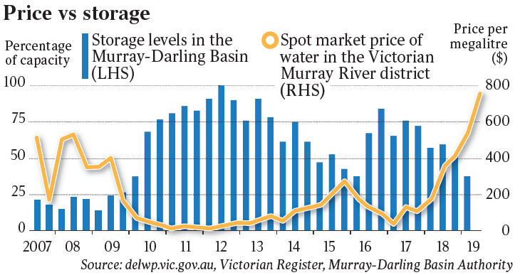
Water prices take off..

Slide 26
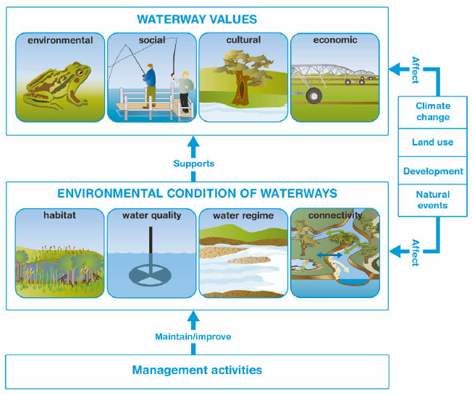
Goulburn Broken Regional Waterway Strategy
Notes:
Framework
Will talk about Env aspects

Slide 27
Useful links
https://www.gbcma.vic.gov.au/ - Goulburn Brocken Basin Authority Website (BOGB)
https://www.facebook.com/gbcma/ - Facebook page of BOGB
Management of the GB basin - through the eyes of the participants of the Dniester project (incl. Ecological flow):
Part 1 https://dniester-commission.com/novosti/upravlenie-vodnymi-resursami-v-avstralii-obmen-opytom/
Part 2 https://dniester-commission.com/novosti/upravlenie-vodoj-v-avstralii-obmen-opytom/

