Slide 1
Analysis of the Impact of Dniester HPP Reservoirs on the Status of the Dniester
Expert group’s work organisation
and first results
Chisinau, 17 September 2018

Slide 2
Setting Objectives
Evidence-based analysis of the impact of HPPs for the period of their operation based on actual data.
Questions for which we will be seeking answers
how the water flow has changed after / as a result of the construction of water reservoirs (and why)
how the water quality, status of populations and ecosystems has changed (and why)
how essential economic needs (e.g., water supply) have changed and are satisfied today

Slide 3
Expert Group’s Work Organisation
A mixed expert group focusing on three subjects:
hydrology
hydrochemistry and status of aquatic and riparian ecosystems
water use (including irrigation and water supply)
Group members: employees of academic institutions, production organisations, NGOs, independent experts
Heads and co-heads of subgroups – from both sides.

Slide 4
Group's Operating Principles
striving for dialogue, avoiding politics, respecting the opinion of colleagues
fairness and transparency (verifiable calculations, conclusions and results)
patience (work takes time)
coordinated formulation of problems (there are no problems that cannot be coordinated) as well as possibilities and ways of solving them
Priority: achieving consensus (if necessary, reasoned dissenting opinions are documented)
Chatham House Rule ensures freedom of discussion

Slide 5
Results presentation format
Expert group meeting reports (June, September 2018)
GEF Transboundary Diagnostic Analysis Section (Oct 2018)
Extended Report - Annexes to the TDA (Dec 2018 - early 2019)
What has already been done
Two expert group meetings (Kiev, 18 June and Chisinau 14 Sept)
Principal coordination of analysis methods in subgroups
Consolidation of data sets for analysis (Moldova, Ukraine)
Start of the analysis, first results

Slide 6
Analysis and first results: hydrology
Daily data from gauging stations:
Zaleschiki
Mogilev-Podolsky
Bender
Method: WFD Guidance Document No. 31

Slide 7
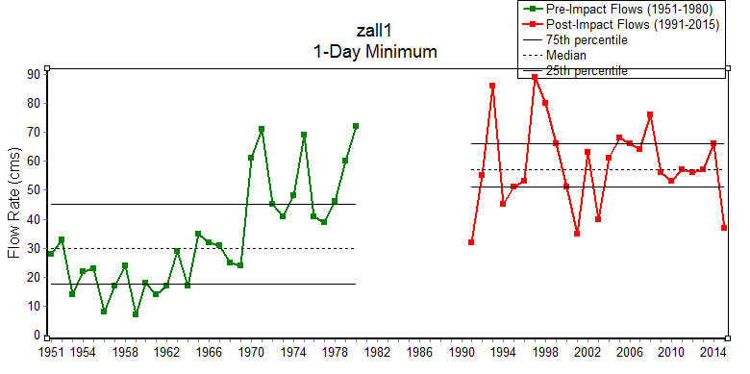
Climate change – a flow rate increase, compared to the 1950s-1980s of the 20th century, during a cold period of the year: a minimum flow rate increased by 18–73% and the maximum flow rate increased by 2–4% at Zaleschiki station.
.

Slide 8
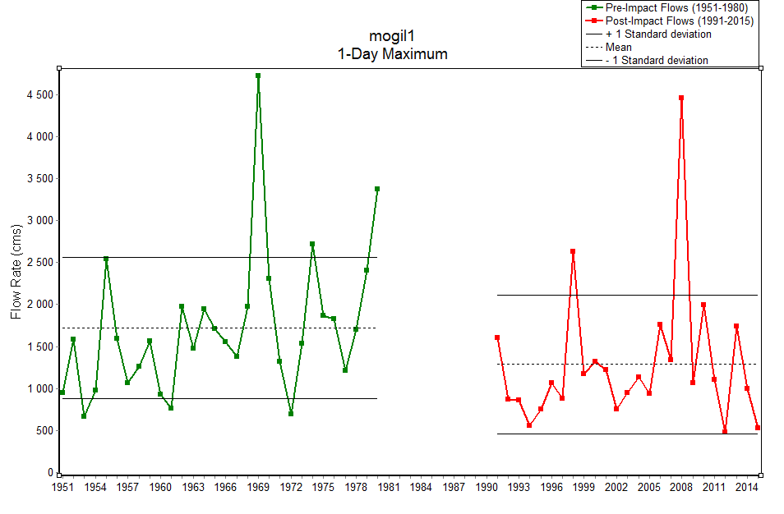
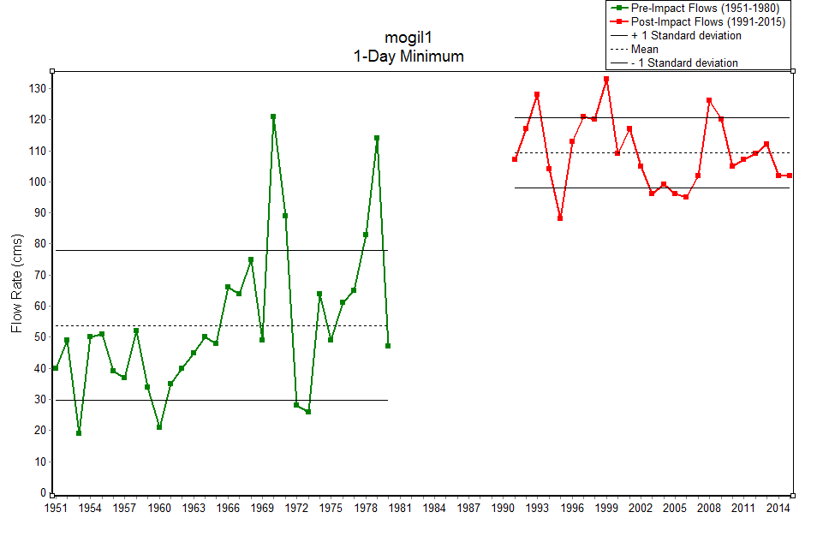
Reservoir and climate impact (Mogilev-Podolsky and Bender): a 15–25% reduction in the maximum spring flow (except for May) and an increase in the minimum flow by 35% to 100% or more, depending on the averaging period.

Slide 9
Reservoir impact: the same characteristics when comparing different gauging stations during the modern period of 1991-2015: an increase in the minimum and a decrease in the maximum flow in Mogilev-Podolsky compared to the total inflow to it and in Bender compared to Mogilev-Podolsky.

Slide 10
Analysis and first results: hydrochemistry
Data of observations of dissolved oxygen concentration and temperature. As a partial characteristic of changes in the solid flow – monitoring observations of water turbidity (suspended solids concentration in water).
Main focus on gauging stations of the Ukrainian Hydromet, Moldovan Hydromet, Tiraspol Hydromet: Zaleschiki, Naslavcea, Mogilev-Podolsky, Otaci, Soroca, Hrusca, Camenca, Dubasari.
Notes:
Suspended Sediment Dynamics Changes Temperature Regime Changes Oxygen Regime Changes

Slide 11
Mean annual suspended sediment discharge (kg/s) in Zaleschiki (1) and below the Dniester HPP (Mogilev-Podolsky gauging station) (2) in 1990-2015.
1
Mean annual suspended sediment discharge (kg/s) in Zaleschiki (1) and below the Dubasari HPP (tailwater) (2) in 1959-1980.

Slide 12
1
Annual water temperatures (degrees) in Mogilev-Podolsky in 1951-1980 (1) and 1990-2015.
Annual water temperatures (degrees) in Hrusca in 1968-1980 (1) and 1990-2015.
Deviation of water temperature in 1990-2015 (degrees) at Mogilev-Podolsky gauging station compared to 1951-1980
Deviation of water temperature in 1990-2015 (degrees) at Hrusca gauging station compared to 1968- 1980

Slide 13
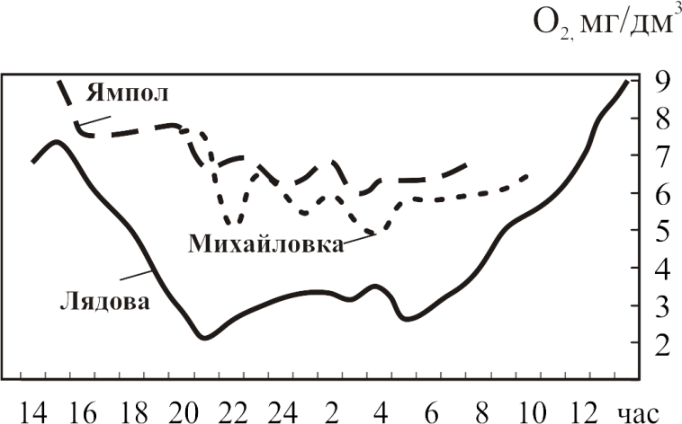
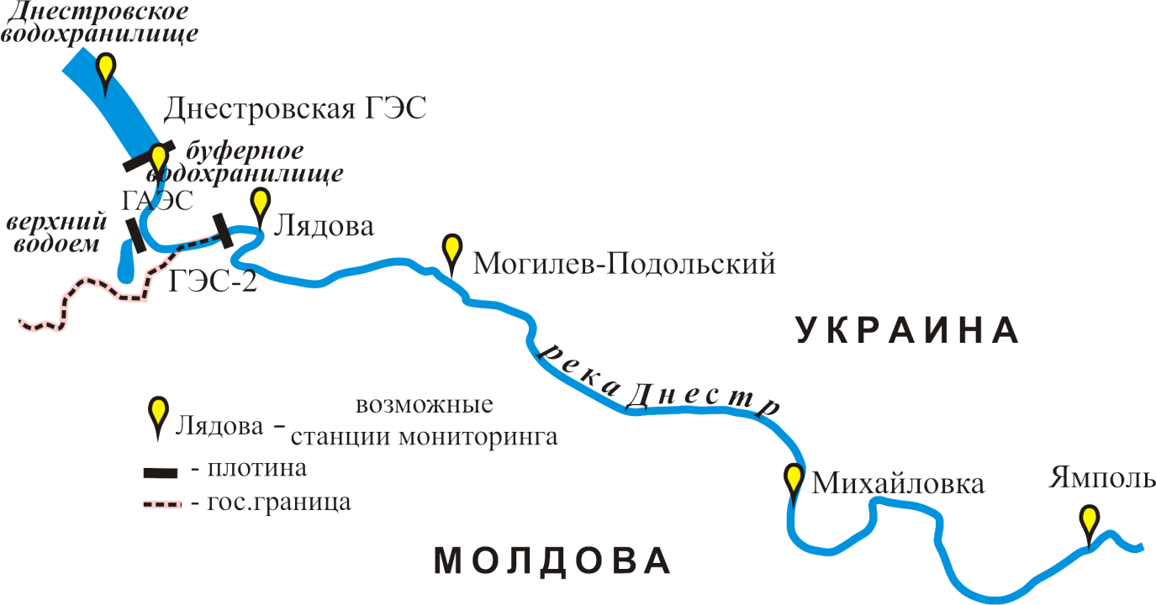
Oxygen and thermal stratification in the Dniester reservoir, the volumes of water discharges from HPP and HPP-2, and the residence time of water in the buffer reservoir are important factors of oxygen regime formation in the transboundary section. These may have an impact on daily variations in dissolved oxygen concentration in the water.
September 2014
Naslavcea
Otaci
2009-2015
Soroca
1990-2010
Dissolved oxygen
concentration in water
in Naslavcea
fluctuated (mg / cu dm):
5.48 to 14.0
2008-2015
Dissolved oxygen
concentration in water
in Soroca (above the city) fluctuated (mg / cu dm):
5.96 to 18.0
Dissolved oxygen
concentration in water
Otaci fluctuated (mg / cu dm):
4.90 to 12.8

Slide 14
Analysis and first results: HYDROBIOLOGY
Data on species, dominant species, aggregate quantitative indicators of aquatic organisms (size, biomass, etc.) along with additional indicators (biotic indices, saprobity indices, etc.).
Notes:
The following data must be used as indicators:
species wealth (S)
dominant species (autecological characteristics)
number (N) and biomass (B)
saprobity index and biotic indices (TBI, etc.)

Slide 15
Key Monographs and Publications
Hydrobiological regime of the Dniester and its basins / Edited by L.P. Braginsky.- Kiev: Naukova Dumka, 1992.- 356 p. Lower Dniester Ecosystem under Severe Anthropogenic Pressure/Edited by I.M. Gania.- Chisinau: Ştiinţǎ, 1990.- 260 p. Shevtsova L.V. Ecological State of the Dniester River / L.V. Shevtsova, K.A. Aliev, O.A. Kuzko [and others]. - Kiev, 1998. - 148 p. Shevtsova L.V. Hydroecological Characteristics of the Transboundary Section of the Middle Reaches of the Dniester River / L.V. Shevtsova, I.Kh. Bruma, O.A. Kuzko, T.D.Sharapanovskaya, V.A. Tkachenko, G.A. Zhdanova, S.A. Afanasyev // Hydrobiol.Journal - 1999. - V. 35, No 2. - P. 3–14. Yaroshenko M.F. Hydrofauna of the Dniester River. - M.: USSR Academy of Sciences Press, 1957. – 168 p. Dubasari Reservoir (Formation and Fisheries Significance) / Edited by Associate Member of MSSR Academy of Sciences M.F. Yaroshenko. - M .: Nauka, 1964. - 230 p. Markovsky Yu.M. Invertebrate Fauna in the Lower Reaches of Ukrainian Rivers. Conditions of Its Existence and Ways of Use. // Water Bodies of Dniester Delta and Dniester Liman. – K: USSR Academy of Sciences Press, 1953. – P.1 – 196 p. “Integrated Transboundary Dniester Basin Management: Platform for Cooperation and Modern Challenges”, International Conference (2017; Tiraspol). / Eco-TIRAS, 2017 (Tipogr. “Elan Poligraf”). – 484 p.: fig., tab. Bio-Hydro-Resources of the Dniester Basin, Their Conservation and Rational Use. Coll. Chisinau, Ştiinţǎ, 1980. – 236 p. Nedostup A.T. Zoobenthos of the Dniester River // Hydrobiol.Journal – 1988. – V. 4. – p. 88-95. Zhdanova G.L., Shevtsova L.V., Kuzko O.A., Tsaplina Ye.N., Golovko T.V. Ecological Assessment of Water Quality in the Lower Dniester River // Hydrobiol. Journal – 1995. – V. 31, No 6. – P. 22–34. Shevtsova L.V. Hydrobiological Research of the Dniester: Results, Problems and Ways of Their Solving // Hydrobiol. Journal – 1998. – V. 34, No 6. – P. 35–44 Pollution and Self-Purification of the Dubasari Reservoir/ Edited by M.F. Yaroshenko.- Chisinau, Ştiinţǎ, 1977.- 222 p. Shevtsova L.V. Assessment of the Impact of Spring Water Discharges from the Dniester Reservoir on the Ecosystem of the Dniester Estuary Section / L.V. Shevtsova, V. M. Timchenko, G.A. Zhdanova [and others]. – Kiev, 1994. – 110 p. – Manuscript No. 640-В94, VINITI Shevtsova L.V. Hydroecological Characteristics of the Transboundary Section of the Middle Reaches of the Dniester River / L.V. Shevtsova, I.Kh. Bruma, O.A. Kuzko, T.D.Sharapanovskaya, V.A. Tkachenko, G.A. Zhdanova, S.A. Afanasyev // Hydrobiol. Journal – 1999. – V. 35, No 2. - P. 3–14.

Slide 16
Sampling Stations and Periods of Hydrobiological Monitoring (EQMD)
Station | Period
Naslavcea (Lyadova) | 2011, 2013-2017
Otaci | 2012
Soroca | from 1978
near Rezina (tail part of the Dubasari Reservoir) | 1977 - 1983
(Dubasari Reservoir) above Dubăsari | 1977 - 1988
Dubasari Reservoir) near Dubăsari | 1990 - 2015
Dniester River, below Dubăsari | 1977 - 1988
Vadul lui Vodă | from 2002
Bender | from 1976

Slide 17
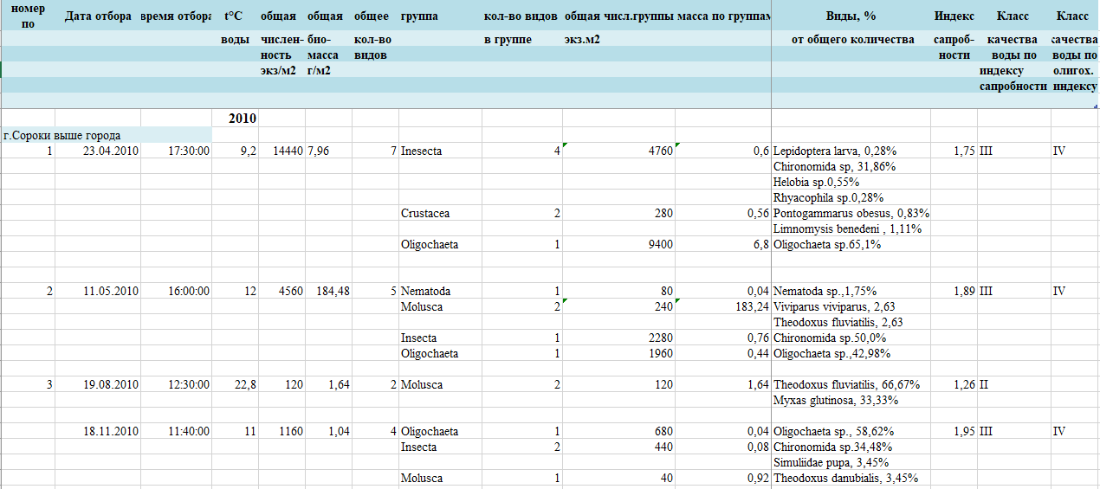
Hydrobiological Monitoring Data
Coordinated use of 2010, 2011 and 2016 data is required for impact analysis purposes

Slide 18
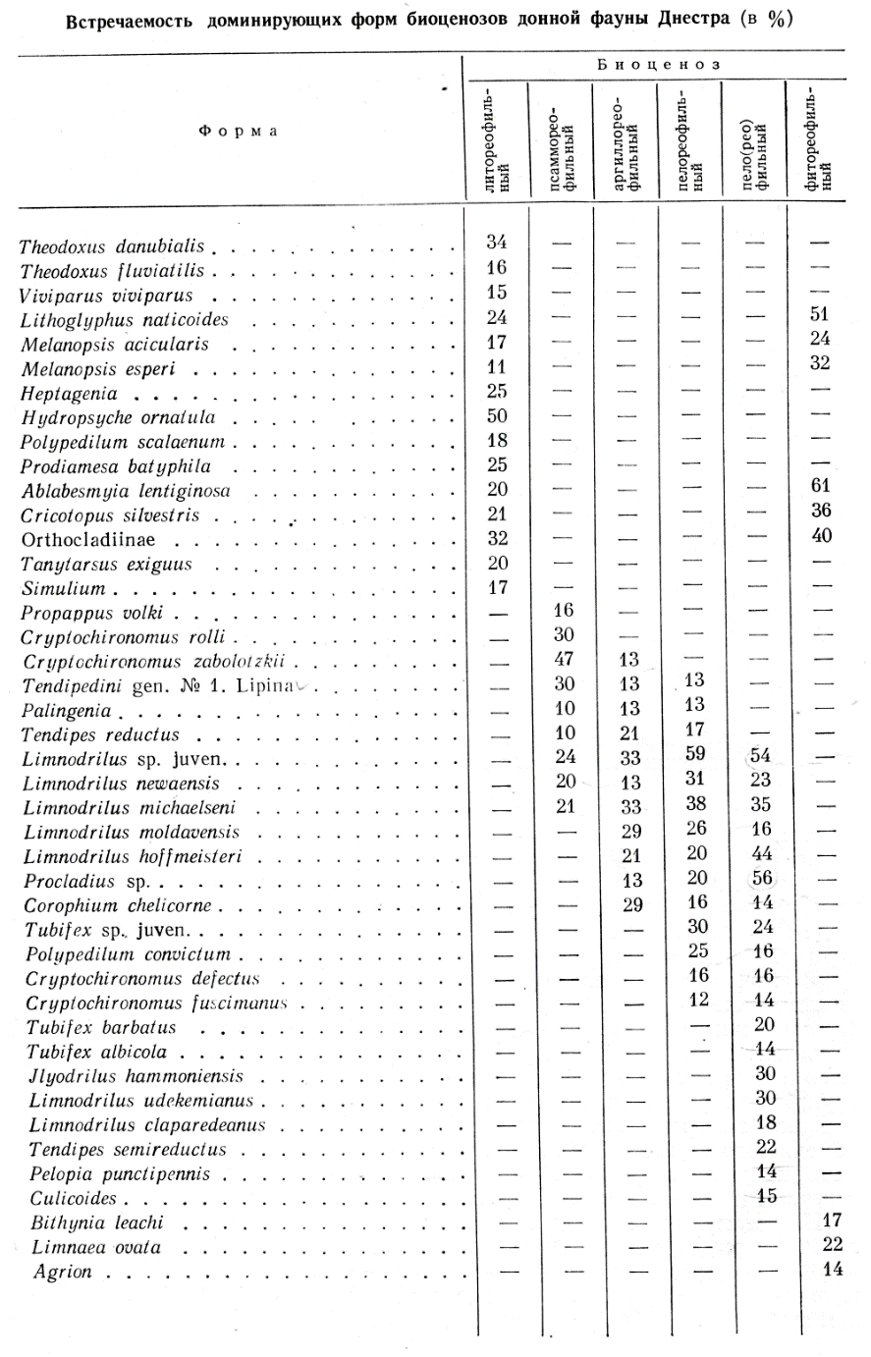
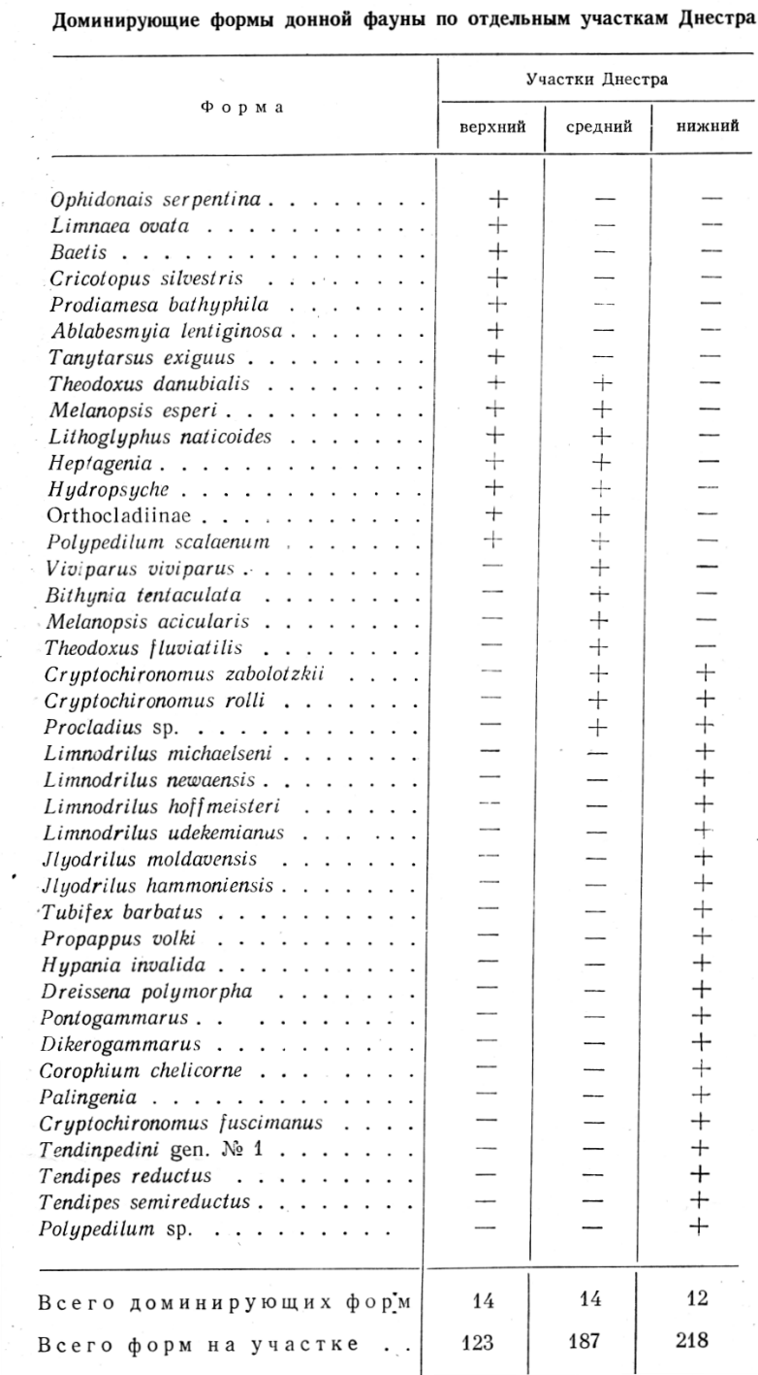
Example: How the operation of the buffer reservoir affected macroinvertebrates of the transboundary river section
Before river regulation
Abundance:
5,300 ind./m2
(1860 - 10,700 ind./м2)
and biomass –
74 g/m2,
(20 - 120 g/m2)

Slide 19
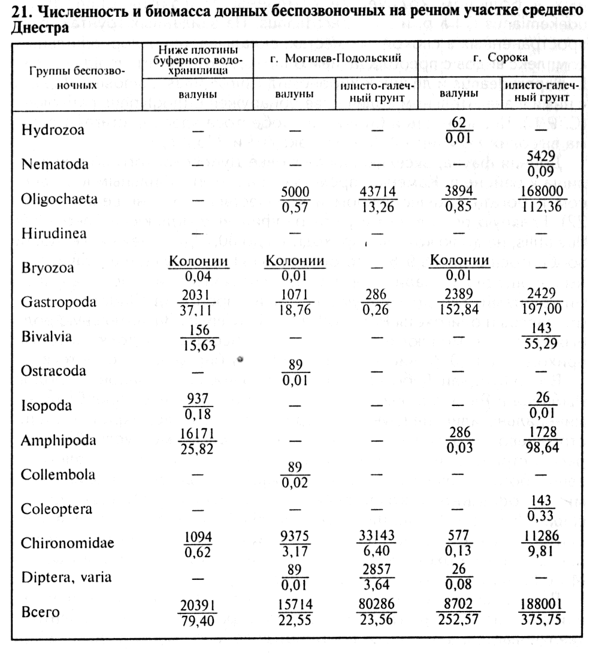
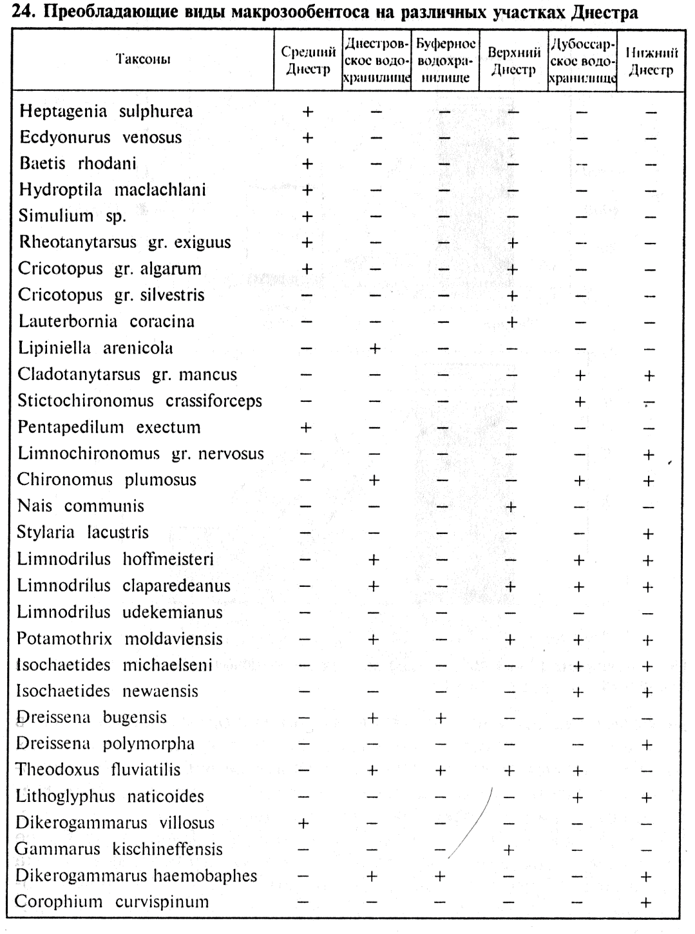
1995
Abundance and biomass of zoobenthos - 20 thous. ind./m2 and 80 g/m2
Notes:
21. Abundance and biomass of zoobenthos in the middle reaches of the Dniester River
24. Dominant species of macrozoobenthos in various Dniester sections

Slide 20
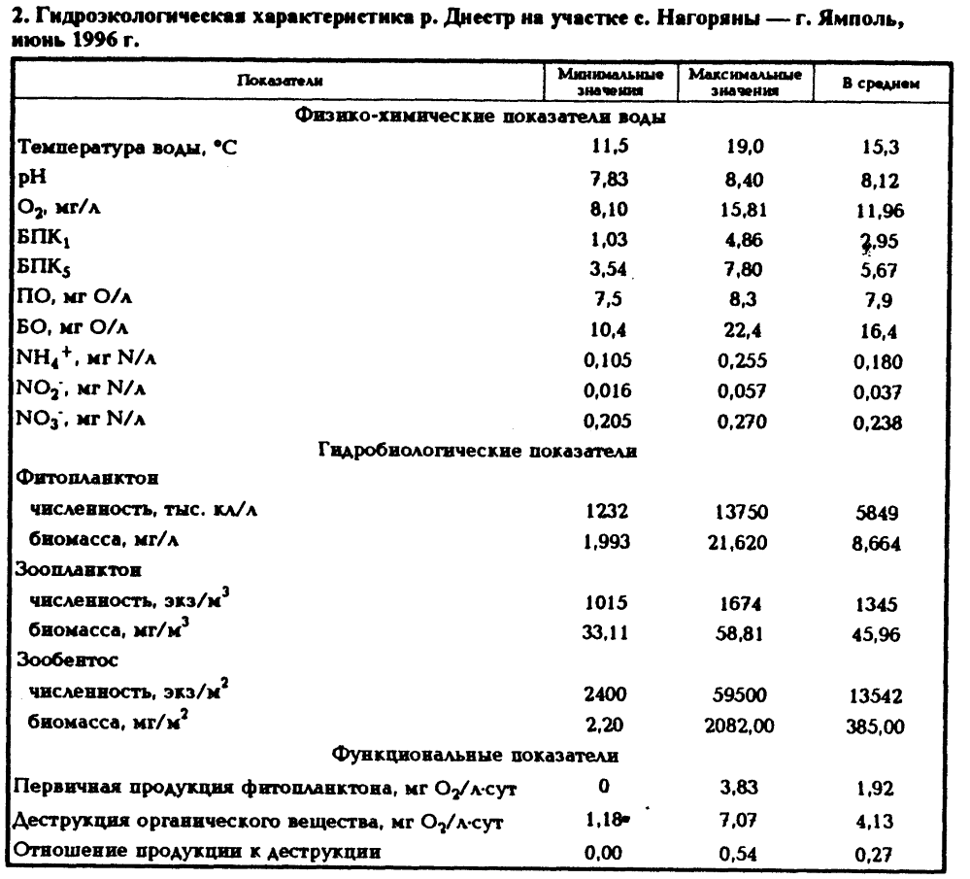
1996
Abundance and biomass of zoobenthos - 13,500.00 ind/sq.m. and 385.0 g/sq.m.
Notes:
2. Hydroecological characteristics of the Dniester River section near Nagoriany – Yampol, June 1996

Slide 21
2010, 2011 and 2016 data provided by EQMD
macrozoobenthos
Section
Sampling date
Species
SI
Total
Mass
number
number
2
g/m
1
2
3
4
5
6
16.03.2011
8
1,95
30200
27,92
Abundance (median):
9,100 ind./m2
and biomass –
25 g/m2,
11.05.2011
10
1,67
11520
18,96
25.05.2011
4
1,9
27040
47,92
Dniester River
10.08.2011
5
2,03
3640
100,16
Naslavcea
12.10.2011
8
1,95
12520
182,24
(Liadova)
12.04.2016
14
1,93
2592
18,46
06.07.2016
22
2,04
1088
26,944
05.04.2017
14
2,01
275
0,611
05.07.2017
18
2,04
914
8,425
05.04.2012
7
1,53
23000
24,96
Dniester River
Otaci
04.07.2012
8
1,76
33680
63,16
03.10.2012
11
1,78
67240
362,84
23.04.2010
7
1,75
14440
7,528
Dniester River
above Soroca
11.05.2010
5
1,89
4560
184,48
19.08.2010
2
1,26
120
1,64
18.11.2010
4
1,95
1160
2,04
11.05.2010
13
1,85
13640
21,12
23.04.2010
6
2,19
17400
2,28
19.08.2010
9
1,71
11880
190,92
Dniester River
below Soroca
18.11.2010
3
2
1080
0,12
15.03.2011
11
1,96
9120
89,38
20.04.2011
6
1,45
1960
0,76
25.05.2011
5
2,2
2760
13,56
09.08.2011
3
1,7
2640
1209
11.10.2011
9
1,85
23480
1043,24

Slide 22
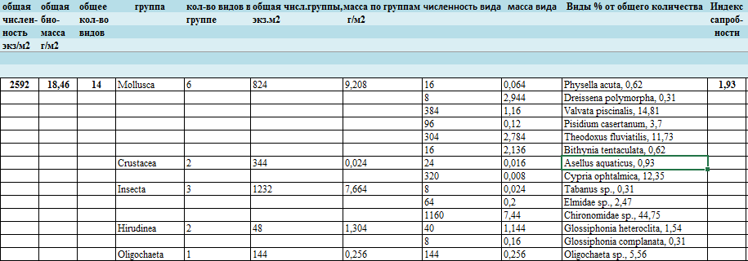
Naslavcea 2016 (12/04/2016)
Abundance and biomass of zoobenthos here - 2,600.00 ind/m2 and 19.0 g/m2

Slide 23
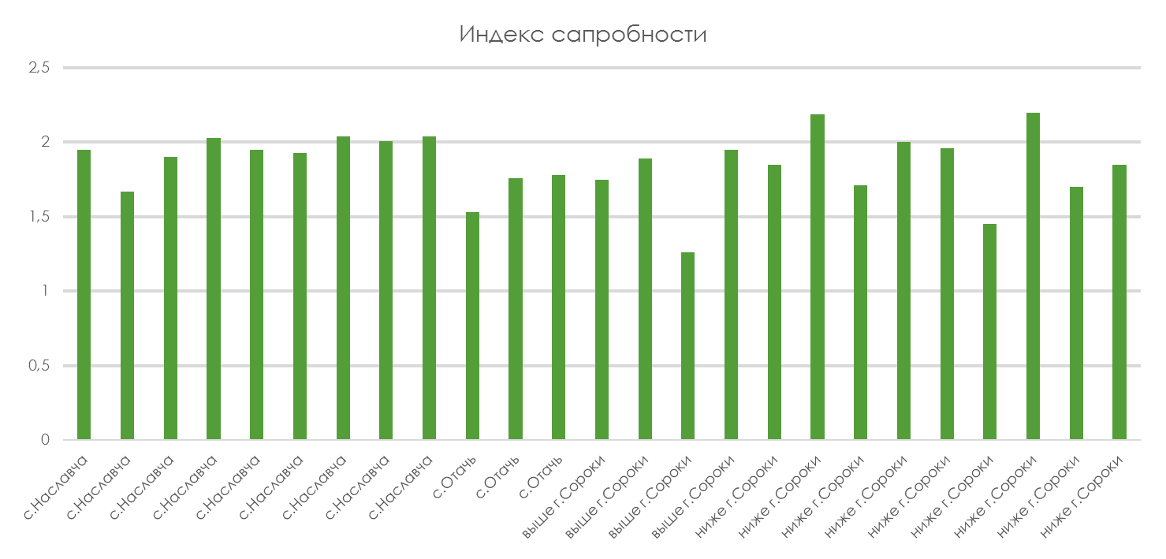
Water Quality Assessment - Saprobity (2010, 2011, 2016)

Slide 24
Bacterial Plankton and Chemical Parameters of Water in the DNIESTER
Additional Sources of Information

Slide 25
Long-term dynamics of abundance (N) and biomass (B) of phytoplankton in the upper reaches of the Dniester River in the territory of Moldova (Naslavcea + Soroca + Camenca), annual mean

Slide 26
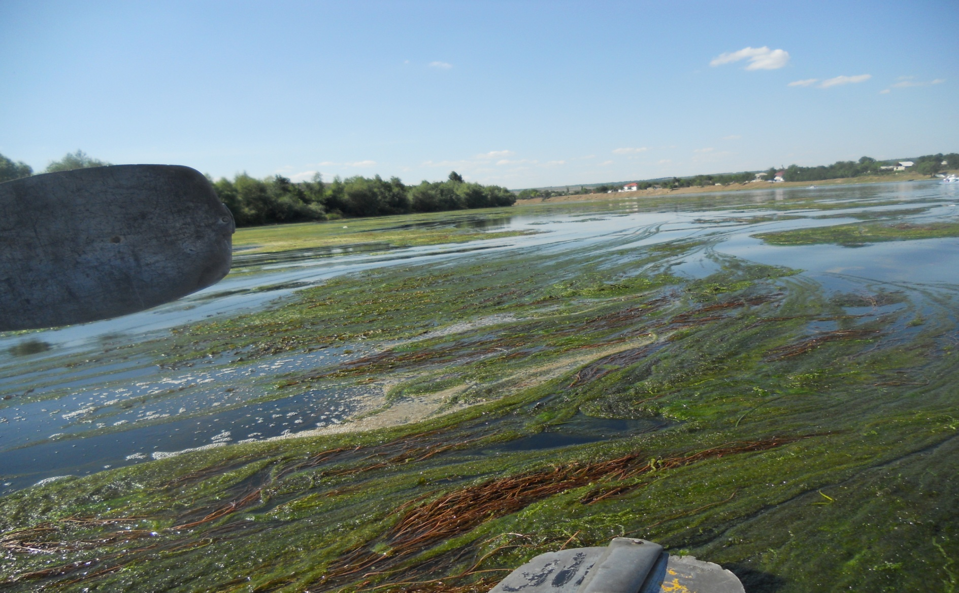
According to available expert estimates, the degree of overgrowth was in the range of 0.7-1% before construction, 10-15% in the 1980s, and is about 85% of the water area presently. Data are required for analysis.

Slide 27
Dniester Overgrowth Evolution According to T.D. Sharapanovskaya (1999)
First signs of the overgrowth of the Dniester River – 1987. Along the river banks starting from Naslavcea and downstream – Potamogeton perfoliatus (clasping-leaved pondweed). By 1991 – the entire sector of Naslavcea -Dubasari is overgrown with vegetation.
1993-1994 – there appears Elodea canadensis (Canadian pondweed)
Dutomus umbellatus (flowering rush), Cladophora fracta and Cl. glomerata, Enteromorpha intestinalis, several species of Spirogyra, and water net Hydrodictyon reticulatum begin to grow.
A lot of previously unseen or rarely encountered species of lower and higher aquatic vegetation have become abundant.
Collection and analysis of primary data for the lower reaches of the Dniester River (Odessa Region)

Slide 28
Ichthyofauna Status in Dniester River Section Between Naslavcea and Camenca
1950-1959 and 1996-2000
EXTINCT SPECIES
Huso huso | Great sturgeon
Acipenses Gueldenstaidid | Russian sturgeon
Acipenser stellatus (Pallas) | Stellate sturgeon
Alosa kessleri pontica (Eich) | Pontic shad
Salmo trutta fario (L) | Brown trout
Thymallus thymallus (L) | Grayling
Leuciscus borysthenicus (Kessl) | Dace
Tinca tinca (L) | Tench
Gobio kessleri (Dybow) | Dudgeon
Abramis ballerus (L) | Blue bream
Lota lota (L) | Burbot

Slide 29
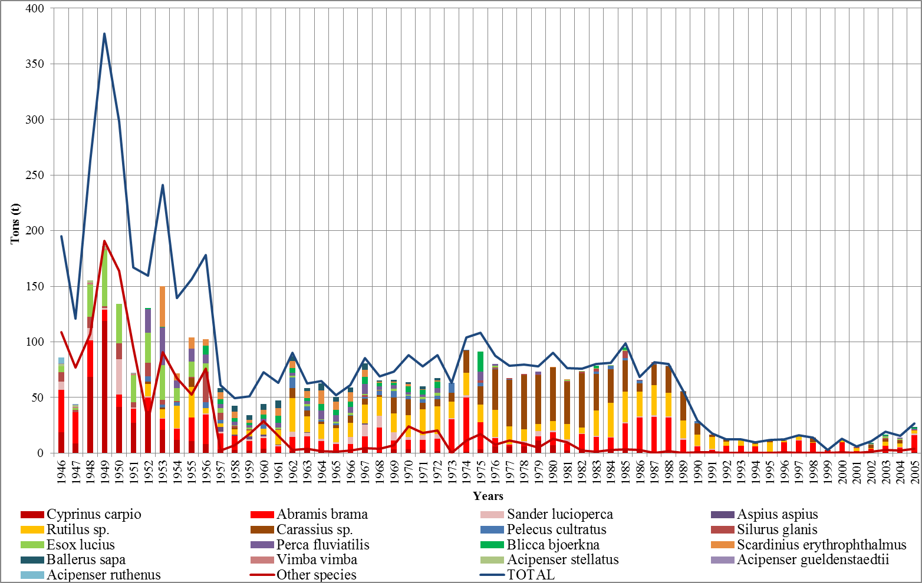
Dynamics of Industrial Fishing in Dniester River in the Territorial Limits of the Republic of Moldova (tons)
Dynamics of industrial fishing in Dniester river in the territorial limits of the Republic of Moldova (tons).

Slide 30
Analysis and first results: water use
Analysis of water use in the Moldovan part of the Dniester River Basin (including the left bank) and in the Odessa Region in 1951–1980 and for the operational period (1990–2015):
analysis of the existing water supply and sewerage system, irrigation dynamics and further development; compilation and analysis of materials of annual reports 2-TP “water industry”
analysis of strategic documents and directives in the area of water supply, sewerage, water management of Moldova and Odessa Region of Ukraine.
problem analysis (dry years 2015, 2016; flood discharge in 1998, 2008; status of water intakes in Chisinau and Odessa)

Slide 31
Notes:
Annual Flow of the Dniester River, km3
High-water year
Low-water year

Slide 32
Notes:
Irrigation
Water supply

Slide 34
Annual Water Flow below the Dniester Reservoir
(effective Operation Rules)

Slide 35
Annual Flow of the Dniester River (Bender) and Water Use in the Basin in the Extremely Dry Year of 2007, mln. m³ (irrigation of 40 thou ha in Moldova)
Notes:
Annual flow of the Dniester River (2007)
Ecological release and water consumption (2007)
Ecological release

Slide 36
Some Long-Term Aspects of Domestic Water Use
Power generation from renewable sources; theoretical possibility of building power generating facilities in Moldova within the buffer reservoir
Guaranteed satisfaction of water demands, including irrigation, even during dry years. In the long term – highly profitable production of fruit, vegetables and other crops with the creation of a large number of new jobs. Even with the maximum possible consumption, the water volume in the reservoirs is sufficient for at least the next 50 to 70 years. This volume will have to be accumulated and, if possible, retained for irrigation of 550 thousand hectares.
At the same time, in summer periods, it is necessary to preserve the possibility of flood inflows to protect downstream agricultural lands from floods (in many villages, these lands are the only source of subsistence for people). In 1983, HPP also mitigated the effects of an accident in Stebnik.
Conceptually, all of the water use and irrigation indicators included in the rules must be maintained and ensured along with environmental requirements.

Slide 37
Situational Analysis at Chisinau Water Intake
Problem: from the 1980s of the last century and up to the present, on some days, according to the Operation Service of SA „Apă-Canal Chişinău”, the water intake of the main pumping station on the Dniester River operates at water levels significantly lower than the estimated ones.
Data source:
Archives of ACVAPROIECT, MOLDGIPROSTROY, Chisinaugorproekt, MOLDGIPROVODHOZ, ACVAPROIECT, Bender River Port, SA Apă-Canal Chişinău, Apele Moldovei, Direcţia Bazinieră de Gospodărire a Apelor, Soyuzvodkanalproekt (Minsk), GEOVANMAX.
Topographic-geodetic works in September - December 2016 to measure the depths of the Dniester River in its 8 sections, one-hour survey of the water level, vertical and horizontal positioning links to the state geolocation network points in the area of the Chisinau water intake.

Slide 38
Notes:
Layout plan
Scale - 1:5000

Slide 39
Notes:
LONGITUDINAL PROFILE OF THE DNIESTER RIVER (IN THE AREA OF A WATER INTAKE)
DYNAMICS OF CHANGES IN THE MINIMUM RIVERBED LEVEL
Legend:
Riverbed level 1968
Riverbed level 1994
Riverbed level 2002
Riverbed level 2006
Riverbed level 2016
Water mark level where Q=120 m3/s
Water mark level where Q=80 m3/s

Slide 40
Notes:
Dynamics of Changes in the Riverbed Level and Water Mark Level in the Area of the Main Pumping Station
Years Riverbed Level Water Mark Level Where Q = 80 m3/s Water Mark Level Where Q=120 m3/s

Slide 41
Next Steps
Hydrology
Additional analysis of the operation period: after the launch of HPP-1 and the operation of the HPP-2 reservoir in a buffer mode without the operation of HPP-2; after the launch of HPP-2 (1999 - 2002) and before the launch of the PSPP (1st unit - late 2009); modern period (2012 - 2018) after the commissioning of the upstream reservoir of PSPP.
If possible, analysis of diurnal operation mode and water flow below HPP-2.
Detailed analysis of the water balance of HPP-1 reservoir for the years of its operation and of the modern water balance below the HPP-2 reservoir.
Hydrochemistry
Full analysis of available data
Exploring the possibility of analysing additional indicators (organic matter)
Exploring the possibilities of using data from the Dniester-3 project expedition

Slide 42
Next Steps
Hydrobiology and Riparian Ecosystems
Full analysis of available data, including using EU methods
Data collection, coordination of methods and analysis of the status of ichthyofauna and avifauna
Systematisation of information on the status of the Dniester flood lands, overgrowing of the Dniester
Water Use
Continuation of the analysis of the water supply system, strategic documents, challenges, systematisation of information and conclusions
Collection and analysis of data on water use in Odessa Region
General
Summarising and presenting a summary of the analysis of various subgroups
Preparation and submission of recommendations (including regarding filling data gaps)

