Slide 1
Brief Overview of the Operation Rules for the Dniester Hydropower Complex (HPP and PSPP Dniester Cascade) with Buffer Reservoir NHL of 77.10 M

Slide 2
Introduction
The development of new Rules (the previous ones were issued in 1987) was necessitated by changes in the water situation:
- construction of the Dniester PSPP, which uses an off-stream storage reservoir on the right bank of the Dniester River as an upstream reservoir and a buffer storage reservoir of the Dniester HPP-1 as a downstream reservoir;
- change of the design parameters and modification of the buffer reservoir operational modes: with NHL equal to 77.10 m, the operational mode began to depend on water discharges from not only HPP-1, but also PSPP when operating in the pump and turbine modes;
- specification of hydrologic parameters due to the prolongation of the Dniester river calculated discharge parameters in years (from 90 years’ period, 1895/96 – 1984/85, to 118 years's period, 1895/96 – 2013/14);
- accumulation of experience in actual operation of the Dniester reservoir and HPP-1 during the period of 1987 – 2016;
- taking into account the modern water engineering and environmental requirements for the operational modes of the Dniester cascade reservoirs.

Slide 3
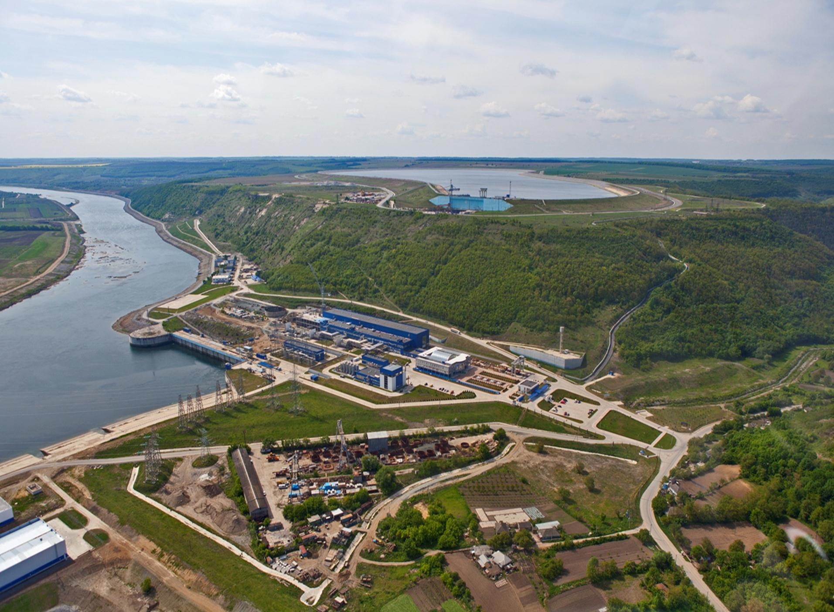
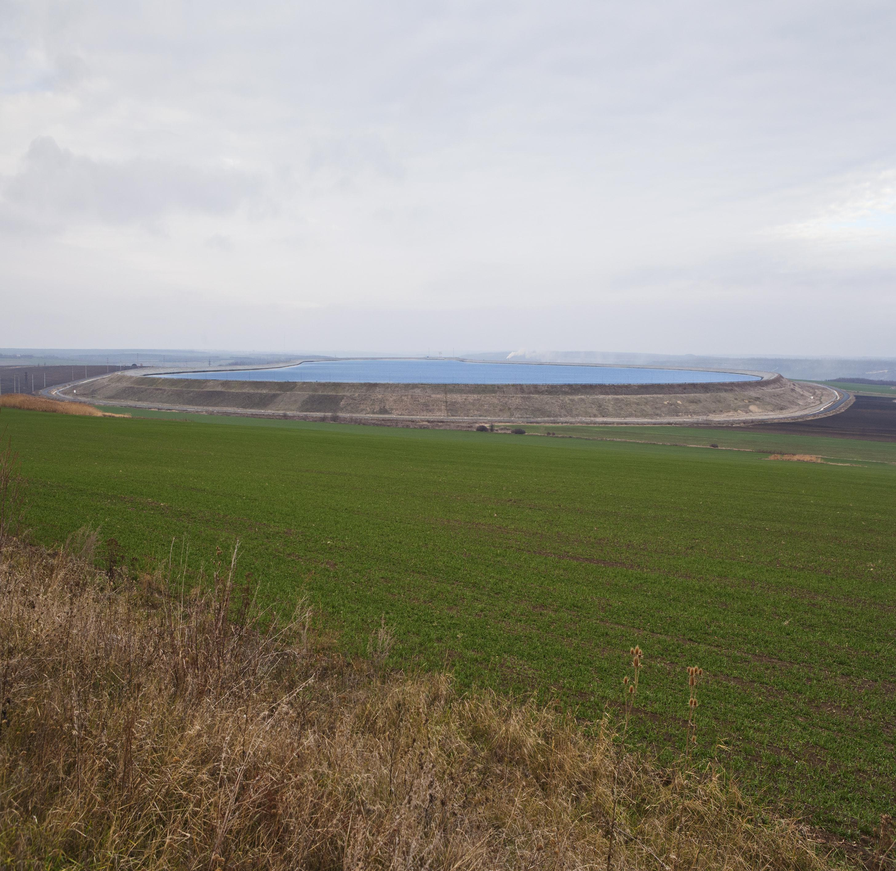
One of the main issues addressed by the Rules is the most effective use of the Dniester cascade reservoirs with minimal impact on the environment of adjacent areas.
The operation of the Dniester cascade reservoirs depends on both the basic technical parameters set at the project design stage and on the formation of the Dniester River water regime above the cascade.

Slide 4
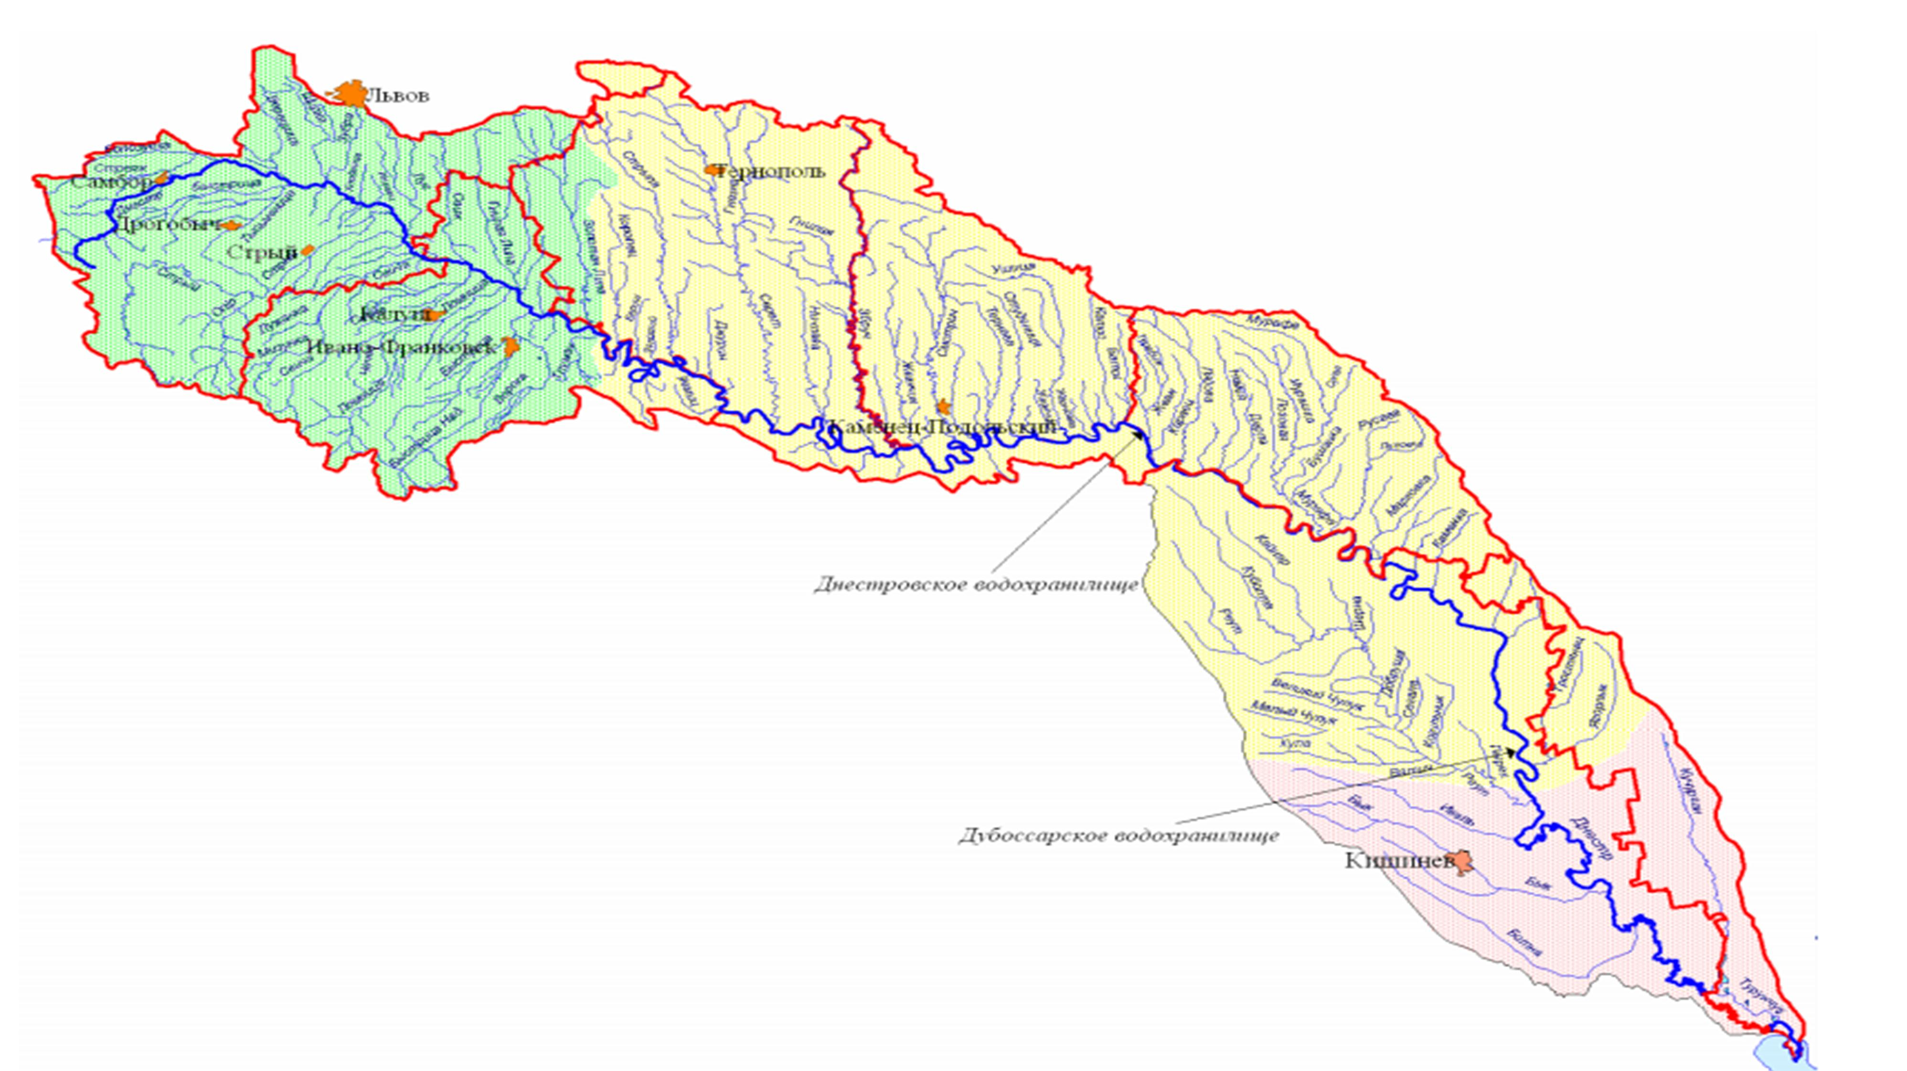
By the conditions of alimentation and water regime formation, the Dniester basin is divided into three parts:
- an upper part is located on the north-eastern slopes of the Carpathians where its right-bank tributary
- the Bystritsa River flows into the Dniester. The densest and water-abundant network is located there, giving about a half of the river flow;
- a middle part is located on the Volhynian-Podolian and Bessarabian Uplands – before the Reut River enters into it. At this site the basin is divided by numerous low-water tributaries, with groundwater playing a significant role in the river alimentation;
- the basin’s lower Black Sea part is characterised by weakly developed river network and unfavourable conditions for surface runoff formation.

Slide 5
The HPP and PSPP Dniester cascade is located in the middle part of the Dniester basin.
The main tasks of the Dniester cascade reservoirs are:
- reducing the negative impact of harmful water effects by using the flood control facility of the Dniester reservoir;
- ensuring compensational releases for water supply, irrigation and navigation at the Dniester section from the Dniester hydropower complex to the river mouth;
- power generation at HPP-1, HPP-2 and PSPP.
The Dniester reservoir is the main flow regulator. It ensures seasonal, weekly and daily regulation solving the following tasks:
— reducing the negative impact of harmful water effects;
— ensuring compensatational releases for municipal and industrial water supply, ecological releases for irrigation, navigation in the downstream Dniester part up to the mouth;
— power generation at HPP-1.

Slide 6
Based on long-term observations at hydrological stations (starting from 1985), the table shows average monthly observed natural water discharge in the Dniester River below 100 m3/s by year, month.
No., | Year | Average monthy observed water discharge below 100m³/s in the Dniester River at Dniester HPP-1
 |  | January | February | July | August | September | October | November | December
1 | 1900-1901 | 51.5 | 86.4
2 | 1903-1904 | 80.2
3 | 1904-1905 | 71.5 | 82.4
4 | 1905-1906 |  |  |  |  | 83.0
5 | 1908-1909 |  | 87.0
6 | 1911-1912 |  | 81.1
7 | 1917-1918 |  |  |  |  |  | 88.0 | 90.0
8 | 1919-1920 |  |  |  |  |  | 89.0
9 | 1920-1921 |  |  |  |  |  | 66.9 | 72.5
10 | 1921-1922 | 64.5 | 66.8 |  |  |  | 55.3 |  | 64.5
11 | 1923-1924 |  | 89.0
12 | 1924-1925 | 33.6 |  |  |  |  | 76.0 | 58.1 | 42.8
13 | 1928-1929 | 67.0 | 61.0
14 | 1929-1930 | 82.0 | 68.0
15 | 1930-1931 | 66.0 | 60.0 |  |  | 76.0
16 | 1931-1932 |  | 51.1 |  |  |  |  |  | 80.7
17 | 1932-1933 | 38.6 | 56.0 |  |  |  |  |  | 94.6
18 | 1933-1934 | 70.2 | 73.8 |  |  |  |  |  | 73.8
19 | 1934-1935 | 56.0 | 64.0
20 | 1935-1936 |  |  |  |  |  |  | 59.5 | 70.4
22 | 1936-1937 | 76.0
21 | 1939-1940 |  |  |  |  | 74.0
22 | 1942-1943 |  |  |  |  | 78.0 | 88.0
23 | 1943-1944 |  |  |  | 74.0 | 74.0 | 64.0 |  | 93.0
24 | 1945-1946 |  |  |  |  |  |  |  | 88.0
25 | 1946-1947 | 43.0 | 54.0 | 85.0 | 65.0 |  | 65.0 |  | 84.0
26 | 1950-1951 |  |  | 77.1 | 91.7 | 62.0
27 | 1951-1952 |  |  |  |  |  |  | 84.0 | 84.4
28 | 1952-1953 |  |  |  | 70.8 | 76.0
29 | 1953-1954 | 62.9 | 55.5 |  |  |  |  |  | 93.9
30 | 1954-1955 |  |  |  |  | 85.6 | 91.2 | 96.2
31 | 1957-1958 |  |  |  |  |  | 85.6 | 87.3
32 | 1959-1960 |  |  |  |  |  | 50.3
33 | 1961-1962 | 87.6 | 61.3 |  |  |  | 30.4 | 59.5 | 56.2
34 | 1962-1963 |  |  |  |  |  | 57.6 | 86.2
35 | 1963-1964 |  | 68.4 |  |  | 87.7 | 60.2 | 86.6
36 | 1965-1966 |  |  |  |  |  | 82.2
37 | 1966-1967 |  |  |  |  |  | 94.3
38 | 1967-1968 |  |  |  |  |  | 76.7
39 | 1969-1970 |  |  |  |  |  | 72.5
40 | 1973-1974 |  |  |  |  |  | 85.2 | 96.4
41 | 1986-1987 | 68.0 |  |  |  |  |  |  | 82.3
42 | 1990-1991 |  |  |  | 93.8
43 | 1994-1995 |  | 98.7 |  | 93.1
44 | 1995-1996 |  |  |  | 91.2

Slide 7
As can bee seen from the table below, after the commissioning of the Dniester HPP-1, the regulated water flow does not fall below 97 m³/s. If we add lateral inflow of 3 m3/s in the buffer reservoir section, we can see that the observed minimum average monthly flow below the Dniester cascade was not less than 100 m³/s .
Year / | month | III | IV | V | VI | vn | VIII | IX | X | XI | XII | I | II | Average
1983 | 1984 | 277 | 378 | 319 | 354 | 271 | 268 | 168 | 164 | 110 | 110 | 140 | no | 223
1984 | 1985 | 123 | 413 | 337 | 335 | 435 | 223 | 159 | 109 | 114 | 115 | 111 | no | 216
1985 | 1986 | 253 | 426 | 440 | 395 | 246 | 167 | 206 | 179 | 177 | 288 | 262 | 129 | 265
1986 | 1987 | 193 | 321 | 195 | 208 | 219 | 228 | 142 | 100 | 97 | 111 | 113 | 115 | 170
1987 | 1988 | 97 | 322 | 269 | 249 | 211 | 215 | 148 | 101 | 97 | 115 | 222 | 182 | 186
1988 | 1989 | 282 | 418 | 219 | 478 | 264 | 177 | 403 | 194 | 113 | 218 | 188 | 145 | 258
1989 | 1990 | 192 | 198 | 807 | 426 | 222 | 199 | 319 | 219 | 139 | 281 | 129 | 145 | 274
1990 | 1991 | 133 | 136 | 230 | 187 | 209 | 210 | 174 | 122 | 97 | 121 | 118 | 119 | 155
1991 | 1992 | 97 | 133 | 289 | 452 | 329 | 405 | 157 | 373 | 278 | 138 | 137 | 169 | 247
1992 | 1993 | 255 | 310 | 250 | 220 | 245 | 258 | 175 | 127 | 532 | 211 | 180 | 148 | 243
1993 | 1994 | 339 | 399 | 220 | 210 | 304 | 230 | 416 | 247 | 183 | 253 | 239 | 185 | 269
1994 | 1995 | 305 | 231 | 223 | 328 | 218 | 217 | 148 | 98 | 97 | 119 | 116 | 113 | 185
1995 | 1996 | 212 | 387 | 301 | 234 | 247 | 229 | 153 | 108 | 97 | 117 | 116 | 117 | 193
1996 | 1997 | 97 | 850 | 416 | 197 | 196 | 199 | 395 | 353 | 211 | 216 | 151 | 252 | 293
1997 | 1998 | 251 | 343 | 497 | 406 | 314 | 367 | 209 | 325 | 222 | 347 | 393 | 377 | 338
1998 | 1999 | 246 | 557 | 500 | 800 | 748 | 322 | 244 | 433 | 513 | 211 | 291 | 249 | 426
1999 | 2000 | 879 | 725 | 377 | 277 | 267 | 225 | 204 | 232 | 165 | 282 | 163 | 475 | 355
2000 | 2001 | 379 | 755 | 214 | 201 | 194 | 206 | 143 | 101 | 97 | 111 | 115 | 234 | 228
2001 | 2002 | 356 | 266 | 187 | 602 | 519 | 387 | 402 | 276 | 305 | 187 | 295 | 503 | 356
2002 | 2003 | 378 | 311 | 227 | 317 | 209 | 210 | 220 | 388 | 268 | 134 | 142 | 132 | 245
2003 | 2004 | 501 | 388 | 217 | 174 | 156 | 177 | 133 | 97 | 97 | 110 | 111 | 312 | 206
2004 | 2005 | 333 | 198 | 196 | 219 | 221 | 319 | 185 | 250 | 285 | 229 | 176 | 142 | 230
2005 | 2006 | 444 | 508 | 510 | 346 | 138 | 326 | 181 | 229 | 127 | 162 | 147 | 110 | 270
2006 | 2007 | 309 | 868 | 330 | 615 | 275 | 282 | 217 | 184 | 230 | 142 | 231 | 338 | 333
2007 | 2008 | 338 | 149 | 203 | 165 | 198 | 194 | 296 | 274 | 262 | 250 | 203 | 228 | 230
2008 | 2009 | 329 | 522 | 395 | 194 | 1025 | 412 | 407 | 441 | 187 | 260 | 278 | 371 | 403
2009 | 2010 | 456 | 613 | 200 | 341 | 243 | 194 | 154 | 131 | 242 | 220 | 222 | 182 | 266
2010 | 2011 | 482 | 361 | 558 | 854 | 873 | 278 | 259 | 234 | 197 | 378 | 376 | 218 | 424
2011 | 2012 | 252 | 249 | 207 | 189 | 399 | 340 | 154 | 124 | 107 | 167 | 125 | 128 | 204
2012 | 2013 | 310 | 285 | 199 | 261 | 198 | 194 | 154 | 100 | 97 | 113 | 111 | 228 | 187

Slide 8
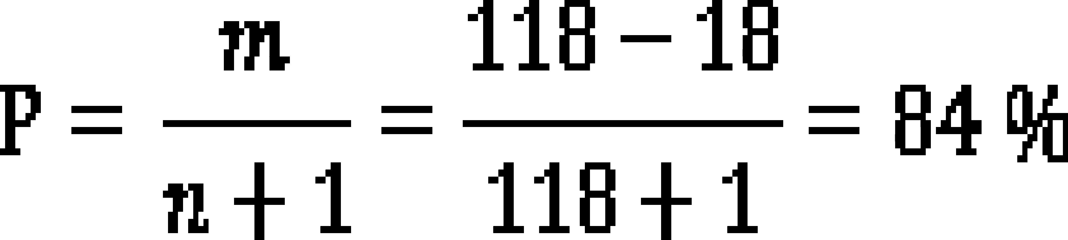
When the new version of the Rules was being agreed on, the necessity of increasing the minimum average daily flow from 100 m3/s to 130 m3/s was voiced many times.
As a result of the water and energy balance calculations of discharge parameters for the 118 years’ period, deviations (years in which the water discharge was less than 130 m³/s during one or more months) were observed in 18 years, namely: 1897/98; 1899/1900; 1908/09; 1918/19; 1919/20; 1927/28; 1938/39; 1943/44; 1950/51; 1951/52; 1958/59; 1961/62; 1963/64; 1964/65; 1968/69; 1972/73; 1983/84; 2005/06.
The exceedance probability by number of uninterupted years with a water discharge of 130 m3/s will be as follows:
Where:
m – the number of years in the series of observations, excluding the years of deviation
n – the number of years in the series of observations.

Slide 9
During a summer-autumn period, Dniester reservoir operates in the mode of compensating releases, which are made to provide water to Dniester users located downstream up to the mouth. The values of the compensating releases are approved by the Interdisciplinary Commission depending on the anticipated water consumption, expected aggregated influx into the Dniester reservoir and intermediate inflow volume in the section between the Dniester cascade and the Dniester mouth. Average monthly compensating releases with various probability are presented in the table.
Indicator | Value
Average monthly compensating release, m³/s:
- 99 % exceedance robability; | 100
- 95 % exceedance robability; | 104
- 90 % exceedance robability; | 108
- 84 % exceedance robability; | 130
- 75 % exceedance robability; | 160
- 50 % exceedance robability; | 213
- 25 % exceedance robability; | 281
- 16 % exceedance robability; | 344

Slide 10
The creation of the Dniester reservoir has made it possible to reduce flood damage by controlling floods.
Floods on the Dniester caused full or partial inundation of settlements, agricultural land, roads, communication lines and other economic facilities. To reduce floods, a flood control facility of 570 mln.m3 capacity is used in the reservoir. It is located in the prism between the marks of NHL=121.0 m and TSS =125.0 m. The flow regulation in case of floods is carried out according to parameters provided in the table without taking into account forecasts:
Indicator | Flood frequency, %
 | 0.01 | 0.1 | 0.5 | 1 | 5 | 10 | 20 | 50 | 70
1 Maximum flow rate at Zalischyky gauging station, m³/s | 13260 | 8320 | 6000 | 5140 | 3400 | 2750 | 2130 | 1330 | 1000
2 Maximum flow discharge rate through the hydrosystem, m³/s | 13260 | 8320 | 5550 | 2600 | 2600 | 2600 | 2130 | 1330 | 1000
3 Maximum water level in the reservoir (near the dam), m | 125.0 | 125.0 | 125.0 | 125.0 | 122.0 | 121.1 | 121.0 | 121.0 | 121.0
4 Maximum flow reduction through regulation, m³/s
 | 0 | 0 | 450 | 2540 | 800 | 150 | 0 | 0 | 0
% | 0 | 0 | 7.5 | 49.4 | 30.7 | 5.5 | 0 | 0 | 0

Slide 11
Before the construction of the Dniester cascade, the following floods were observed in Mogilev-Podolsky: 1924/3280 m³/s, 1927/3340 m³/s, 1932/4400 m³/s, 1941/7480 m³/s, 1969/4820 m³/s, 1980/3530 m³/s.
As an example, on 19 June 1998, a water level in the Dniester reservoir was 120.96 m. When a flood routing took place, the reservoir water level was heightened to 122.8 m. Water inflow increased from 647 m³/s on 18 June to 4250 m³/s on 21 June. According to the data provided by HPP-1, maximum water discharge was 2120 m³/s on 24 June. At the entrance of the river to the territory of the Republic of Moldova, the maximum discharge was 2120 m³/s.
The highest flood discharge passing through the Dniester cascade was in 2008. The water inflow was 5220 m³/s on 27 June (whereas the forecast of water inflow for 28 June was 6000 m³/s), and water discharge was about 3330 m³/s.
The examples above show that the Dniester cascade is of tremendous importance for the population in the riverside area.

Slide 12
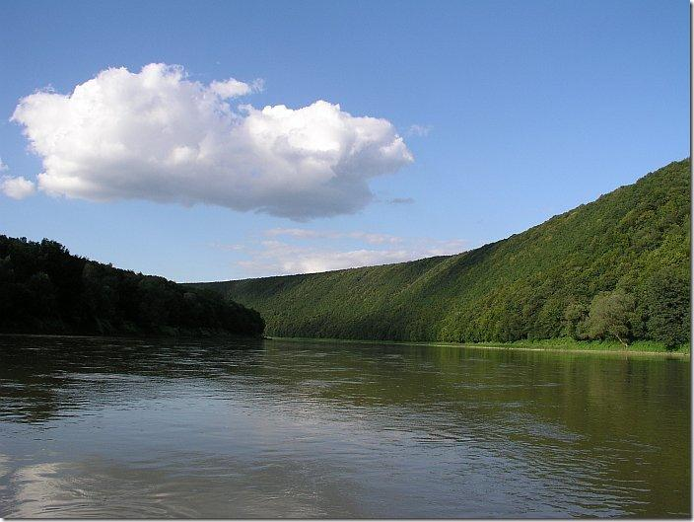
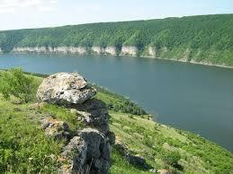
In connection with the commissioning of the Dniester PSPP and changes in the buffer reservoir parameters, the safe operation of the Dniester hydropower complex requires the approval of these Rules, which provide the most important principles for expedient operation of water reservoirs of the Dniester HPP and PSPP cascade with considering the interests of water users and with adhering to environmental requirements and ensuring trouble-free operation of hydrosystem facilities as well as population safety in the riverside area.
Thank you for your attention!

