Slide 1






GEF Project “Enabling transboundary co-operation and integrated water resources management in the Dniester River Basin”:
10 months’ work results
(November 2017 – September 2018)
1st Meeting of the Dniester Commission
Chisinau, 17 September 2018
Tamara Kutonova, OSCE, Regional Project Coordinator

Slide 2
Structure of Project+
3 Components
TDA (diagnosis), Black Sea, nutrients, water balance, climate change
SAP, bilateral groups and basin councils, twinning, and hydropower (water distribution)
Monitoring, data exchange, floods, demo projects, awareness raising
Project duration – 3 years
Actual project start – November 2017.

Slide 3
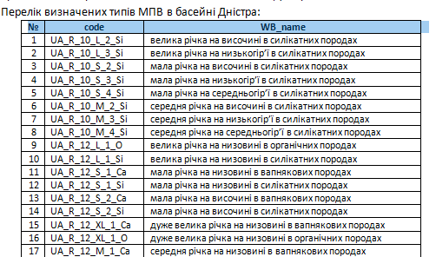
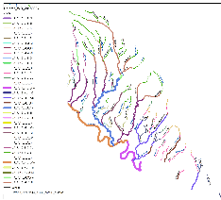
Transboundary
Diagnostic Analysis (TDA)
National and transboundary levels – WFD
Identification, typology
In Moldova, surface water body types have been identified for the entire Dniester and its tributaries with an area of more than 1,000 km². At present, the river is divided into 21 sections grouped into 11 types, and a typological division of smaller basins has been initiated.
In Ukraine, 916 surface water bodies for 420 rivers of the basin (out of 488 rivers, i.e., 86%) and 32 types of surface water bodies have been delineated (with more likely to appear)
Groundwater - almost all maps have been constructed (based on the maps from the Water Resouces Agency), all 8 (MD) and 11 (U) arrays are highlighted, with their desciptions being prepared, and long-term information on water use has been collected, with hydrological peculiarities. Overall area – Sarmat in the south

Slide 4
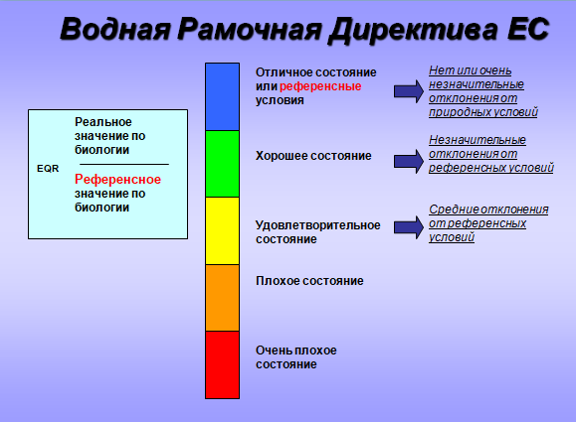
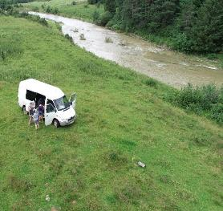
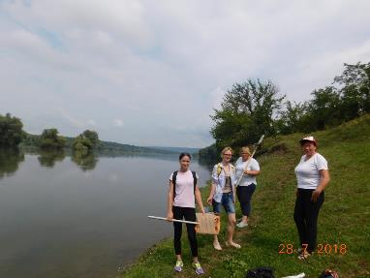
2) Reference conditions - conditions that could exist where there is no anthropogenic impact
Over 40 basin sections that are 100 to 1,000 m long have been surveyed in the Carpathian ecoregions, the Eastern Plains and the Pontic province, presently – the lower reaches of the Dniester River and the Yagorlyk tributary
Survey: algae, higher aquatic plants, invertebrates, fish, dissolved О₂ content, t, transparency, pH, salinity, salt composition, electrical conductivity, nutrients, organic substances)

Slide 5
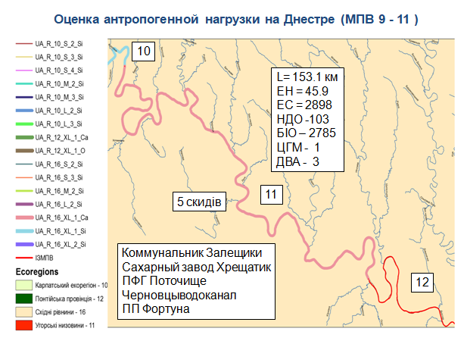
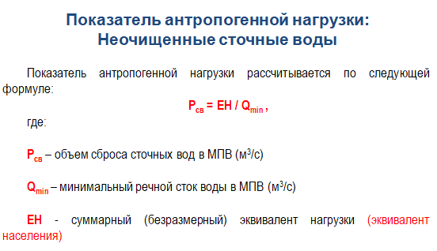
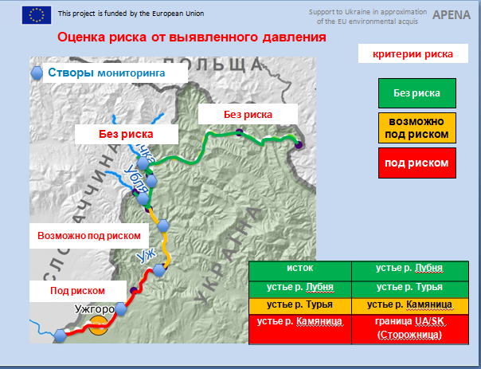
3) Main Types of Anthropogenic Loads and Their Effects
=>
=>
=> Ecological goals
Notes:
Anthropogenic load:
Untreated wastewater
The anthropogenic load is calculated according to the following formula:
Where
Pcs - wastewater discharge to groundwater (m3/s)
Qmin – minimum river flow to groundwater (m3/s)
EH – total (dimensionless) load equivalent (population equivalent)

Slide 6
Diffuse Pollution
(Nitrates Directive)
Identification of nitrate sensitive areas
Coordinated common / bipartite load and risk estimation methodology
Data collection for the analysis (proportion of the population not connected to sewage system, livestock number, soil types)
River basin area delineation / mapping

Slide 7
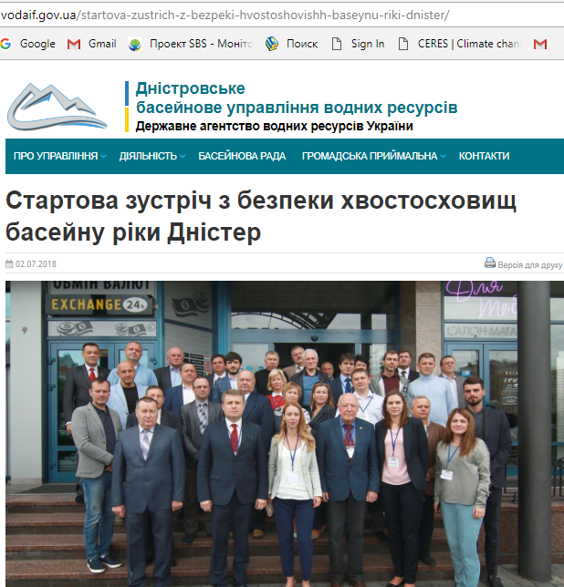
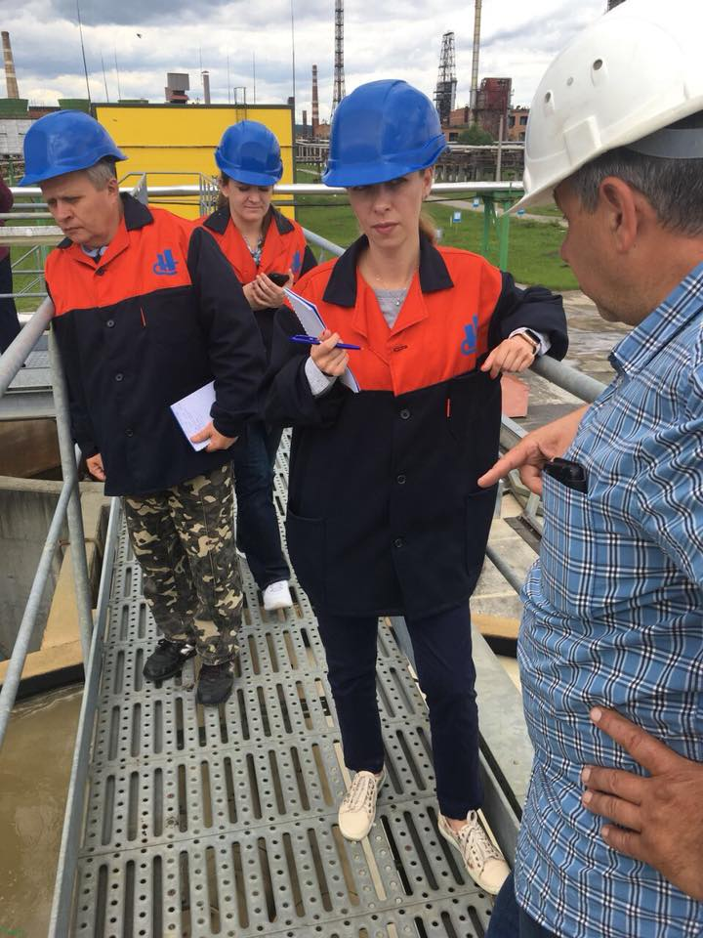
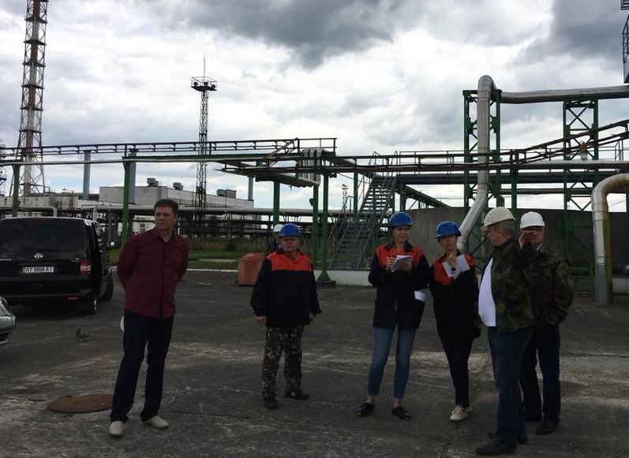
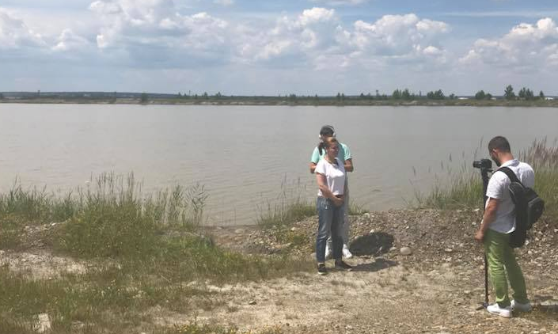
Inventory of Tailing Dumps
Start meeting (Ivano-Frankovsk, 2 July)
Visit to enterprises / tailing dumps:
Neftekhimik-Prikarpattia - 1 (Nadvirna)
Burshtyn TPP - 4 (Burshtyn)
Oriana-ECO- 3 (Kalush)
Stebnik Mining Chemical Enterprise Polimineral - 1 (Stebnik)
Razdol Mining Chemical Enterprise Sirka - 3 (Novy Razdol)

Slide 8
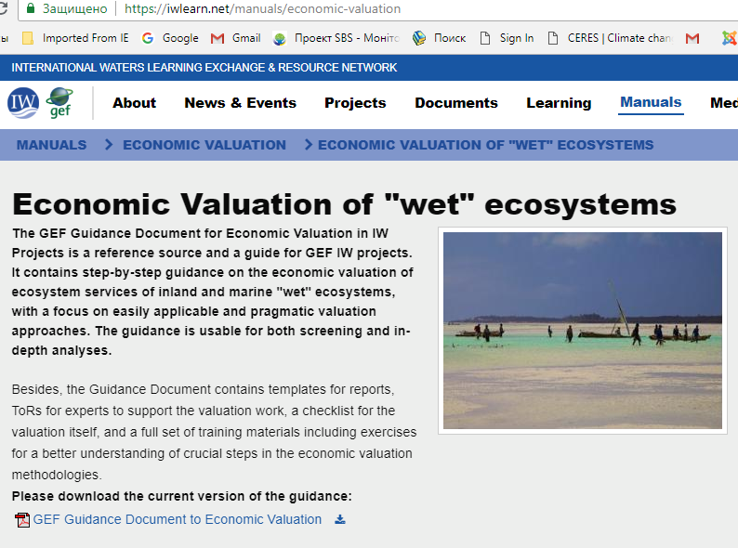
Economic Considerations
Economic analysis of water use
Economic valuation of ecological services

Slide 9
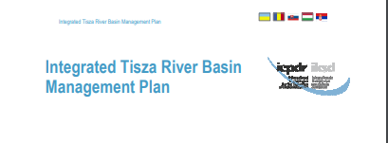
TDA: Content and Time Frame
Final TDA
60 pages of the main text, concise and focused on presentation of results
About 15 maps
Tisza RBMP style
Draft TDA will be ready for the second meeting of the Project Steering Committee (18 December 2018)
Follow-up work at the national level will continue until March 2019.

Slide 10
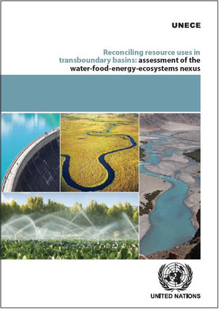
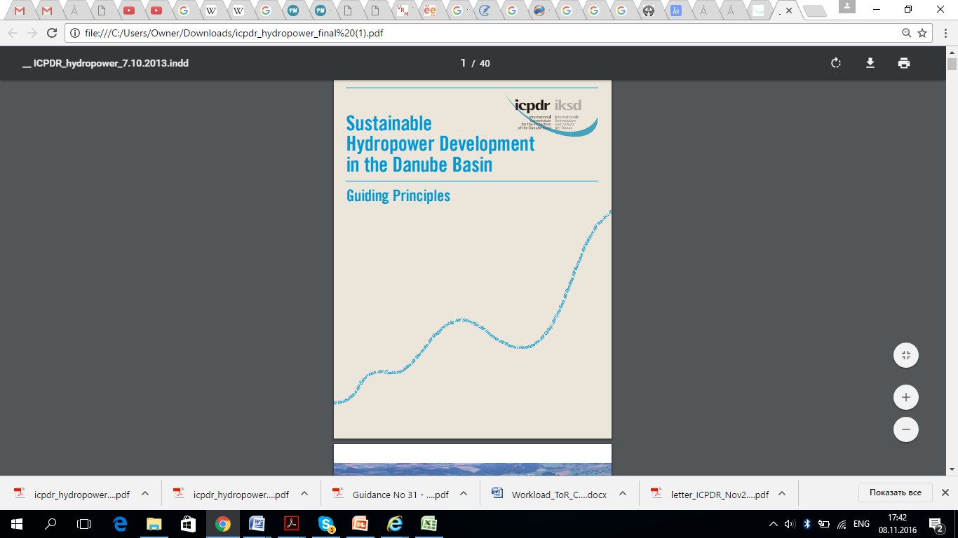
Hydropower
Objectives
Assessment of the impact of hydropower complex on ecosystems
Recommendations on the updated draft Reservoir Operation Rules
Platform for discussing a HPP cascade plan for the Upper Dniester
Preliminary results for 1 and 2 will be presented today
Support
UNECE
ICPDR
Albufeira Convention

Slide 11
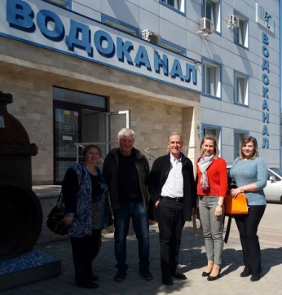
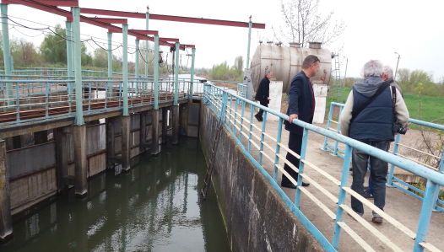
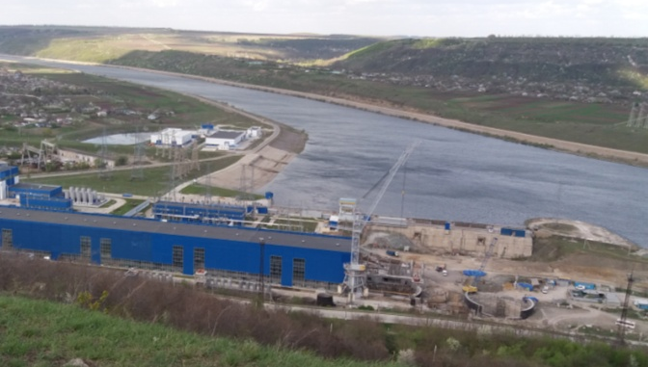
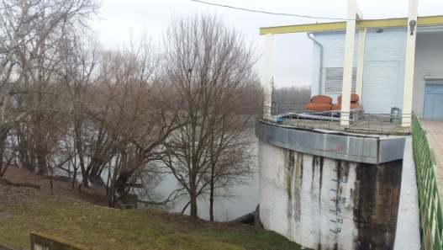
Reservoir Operation Rules
Meetings:
Water Resources Agency in Odessa Region
Infoxvodokanal and Apa-Canal Chisinau (+water intakes)
HPP-1, HPP-2, PSPP, Dubasari HPP
Ukrhydroenergo and Ukrhydroproject
Lower Dniester National Natural Park
Odessa State Ecological University
Eco-TIRAS, NECU, NGO Black Sea Women's Club, Ecoclub Kray
Apele Moldovei
Moldovan Hydromet
Aquaproject Research Institute
Draft rules uploaded at UHE website on 20 April - for commenting within a month
Comments
MD authorities (integrated)
Odessa Oblast Water Resources Agency
Eco-TIRAS
Infoxvodokanal
Lower Dniester NNP
Tiraspol
NECU

Slide 12
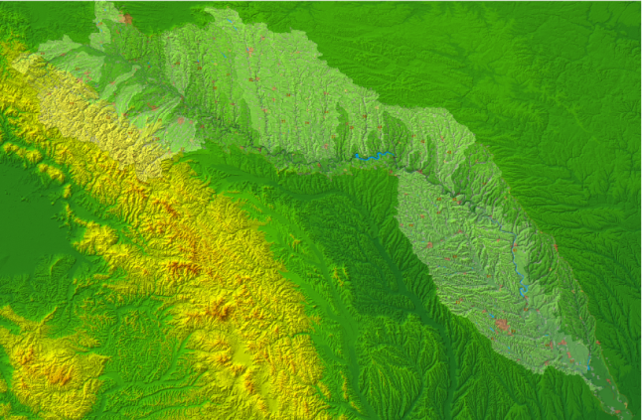
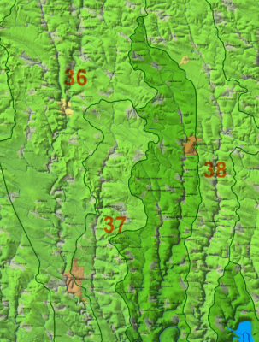
Determination of the Current and Future
Water Balance
Updated (18 sections) and detailed zoning (39 sections) has been developed
System interface has been approved
Virtually all data have been collected (including for the runoff map)

Slide 13
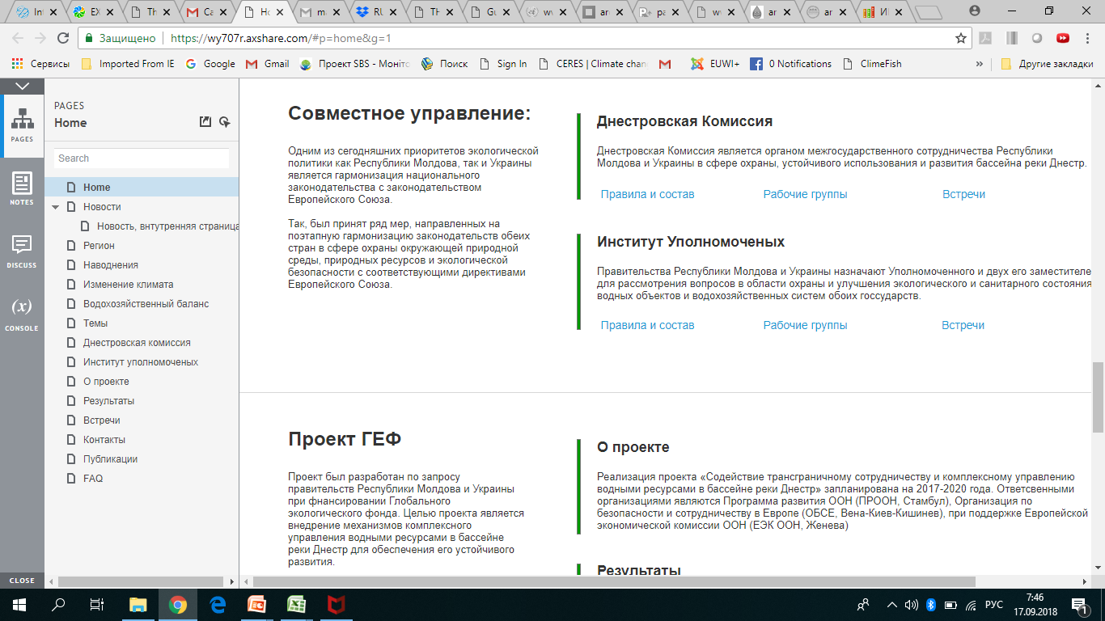
Joint Management Bodies
Dniester Commission:
- Preparatory (05.04.2018) and first (17.09.2018) meetings
- Preparation of draft documents
Support of country basin councils
Study tour to Spain and Portugal (19-23.11.2018)
Website

Slide 14
Floods Directive
Consultations were held regarding the implementation of the Directive in Ukraine with the Interagency Commission on the Directive and the project “Support to Ukraine in Approximation of the EU Environmental Acquis”
Terms of reference were developed to carry out a preliminary flood risk assessment in Ukraine (time frame – October 2018 to March 2019)
Moldova's Directive-related needs were discussed
Dniester reservoir inflow forecasting
Consultations were held with Ukrhydromet and preliminary terms of reference were developed for improving the Dniester reservoir inflow forecasting system

Slide 15
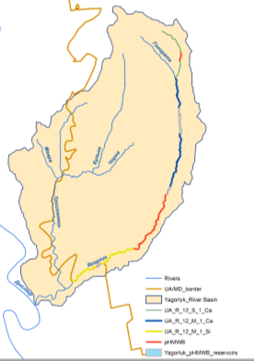
Demo Projects
1) Ecological restoration of Yagorlyk
Overall river restoration stages were analysed
The first meeting was held, with preliminary developments on Yagorlyk presented as part of the TDA
Further steps, by the end of 2018:
  General field study of the basin
  selection of a section for renaturalisation jointly with the
  stakeholders
  more detailed analysis of the selected section
  (Tentatively - lower reaches of Yagorlyk, including
  a section bordering with Moldova (
  Transdniestria).
  2) Knowledge improvement, improvement of
  Cooperation and pilot projects on fish
  Biodiversity in MD-UKR lower reaches of the Dniester River

Slide 16
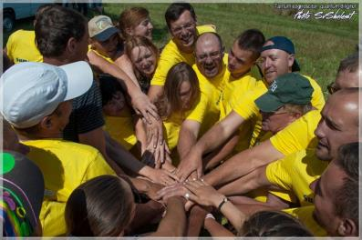
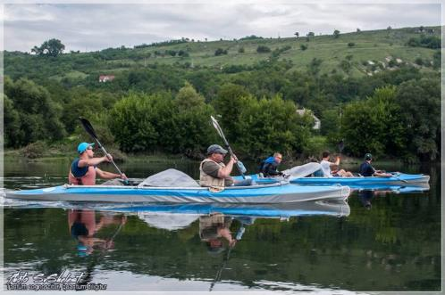
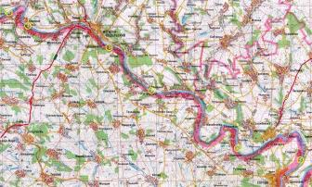
Awareness Raising
Dniester Youth Summer School and expeditions along the Dniester (July 2018) – students, school teachers, NGOs and journalists from Moldova (including Transdniestria) and Ukraine

Slide 17
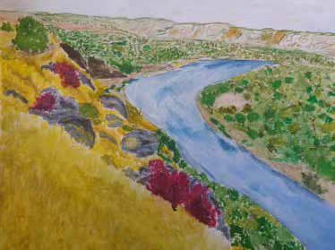


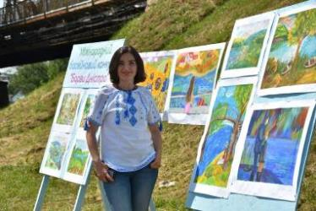
Contest “Colours of the Dniester”: (by 2017 and 2018)

Slide 18
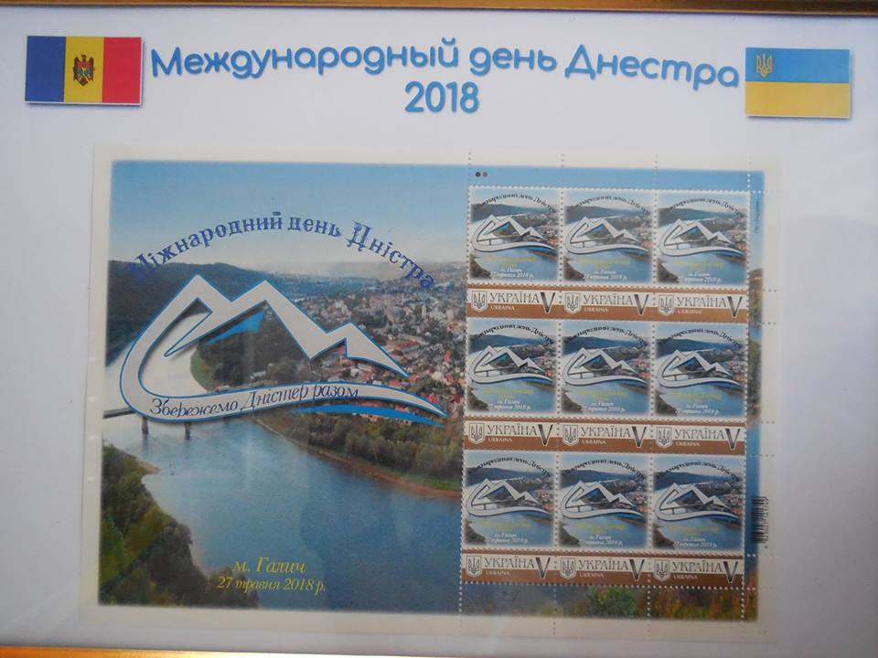
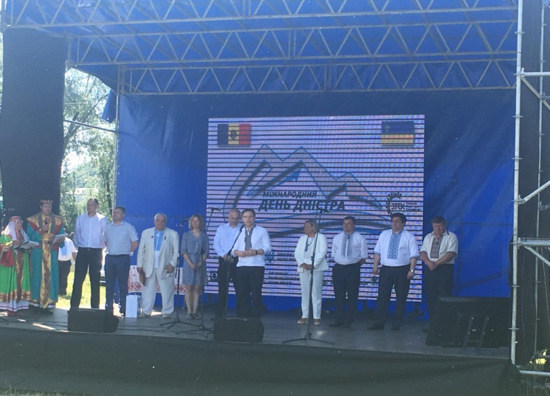
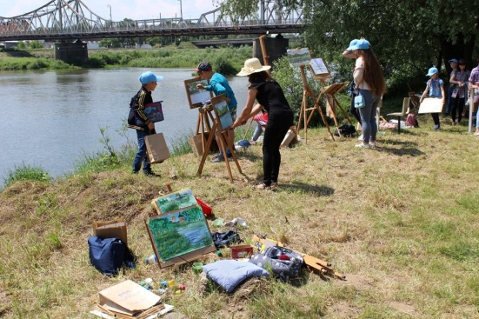
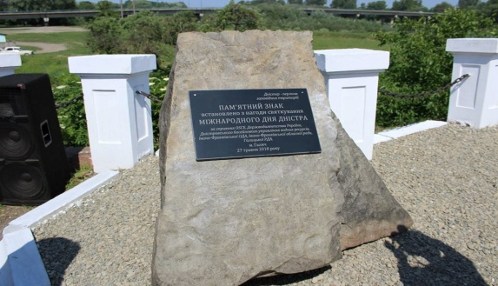
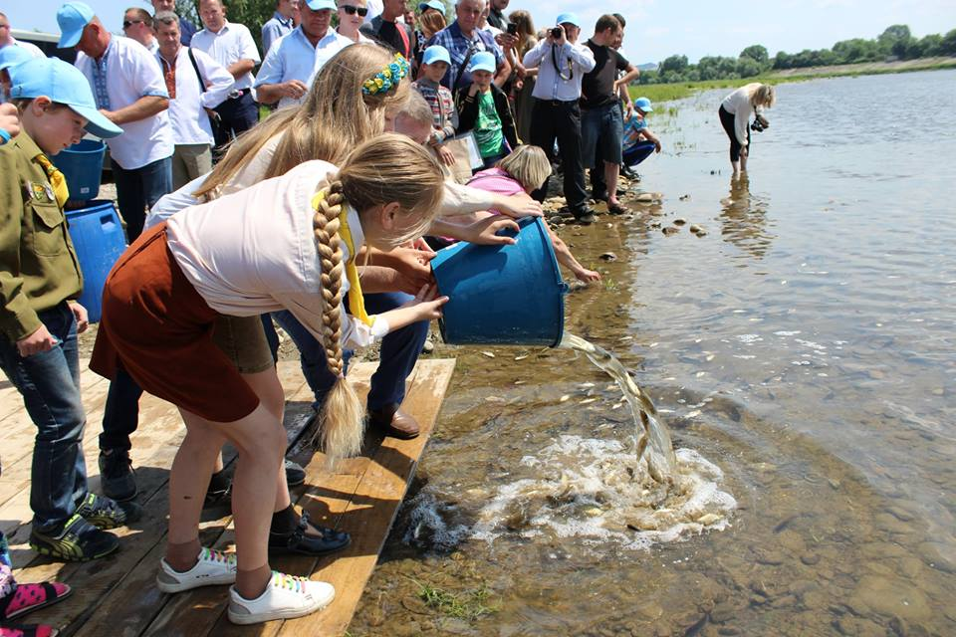
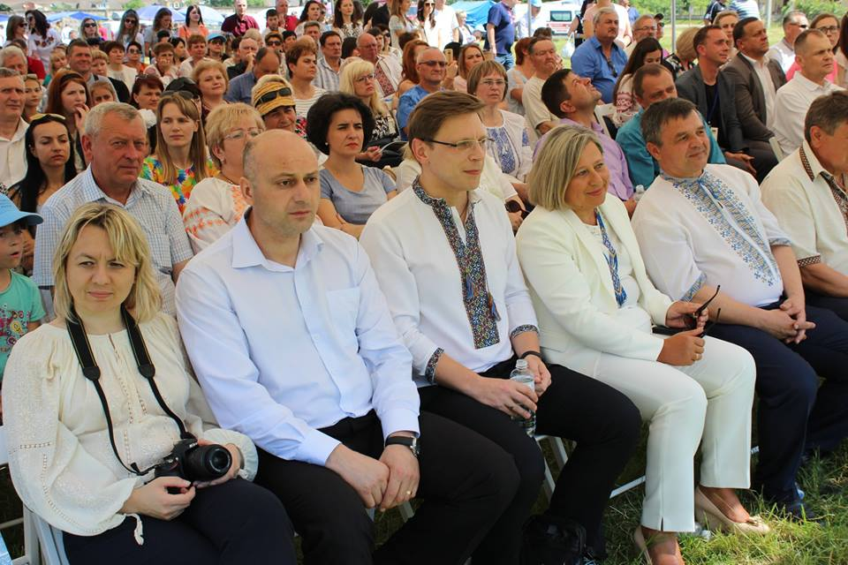
Dniester Day
In 2019+ - in July?

Slide 19
Project Meetings (Dec2017 – Sept2018)
First project kickoff workshop (Kiev, 18 December 2017)
First meeting of the Project Steering Committee (Kiev, 18 December 2017)
First meeting of the TDA Working Group (Chisinau, 15 March 2018)
First meeting of the Working Group on Hydropower in the Dniester Basin (Chisinau, 15 March 2018)
Working meeting of an expert group on analysis of the impact of Dniester HPP reservoirs on the Dniester basin status (Kiev, 18-19 June 2018)
Kick-off meeting to study the current status of tailing dumps of the Dniester River Basin (Ivano-Frankovsk, Ukraine, 2 July 2018)
Meeting of experts on development of TDA / elements of the joint Dniester RBMP (Kiev, 26 July 2018)
River restoration meeting (demo project, Kiev, 13 September 2018)
Second working meeting of an expert group on analysis of the impact of Dniester HPP reservoirs on the status of the Dniester (Chisinau, 15 14 September 2018)
First meeting of the Commission on Sustainable Use and Protection of the Dniester River Basin (Chisinau, 17 September 2018)

Slide 20
Project Meetings (up until the end of 2018)
11. Second meeting on tailing dumps (Kiev, late September – early October 2018)
12. First meeting of the basin council of the Ukrainian part of the Dniester River (Ivano-Frankovsk, Ukraine, October 2018)
13. Participation in GEF IW Learn Conference (Morocco, 3-8 November 2018)
14. Study tour on IWRM and implementation of the Albufeira Convention (Spain – Portugal, 19-23 November 2018)
15. Second meeting of the Project Steering Committee (Odessa, 18 December 2018)

Slide 21
Regular Consultations (stakeholder analysis / bulletin)
MD and UKR Environment Ministries MD and UKR water agencies MD and UKR Health Ministries MD and UKR Geological Services MD Fisheries Conservation Service Ukraine’s State Fishery Agency Ukrhydroenergo Dniester-Prut Basin Board on Water Management Odessa Oblast Ecology and Agriculture Administration Odessa Water Agency Odessa Regional Development Bureau Odessa Regional State Consumer Service Infox vodokanal RM Transdniestria regional authorities on ecology and agriculture, SES, hydromet | Lower Dniester National Nature Park Khotyn National Nature Park Dniester Canyon National Nature Park Ecological University (Odessa) Ternopol University Transnistria University Regional Integrated Ecomonitoring Center JugNIRO Hydrobiology Institute of the National Ukrainian Academy of Sciences (NUAS) NUAS Zoology Institute | Eco-TIRAS Regional Research Center NECU Eco-Spectr Biotica NGO Kray Mama-86 WWF Zoi Envir’t Network Euroregion Dniester Albufeira Convention Belhydromet Water Convention Secretariat WMO Sava Commission ICPDR Dniester Basin Council (Rzeszów, Poland) | UNDP (Istambul, MD, UKR) EU delegations to MD and UKR EU Apena Project FAO EBRD EPIRB EMBLAS EUWI+ OSCE (Vienna, MD, UKR) Nitrates Project (MD) MD Climatic Office ADA's / SDC's Water & Sanitation Project PPRD – East -2 Other GEF TDA / SAP Projects (Drina, Kura)

Slide 22
National Priorities and GEF Project
Dniester-GEF | Moldova |  | Ukraine
TDA | (Art. 5) WFD, Nitrates Directive
 | Dniester basin district MP | Mining Waste Directive
SAP | WFD, Nitrates Directive, for MD - Dniester basin district MP, Art. 11-13 of the Protocol on Water and Health
HydroQ | WFD, Strategic framework for adaptation to climate change in the Dniester basin and Implementation Plan, for MD - Dniester basin MP
Climate change adaptation plan / Lower Dniester |  |  | Strategic framework for adaptation to climate change in the Dniester basin and Implementation Plan
Floods simulation | Floods Directive
Flash floods forecast on tributaries | Floods Directive, Strategic framework for adaption to climate change and MP
DHPP inflow forecast | Floods Directive, Strategic framework for adaption to climate change and MP
Country and TG flood risk MP | Floods Directive, Strategic framework for adaption to climate change Dniester basin and Implementation Plan
Demo projects | EU Emerald Network, national ecological networks, MP for Ramsar sites and natural reserve areas, MD Biodiversity Strategy, environmental strategies
Awareness raising | Environmental strategy 2014-23 |  | Environmental strategy until 2020

Slide 23
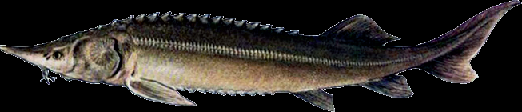
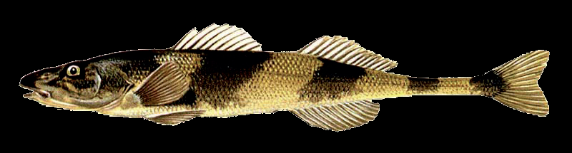
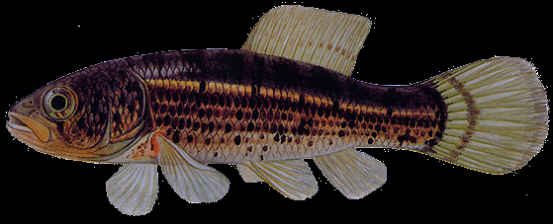
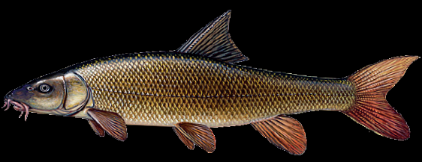
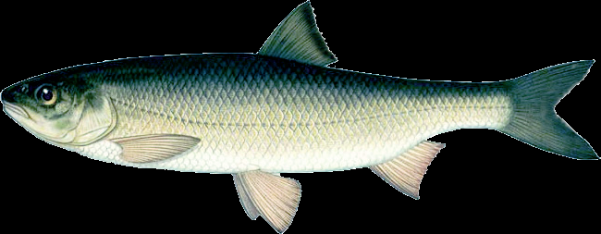
Flag species ?
Sterlet, Acipenser ruthenus
VU*, EN**
Rare streber, Zingel streber
VU*, CR-RE**, ▼
European mudminnow, Umbra krameri
EN*, CR**, ▼
Barbel,
Barbus barbus barbus VU
Black Sea roach, Rutilus frisii VU*, EN**

Slide 24
THANK YOU
FOR PARTICIPATION AND ATTENTION!

