Slide 1

New Regulations to Operate the Water Reservoirs of the HPP and PSPP Dniester Cascade
Comments on the Draft Document
Pedro Cunha Serra, Consultant

Slide 2
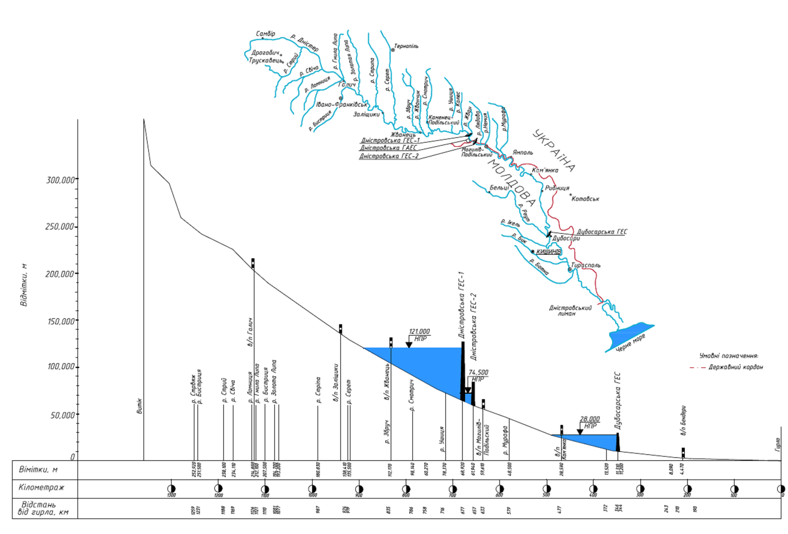
The Dniester cascade
The scope of the assignment is the evaluation of the draft Updated Regulations (UR) to Operate the Water Reservoirs of the HPP and PSPP Dniester Cascade, which consist of, from upstream to downstream, a dam equipped with a hydropower plant (HPP) and a large reservoir, Dniestrovski 1 HPP, a pump storage power plant (PSPP), Dniestrovskaya PSPP, and a second dam, Dniestrovski 2, also equipped with a HPP, the PSPP using the reservoir thus created between the two main dams as the downstream reservoir, also referred herein as the buffer reservoir.

Slide 3
Main tasks to be performed by the cascade
The main tasks that are to be performed by the cascade are described in the draft Regulations as follows:
  Flood control through using the flood control volume available in the Dniestrovski 1 reservoir;
  Power generation at HPP-1, HPP-2 and PSPP, HPP-1 and PSPP being the most valued power-stations as for energy production and HPP-2 being used for the creation of the buffer reservoir and reregulation of flows;
  Ensuring compensational releases for water supply, irrigation and navigation at the Dniester water-course from the cascade to the estuary;
  Ensuring the cascade’s environment conservation function through increasing the Dniester’s flows during abnormal dry periods by means of flow regulation, including spring environmental releases;
  Stable provision of water to the downstream settlements and industries.

Slide 4
The DCR is in position to fulfill all these tasks but some of these may result conflictive and so the Operation Rules are needed:
  Flood control may conflict with hydropower generation;
  It may also conflict with release of water for conservation, for water supply, irrigation and other uses;
The need to develop these new Regulations was caused by changes in water engineering situation:
Setting of the Dniestrovskaya PSPP seven unit operation for which the buffer storage reservoir of the Dniester HPP-1 is used as the downstream reservoir;
Change of the design parameters and modification of the buffer reservoir operational mode to the conditions of the PSPP seven unit operation when the buffer reservoir NHL will be heightened to 77.10 m;
Specification of hydrologic parameters due to the prolongation of the Dniester river calculated discharge parameters in years (from 90 years’ period, 1895/96 – 1984/85, to 119 years’ period, 1895/96 – 2013/14);
Accumulation of experience in actual operation of HPP-1 during the period 1987–2016;
Taking into account the modern water engineering and environmental requirements, namely the requirements in the EU directives, to the operational modes of the Dniester cascade reservoirs.

Slide 5
Characteristics of the Dniester Cascade
 |  | Units | Dniestrovski 1 HPP | Dnistrovskaya PSPP (upper reservoir) | Dnistrovskaya PSP (expansion) | Dniestrovski 2 HPP | Dniestrovski 2 (expansion)
Reservoir | NHL | (m) | 121 | 229,5 | 229,5 | 74,5 | 77,1
 | mwl | (m) | 102,5 | 215,5 | 215,5 | 67,6 | 67,6
 | HWL | (m) | 125 | - | - |  | 82
 | Useful volume | (mln m3) | 1907 | 11,45 | 32,7 | 23,4 | 31,8
 | Flood control volume | (mln m3) | 570 |  |  | 55,8 | 41,6
 | Crest elevation | (m) | 127 |  |  | 84 | 84
Power house | nr of groups | - | 6 | 3 | 7 | 3
 | Type of groups |  | Kaplan | Francis | Francis | Kaplan
 | Maximum equiped flow | (m3/s) | 1970 |  | 1890 | 471
 | Total instaled capacity (turbine mode) | MW | 702 | 972 | 2268 | 40,8
 | Total instaled capacity (pumping mode) | MW |  | 1263 | 2947
 | Energy produced | GWh/year | 896 | 1015 | 2720 | 94,5
Downstream of the cascade and already inside of Moldova can be seen Dubasary dam (1954) and reservoir. Dubasary is now benefiting from the regulation of Dniester’s flows produced by Dniestrovski 1 (1983) reservoir.

Slide 6
млн. м³ cub m | ПостройкаConstruction 154 | 1979 | 1982 | 2012
Полный объем(НПУ 28.00 м) / Full volume (normal level 28.00) | 485 | 307 | 266 | 261
Мертвый уровень Dead level |  |  | 108 | 98
Полезный объём Useful volume | 214 | 202 | 158 | 163
Заилено Silted |  | 178 | 219 | 224

Slide 7
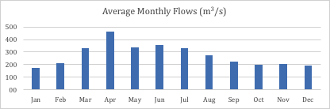
Hydrology of the Dniester river
The Dniester flows are being measured since long at a set of gauging stations located in the main course of the river and some of its tributaries. We selected the Mohyliv-Podilsky gauging station which is situated a few km downstream of the cascade and for which we have monthly data ranging from January 1950 to December 2010.
The figures show the importance of spring flows in the Dniester as the result of rainfall and snow melting, the low flows seasons being autumn and winter.

Slide 8
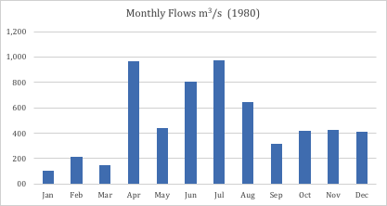
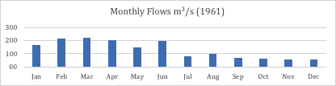
Hydrology of the Dniester river
Interannual irregularity of Dniester flows is of some importance, as can be seen here (1961, a very dry year, and 1980, a very wet year):
As for floods, flood peaks and flood volumes, as can be seen it is common to have floods with quite high peak flows and large volumes, as large as the whole useful capacity of Dniestrovski 1 reservoir (appr. 2,000 mln m³) or even greater, once every ten years in average, usually during spring and summer months.
Year | Starting in | Ending in | Maximum flow (m3/s) | Volume (mln m3)
1969 | Jun-11 | Jun-20 | 4,800 | 2,000
1980 | Jul-25 | Aug-04 | 3,530 | 2,000
1998 | Jun-20 | Jul-03 | 2,700 | 1,900
2008 | Jul-28 | Aug-06 | 4,510 | 3,000
2010 | Jun-26 | Jul-18 | 2,050 | 3,000

Slide 9
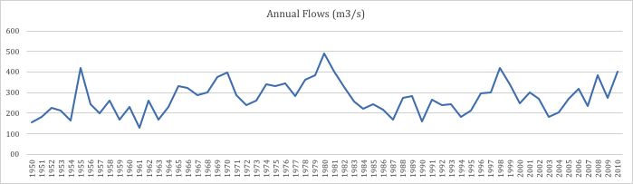
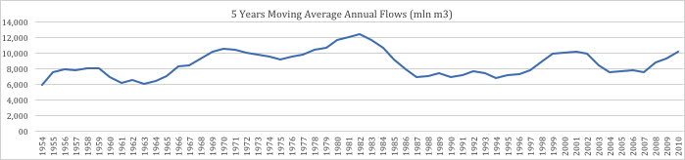
Hydrology of the Dniester river
The impacts of climate change on Dniester flows seems not to be very significant up to now, but things can change in the future.
Annual flow (m³/s)
5 years moving average annual flow (m³/s)

Slide 10
Hydrology of the Dniester river
The natural annual runoff of the Dniester River at Dniestrovski HPP-1 and Dubasary HPP sections are presented (it is assumed that the runoff at Dniestrovski HPP-2 is the same as for Dniestrovski HPP-1):
(this table reads this way: 25% of the years the Dniester discharge will be above 10.4 km³ at Dniestrovski HPP-1 site)

Slide 11
Irretrievable water consumptions
The table presents the so called irretrievable water consumptions that have been considered in the design of the Regulations.
As nowadays irrigation is much below this figures, what really the table shows are the future needs that have to be considered in the operation.
Nevertheless, stakeholders claim that more water should be released in order to satisfy their needs during the dry season (130 m3/s were mentioned).

Slide 12
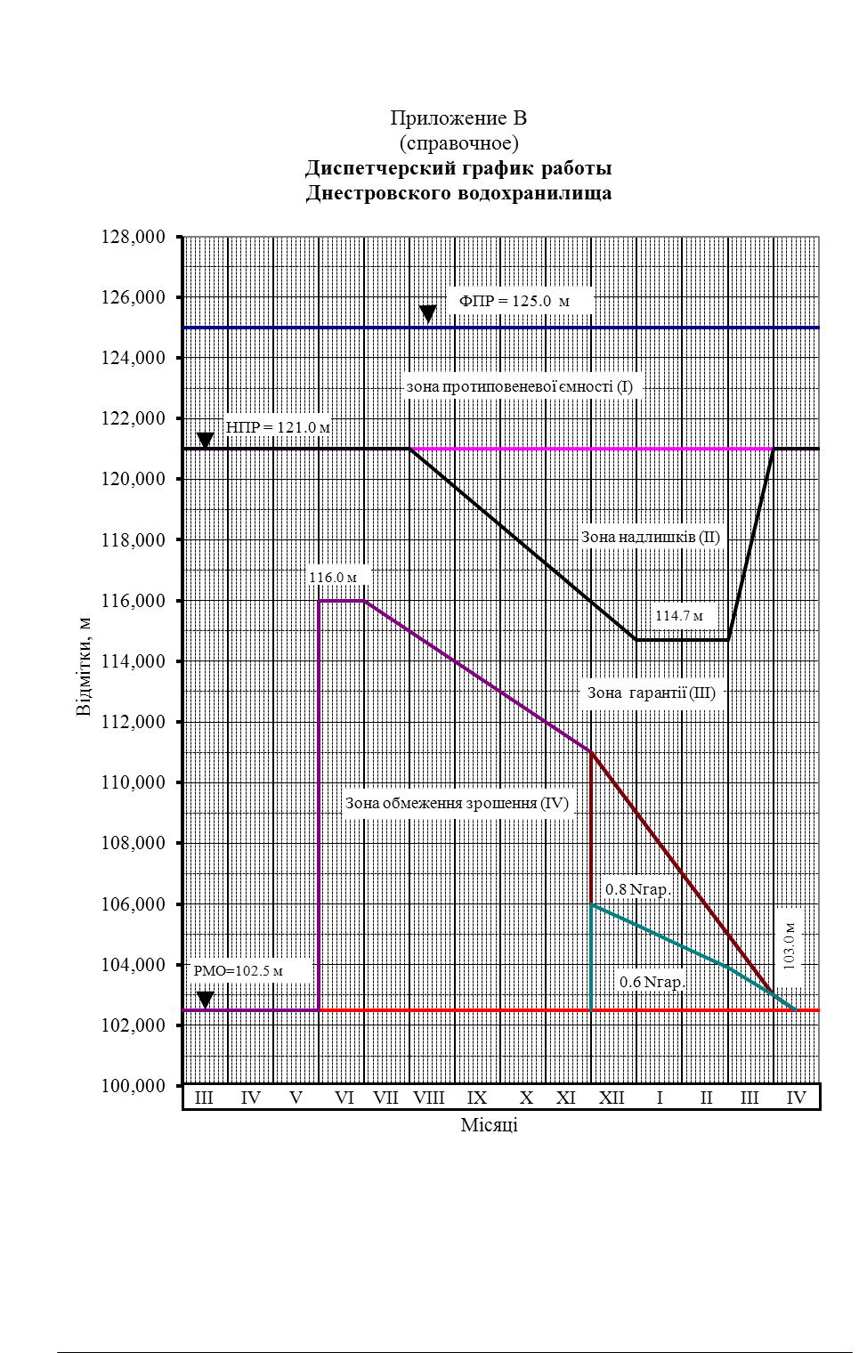
Dniestrovski 1 dispatch operating curves
The Operating curves are a very important part of the UR, as they delimit zones where the operator is somehow conditioned and has his operational capacity more or less stringently limited by the rules.
  Further efforts should be developed in order to make the use of this curves clearer to the stakeholders.
  The meaning of the 114,7 m operating level should be made more clear.
    What are the rules when the water level in the reservoir is situated in zone II.
    And in zone III.
    And in Zone IV.

Slide 13
Flood routing
Dniestrovski 1 reservoir is to be used for flood control, besides seasonal flow regulation.
The storage capacity that is considered to be used for flood routing is in the order of 570 mln m³, the zone I volume. This volume can be increased up to 1400 mln m³ in case zone II is also available.
Precautionarily the draft Regulations consider the zone I volume only and therefore flood routing is of little use in case of very big floods, as could be expected. But even in this case some routing will take place in case the flood control facility (the volume between levels 121.0 m and 125.0 m) is not full.
Anyway, the draft Regulations assume a conservative (pessimistic) scenario and assume that no routing will take place above 8320 m³/s peak flow, which corresponds to the 1 in 100 years frequency.
This can be argued as realistic as such huge floods represent very large volumes of water and when the peak flow arrives to the reservoir this is already filled to the top (125.0 m).
Flood routing can be improved resorting to hydrologic forecast and 24h forecast is proposed. This is perhaps something that can be improved with 48, eventually 72 hours forecast. We believe this should be tried.
Most probably flood routing can also be improved by coordinating the operation of Dniestrovski 1 and Dubasary reservoirs (1,000 m³/s in 24 hours represent 86.4 mln m³, something in the order of Dubasary’s reservoir capacity).

Slide 14
The issue of spring flows
This issue is object of monthly Protocols that are signed by the participants in the Interdepartmental Commission in Kiev. In April the mainly spring flows are at stake.
The first floods flowing into Dniestrovski 1 reservoir (peak flows above 1,000 m³/s or something of the kind) usually occur in March and April, if we consider the available information, but can come earlier (February, as it was the case in 1961, 1966, 1968, 1977 and 1979) or later (July, in 1997, August, in 1991 and even September as it happened in 2009).There are actually historic floods registered in all seasons and every month, from January to December.
As for these first floods,
  17 out of 61 are registered in March,
  15 in April,
  5 in February and May, each,
  3 in June
and other are scattered among the other months (in 12 years this peak flow was not attained). In one case, 2008, the first floods occurred in April, from the 20th to the 27th and in July and August huge floods happened with a peak of 4510 m³/s in the 28th July.

Slide 15
The issue of spring flows
When we compare these figures with what was agreed in the Interdepartmental Commission the 13th April 2018, starting from the 14th April,
Day 1 - 350 m³/s;
Day 2 - 400 m³/s;
Day 3 - 450 m³/s;
Days 4 to 13 - 500 m³/s;
Days 14 to 15 - 450 m³/s;
Days 16 to 20 - 400 m³/s;
Days 21 to 23 - 350 m³/s;
Days 24 to 25 - 300 m³/s;
Days 26 to 28 - 250 m³/s;
Days 29 to 30 - 200 m³/s;
Day 31 - 150 m³/s.
we find that the total volume that was discharged was of 1,040 mln m³.

Slide 16
The issue of spring flows
But the starting point was:
  the level in the upper reservoir was then 121.37 (zone I, which means that some release of water should take place in order for the reservoir to be prepared to accommodate any flood that might come during spring season);
  inflow to the reservoir was of 500 m³/s, at that time,
which of course made it easy to arrive to an agreement (water temperature in the Lower Dniester was 12ºC, which allowed to start the ecologic discharge). Moldovan interested parties were not present but had the opportunity to participate through e-mail communication. The possibility of having to stop the operations for unforeseen reasons (sharp decrease of flows, formation of rain floods) was agreed.
The 500 m³/s peak flow can be argued, and some experts point out to the need of having 700 m³/s flows lasting at least some hours during the spring, arguing that this was the case every year in pristine conditions with very few exceptions (which is true)
It is possible this is so but what we must underline is that the procedure that was adopted this year can accommodate such changes if they prove to be right and even go beyond this 700 m³/s from time to time, as it happened in pristine conditions:
The issue is for sure a very complex one, as there are low water years when it will not be possible to provide such flows without jeopardising the irretrievable water uses (and under pristine conditions this flows would not occur) and the water flow rates must be also conditioned on water temperature, because of spawning.

Slide 17
The issue of low flows
The issue of summer, autumn and winter flows has been raised by several stakeholders and the request for a minimum outflow from Dniestrovski 1 of 100 m³/s was presented.
In the Regulations (General requirements, 3.1.2) it is said that, according to the PSPP project, the minimum average daily water release during all seasons should be not less than 100 m³/s.
This value had been substantiated by the necessary sanitary river conditions in the water abstraction points used for drinking purposes and for food processing industry needs, as well as by the need to keep the corresponding depth for several purposes.
If we consider the flow data from the Mohyliv-Podilsky gauging station (1950-2010), this mean monthly flow was not attained in 33 out of 366 months in the period September to February, i.e., 1 out of 11 months (and 42 out of a total 732 months, 1 out of 17 months, if we consider the whole period).

Slide 18
The issue of low flows
But, most of all, it should be considered that, for the period 1986 to 2010, when the Dniestrovski 1 HPP and reservoir were already in operation, this mean monthly flow was exceeded in each and every month, which represents a benefit for all downstream water users and for the environment. Anyhow, for prudential reasons a 99% probability of exceedance should be considered.
In the Figure it can also be seen that even the 130 m3/s average monthly flow was exceeded almost every month since the starting of the operation in Dniestrovski HPP 2 and reservoir, which was not the case before. Once again, a probability of exceedance should be considered, 84% being proposed.

Slide 19
More frequent issues raised by the stakeholders
Several issues have been referred to by the stakeholders, such as:
  Short term flows immediately downstream of Dniestrovski 2 dam.
      This is something that impacts the 10-20 km immediately downstream and an issue that has no easy solution; the flow is naturally routed in the river’s channel and the peaks are attenuated; hydraulic models can be used to simulate and assess the routing in the channel and the results used to improve the way Dniestrovski HPP-2 is run;
  Water temperature – we are not sure that such an issue may be tackled with, as the dam is not equipped with intakes at different levels, but eventually an expert should be consulted.
  Smooth discharge during a day should be addressed and monitored (UHE Co should regularly upload hourly discharge to its website)
  Timely exchange of information (DCR, Dubasary, Odessa); we are aware that the exchange of information is already taking place but it can be improved for the benefit of all parties.
  But the last word in what concerns the implementation of these rules and the management of the cascade is to Ukrhydroenergo, as whatever, good or bad, may come out from it is the responsibility of the company;
  A Methodology for non-compliance could be develop upon mutual agreement of the Parties.
    Other comments such as the way the document should be presented, the need for further definitions and other such comments may be considered in the updated rules final document.

Slide 20
Dubasary dam and reservoir
Dubasary dam and power plant are situated in the Middle Dniester and are being operated now by the Transnistrian authorities as a run-of-the-river hydropower-only facility: The water coming from upstream that enters the reservoir is turbined downstream. This way the energy output of the HPP is maximised as the water level (and therefore the head) in the reservoir is kept at its highest (NHL 28 m).
Even if this is not exactly as it is, the present use of the reservoir is limited by the intense siltation that took place in the past (the dam was built in 1950), that reduced the useful storage capacity from the initial 485 mln m3 to some 261 mln m3 that is its present estimated volume according to the information collected.
The reservoir can be used to facilitate water abstraction (stable water level), for some weekly regulation of flows (or deregulation!) and for a modicum of flood control (1000 m3/s represent some 86.4 mln m3 a day).
Anyhow, some coordination between the Riparian should be attempted, as it would be for the benefit of everyone.
Planned upstream cascade of small HPP
It is clear that, previous to the decision to construct, an EIA should be performed according to EU legislation or Espoo and Aarhus Conventions (eventually a SEA, as this is a set of infrastructures in cascade and the cumulative impacts should not be neglected). .

Slide 21
Conclusions
The scope of the Regulations is to impose rules for the operation in order to mitigate the negative impacts and enhance the positive ones. We believe the draft Regulations do contribute to reaching this objective but some improvements can be introduced for the benefit of the downstream stakeholders:
The priorities in what concerns the tasks to be fulfilled by the cascade as defined in the draft Regulations are in line with the concerns of most of the stakeholders that commented this issue and are in line with the international best practices in similar situations.
The reservoir operating curves that the dispatch must follow are as accurate as they can be, having in mind that it is not possible to enforce more binding conditions upon the operation of a hydraulic system whose behaviour is not predictable as it depends from the weather (random snowfall, rainfall, their quantity, spatial distribution and opportunity) and also from the demand (power and energy demand, demand of water for uses, etc., all of them the company does not control).
As for flood control the provisions are in line with the priorities defined, and it should not be forgotten that what has to be compared is not what best fulfils some stakeholders’ wishes (no floods at all but some high flows during the spring and summer) but the reduction in flood peak flows that can be obtained by correctly operating the infrastructures in the cascade. Several days forecast will probably not bring the expected benefits but should be tried.

Slide 22
Recommendations
As for recommendations, we offer the following:
The issue of spring flows being in the order of 700-750 m3/s for several days as was the case almost every year in pristine conditions to cope with the environmental requirements downstream should be considered at least once in a few years (regular flooding of flood plains should be sought). The Protocol that was agreed upon by the relevant stakeholders in April 2018 seems to be a good starting point for future situations, as a procedure for deciding on these issues.
With regards to the minimum flows under 99% probability , the 100 m3/s that are inscribed in the Regulations seem good and should be sought as a rule (and apparently this is not a problem for the running of the cascade, as it is something that is already being done).
It is recommended to have the conditions and responsibilities for emergency operation of the HPP in the cascade to be further clarified: in what circumstances this can take place and who takes the decision (3.3.1.7 in the draft Regulations).

Slide 23
Recommendations
A detailed description of the methodology and justification for the calculation of environmental and compensating outflows of water from reservoirs, based both on current run-off and current water consumption, and considering the expected climate change, at least in the coming decades, should be presented to the stakeholders (eventually included in the Regulations as an annex).
Because not only the operating rules for the cascade impact in the downstream flows, the authorities of all Riparian should meet to arrange a solution for the running of all relevant infrastructures, including Dubasary, so as to have timely flood alert and the needs of water users in the Lower Dniester being attended.
The issue of water levels at the intakes of Chisinau, Odessa and other water utilities should be addressed by the Riparian in some detail. It seems to be mainly an issue of water level in the river and not one of flows, i.e., engineering solutions to increase the water level at the water intake may have to be considered (and there is little that can be achieved on this matter by changing the rules of operation of the cascade).

Slide 24
Recommendations
There seems to be some limitations on the use of the storage capacity of Dniestrovski 1 reservoir between water levels 121 m and 125 m (zone 1 in the dispatch operation curves) which is crucial for flood control. If this is the case these limitations should be removed so as to allow for flood routing.
The issue of thermal stratification deserves some more attention, as it seems to be a serious obstacle to the mitigation of environmental impacts of the upper reservoir. Experts should be consulted and TDA may help to bring clarity and possibly a solution to this problem.
The issue of EIA and SEA of the draft Regulations should be analysed, and it is suggested to hear the opinion of a legal expert. If the Regulations are themselves some kind of mitigation measure of the impacts of an existing infrastructure, then it seems not appropriate to have them subject to EIA, but eventually a legal expert may have a different opinion on this issue.
The Riparian should focus on benefits of cooperation which are at the core of international water law, i.e. the Convention on the Protection and Use of Transboundary Watercourses and International Lakes (UNECE Water Convention). A regular and joint follow-up of the application of the Regulations would be of value for future revisions.

Slide 25
Recommendations
A joint programme for measuring (monitoring) the water flow of the buffer reservoir dam and at the gauging stations in Mogyliv (Ukraine) and Ungur (Moldova), eventually right on HPP-2, should be agreed by the Riparian (hourly discharge).
Last but not the least, the Dniester River Transboundary Commission should be called to have a say on the new Regulations and Ukraine should try to obtain the agreement of the Riparian on the main solutions it proposes. We believe that it will not be very difficult to prove that Moldova with Transnistria have much to gain form the rightful operation of the cascade: more water most of the time, reduced floods, some mitigation of dry years low flows, etc.
The results of the consultation should be amply discussed with the stakeholders, made available to the authorities of all the Riparian and made public, according to the rules of the Aarhus and the Espoo UNECE conventions

Slide 26
THANKS FOR YOUR ATTENTION
pedrocunhaserra@gmail.com

